Slide 1

Securing Virtual Reality Apps Inter-Process Communication
Department of Computer Science
Oluwatosin Falebita, Mahmoud Abdelgawad, Evan Anspach, and Indrakshi Ray
20th International Conference on Information Systems Security (ICISS) 2024

Slide 2
Overview
Problem Statement
Insecure IPC Architecture
NGAC Policy Enforcement
Future work and Limitations
References

Slide 3

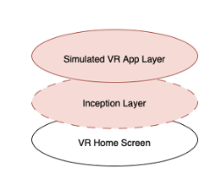



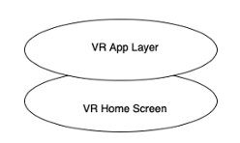
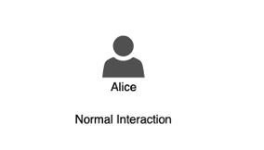
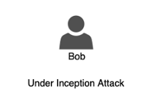
Problem Statement
Attacks in Virtual Reality
Immersive hijacking in Virtual Reality [1]
[1] Yang, Zhuolin, et al. "Inception Attacks: Immersive Hijacking in Virtual Reality Systems." arXiv preprint arXiv:2403.05721 (2024).
Notes:
The First sequence of animation shows
A user Alice interacting with the VR Home Screen which can be used in accessing the VR Apps layer in a normal environment.
The Second sequence illustrate how the Immersive hijacking is introduced into the environment.
An attacker Jack connected to the same network installs a malicious app through android wireless adb which intercepts the startactivity intent sent by the Launcher to be handled by the VR Home Screen thereby presenting an inception layer to the user which can allows Jack to present a Simulate VR App layer to Alice that can be used in manipulate activities performed by Alice.

Slide 4
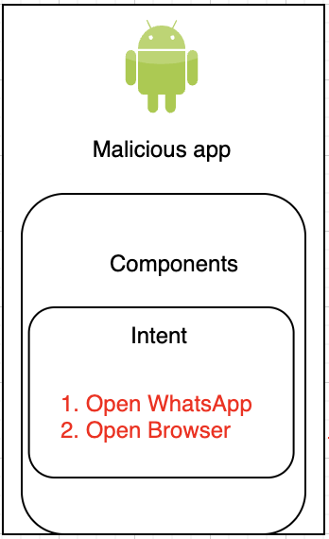
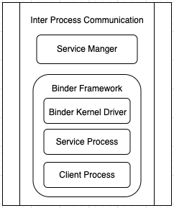
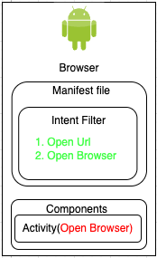
Problem Statement
Immersive manipulation attack (Overlay Attack) [2]
Startactivity(Open Browser)
[2] Casey, Peter, Ibrahim Baggili, and Ananya Yarramreddy. "Immersive virtual reality attacks and the human joystick." IEEE Transactions on Dependable and Secure Computing 18.2 (2019): 550-562.
Notes:
In this scenario a malicious app (caller) sends an intent to the Binder IPC which is resolved through the intent firewall to a legitimate app (target) without verification or validation of the app leading to insecure activity start or overlay attack.

Slide 5
Insecure IPC Architecture
Binder IPC [3]
Intent [4]
App Components
Activities
Broadcast Services
Services
Content providers
[3] https://developer.android.com/reference/android/os/Binder
[4] https://developer.android.com/guide/components/intents-filters

Slide 6
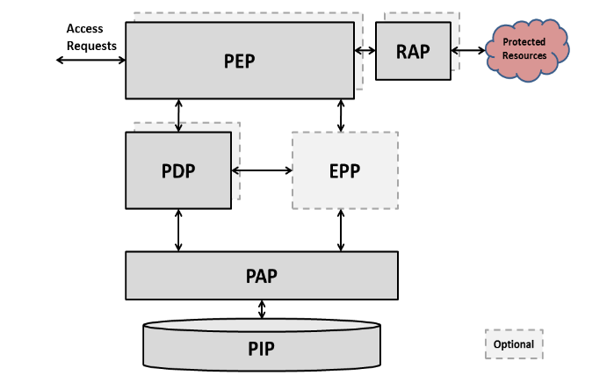
NGAC Architecture
Figure 1: NGAC Functional Architecture [5]
[5] Benigni, D., Francomacaro, S., 2016. Incits 499-201x (revision of incits 499-2013), information technology -next generation access control -functional architecture (ngac-fa) due date: The public re- view is from. URL: https://standards.incits.org/apps/group_public/ download.php/83778/livelink

Slide 7
NGAC Entities Modelling
VR application Attributes
Caller App:
Target App:
App UUID
Signature: [signed, unsigned]
Install source: [trusted source, sideload]
App UUID:
App signature: [signed, unsigned]
App type: [non-native app, native app, system resources]

Slide 8
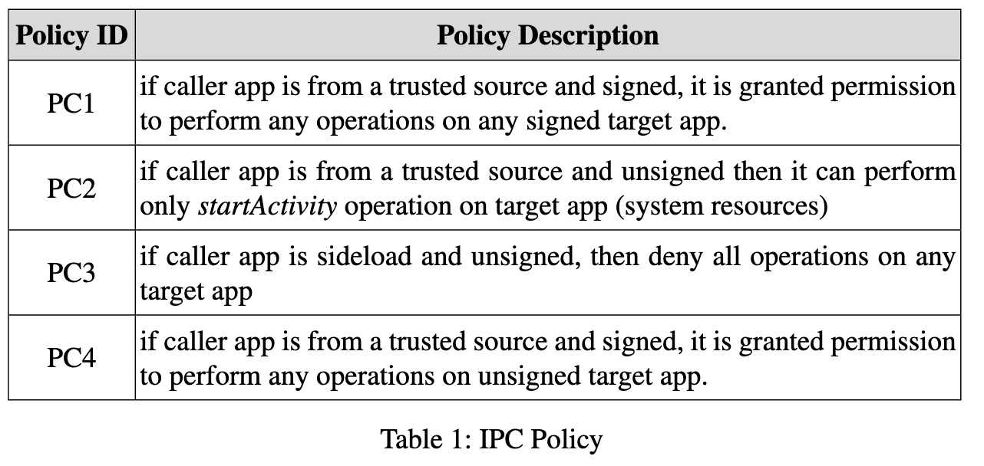
NGAC Policies Formulation
Policy class

Slide 9
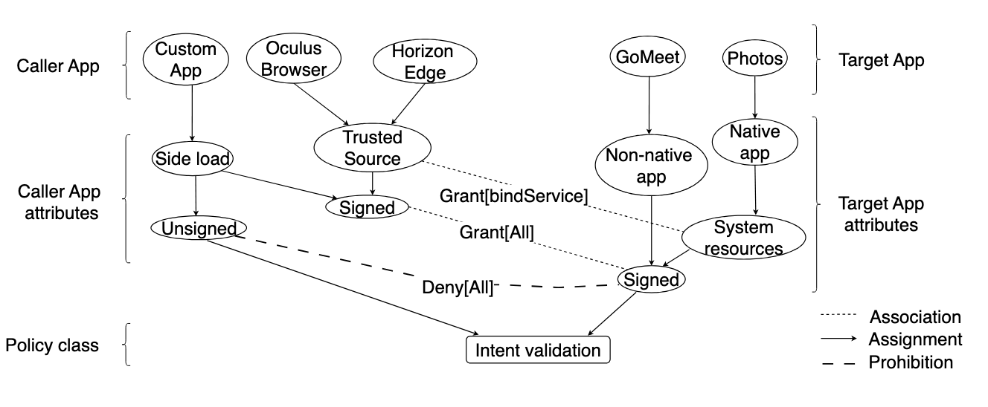
IPC Authorization Graph
Figure 2: NGAC Authorization Graph

Slide 10
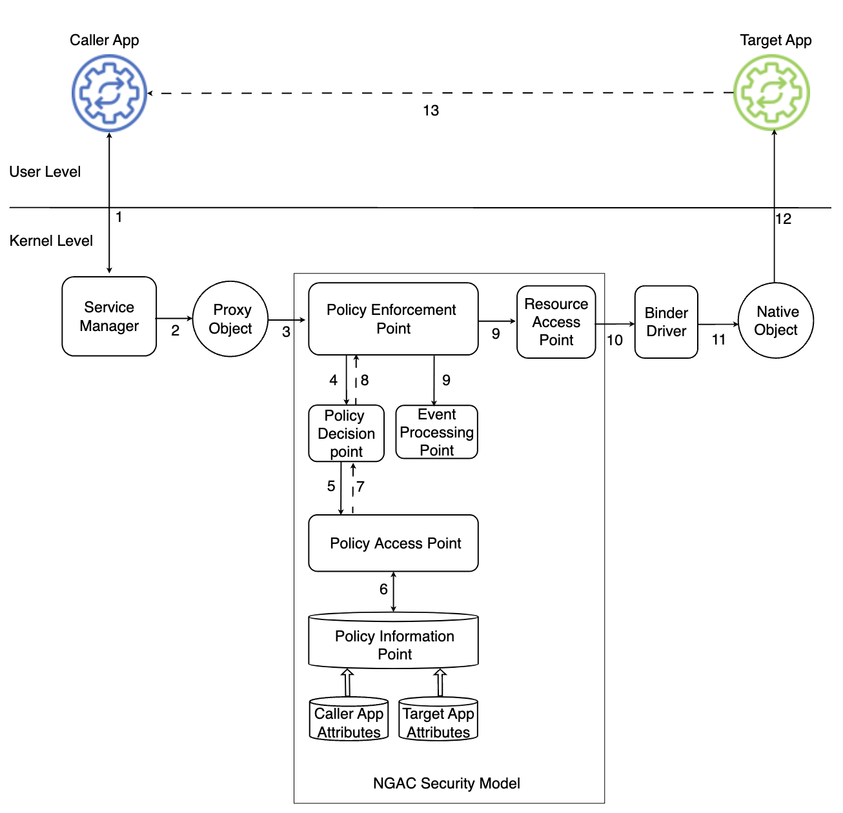
IPC NGAC Policy Enforcement
Figure 3: NGAC IPC Enforcement Architecture
Notes:
This describe the entire architecture design of the framework

Slide 11
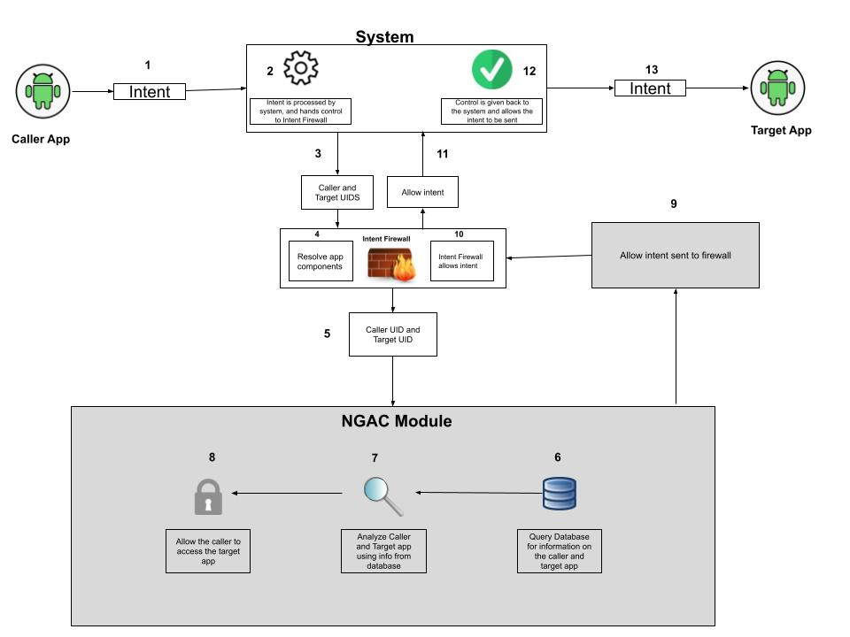
IPC NGAC Policy Enforcement
Figure 4: NGAC IPC Allow Intent
Notes:
This describes the work follow of the NGAC on how it handles an intent that is allowed based on our policy class.

Slide 12
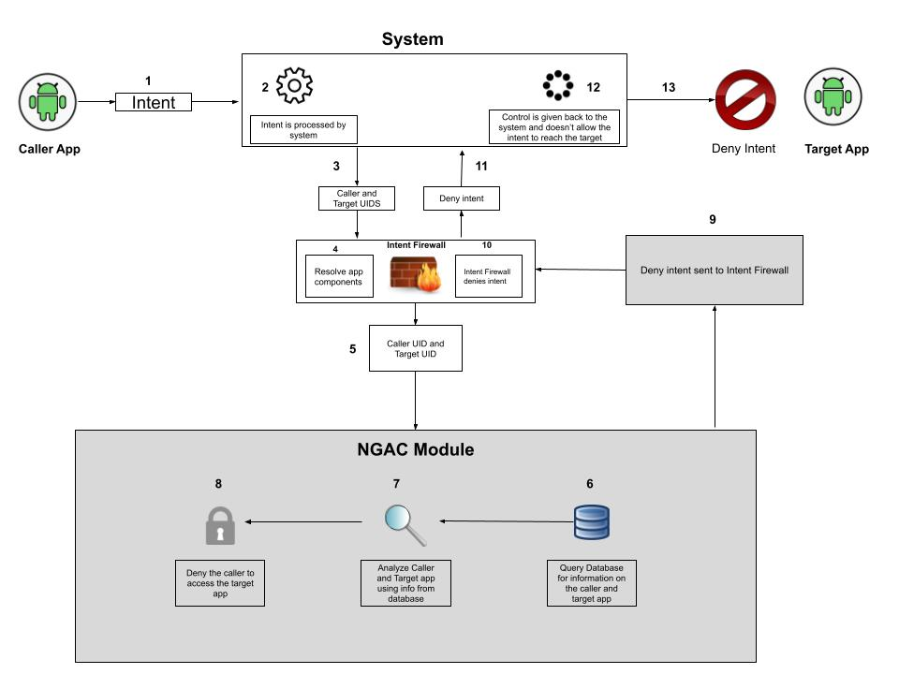
IPC NGAC Policy Enforcement
Figure 5: NGAC IPC Deny Intent
Notes:
This describes the work follow of the NGAC on how it handles an intent that is denied based on our policy class.

Slide 13
Related works
Authentication in Virtual Reality:
User authentication (PIN and Pattern) [6]
3D space to authenticate the user called Room- Lock [7].
Access control in Virtual Reality:
Content-oriented access control mechanism [8].
Intrusion detection via Machine learning [9].
[3] George, Ceenu, et al. "Seamless and secure vr: Adapting and evaluating established authentication systems for virtual reality." NDSS, 2017.]
[4] George, Ceenu, et al. "Investigating the third dimension for authentication in immersive virtual reality and in the real world." IEEE, 2019.
[5] Lv, Zhihan, et al. "Industrial security solution for virtual reality." IEEE Internet of Things Journal 8.8 (2020): 6273-6281.
[6] Wei, Yun-gang, et al. "Research and Application of Access Control Technique in 3D Virtual Reality System OpenSim." 2013 Sixth International Symposium on Computational Intelligence and Design. Vol. 2. IEEE, 2013.

Slide 14
Future works
Future work will present the implementation of NGACIPC enforcement and experiment with its effectiveness.

Slide 15
Thank you.

