Slide 1
AI-Powered Cyber Security & Cyber Resiliency
Rakesh Podder
Shadaab Kawnain Bashir
Colorado State University

Slide 2
iEXAM: Instructable and EXplainable AI for Cybersecurity Analysis and Management using Attack Graphs
Rakesh Podder
Colorado State University

Slide 3
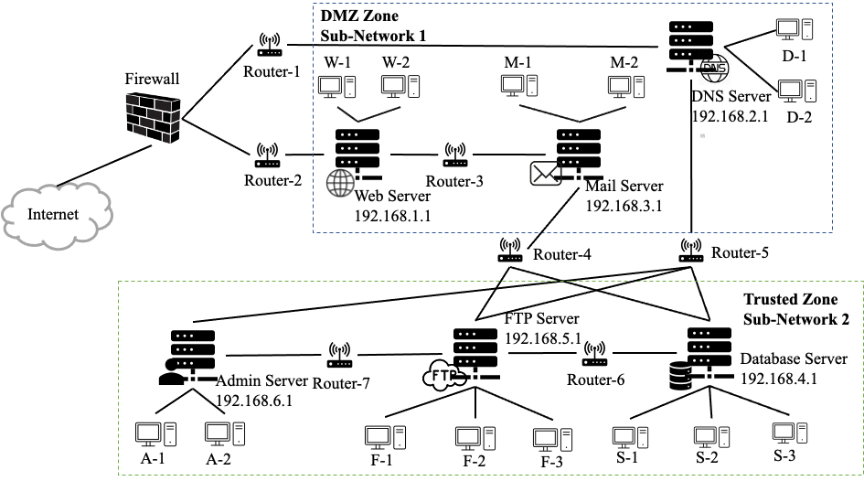
How Hard is the System Admin’s Job?
Network Configurations.
Software, Versions, Services, Capabilities
Connections between machines
IP, Port, Router, Firewall…

Slide 4
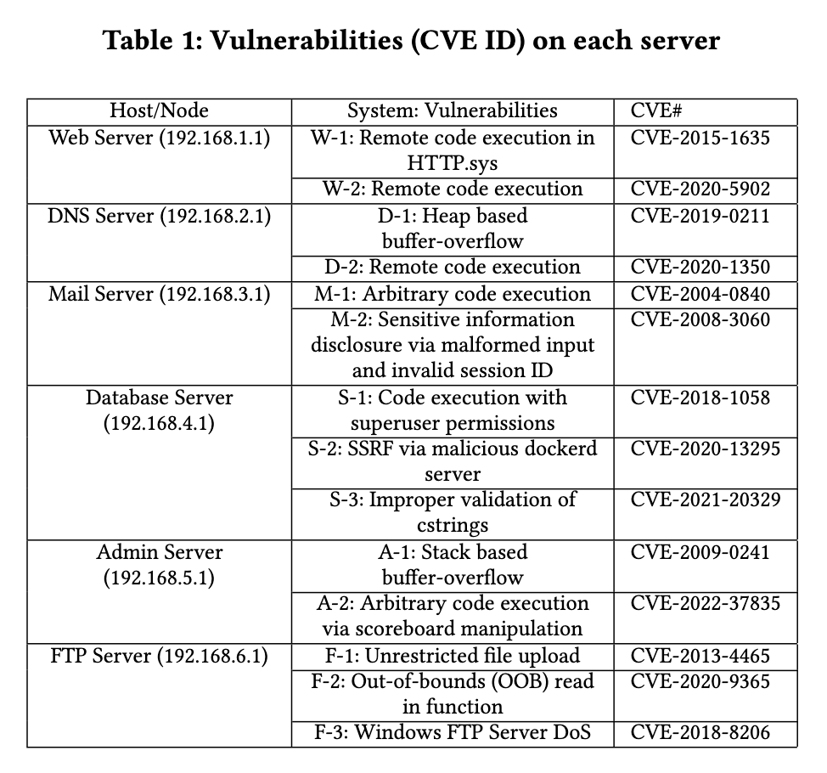
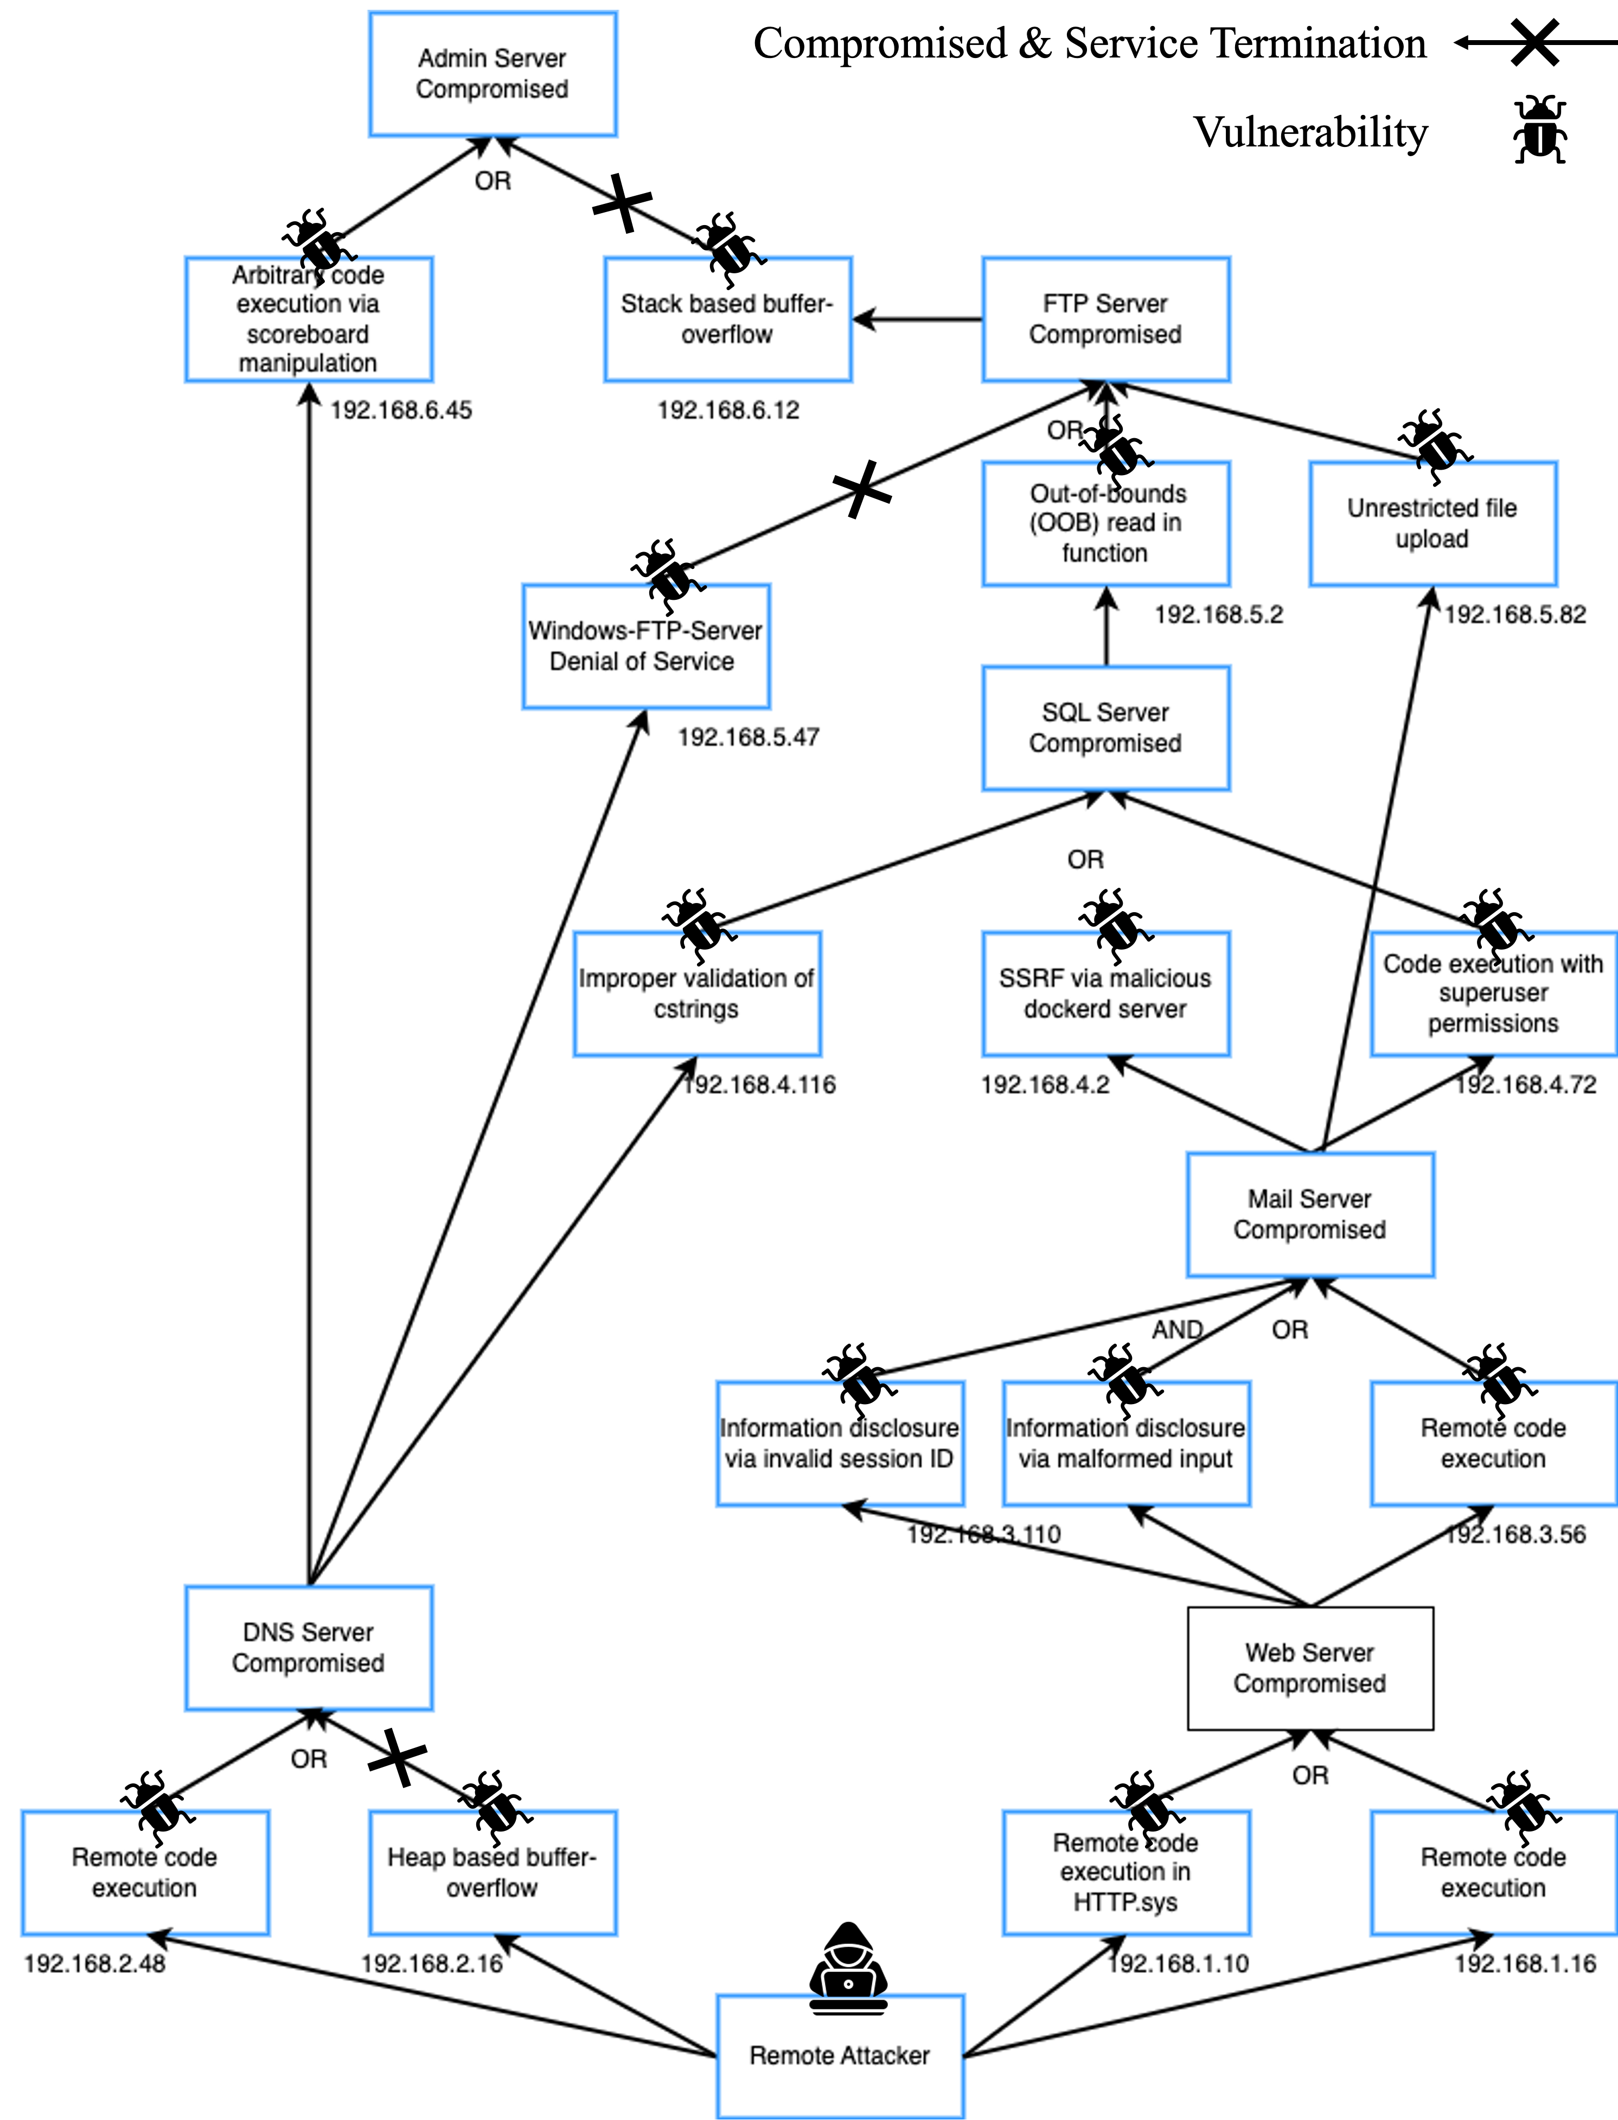
How Hard is the System Admin’s Job?

Slide 5
Motivation
Cybersecurity remains challenging due to evolving vulnerabilities and sophisticated attack vectors.
Attack Graphs (AG) are critical for understanding and analyzing potential vulnerabilities.
Limitations in traditional Security Posture Evaluation Tools:
Overly simplified assumptions (e.g., monotonic attacker actions).
Lack of integration between connectivity and vulnerability parameters.
Inability to perform comprehensive "what-if" scenario analyses.

Slide 6
Limitations of Traditional Attack Graph Tools
High Integration
No support for what-if analysis to explore multiple defense strategies.
Lack human-in-the-loop support for
interactive feedback and refinement.
Fail to jointly model security and network connectivity
Provide no Instructable and Explainable methodology for defensive strategies.
What-If Analysis
Interactive Refinement
Low Complexity
High Complexity
Provide poor model reuse and incremental update capabilities.
Incremental Update
Scenario-Based Optimization
Most existing systems optimize for a single best solution based on predefined criteria.
Traditional attack graph tools assume monotonic attacker behavior, limiting realism
Overlooks human decision-making, resource constraints, or scenario-based needs.
Low Integration
Notes:
Traditional attack graph tools and analysis frameworks are limited in several critical ways:
They often assume monotonicity in attacker behavior, excluding lateral movements and complex attack patterns.
Most existing systems optimize for a single best solution based on predefined criteria, overlooking human decision-making, resource constraints, or scenario-based needs.
There is limited support for what-if analysis, explanations, and interactive refinement, which are essential for practical network defense in evolving environments.
They fail to integrate network connectivity analysis (e.g., availability or service continuity) alongside security measures.
Model reusability and incremental updates are poorly supported, limiting applicability to dynamic systems

Slide 7
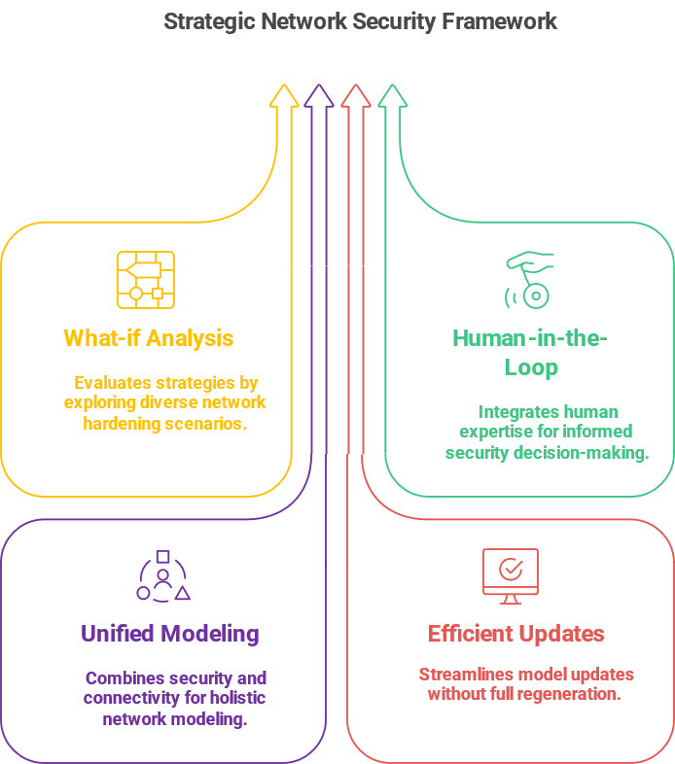
So, what we need?
Enables what-if analysis
Keeps the human-in-the-loop
Jointly models security and connectivity
Supports model updates and refinement efficiently
Notes:
There is a lack of an attack graph-based framework that:
Enables what-if analysis to explore and evaluate multiple network hardening strategies based on evolving goals and constraints.
Keeps the human-in-the-loop, supporting explanation, refinement, and decision-making rather than enforcing automated optimal solutions.
Jointly models security and connectivity, capturing complex dependencies and availability in a unified representation.
Supports model updates and refinement efficiently, without regenerating entire models from scratch.

Slide 8
How to solve the problem?
AI planning for diverse strategies
Attack- Connectivity Graph
1. Represent attack scenarios. 2. Perform what-if analyses. 3. Generate diverse hardening strategies.
A hypergraph model combining attack dependencies and network connectivity.
Basic security metrics
Human-in-the- loop analysis
1. Impenetrability (no attack paths) 2. Attack difficulty (increased attacker effort).
1. Admins can review multiple hardening option. 2. Request explanations for proposed solutions. 3. Choose strategies based on resources,
feasibility, or policy.

Slide 9
Our Contributions
Formalization using AI Planning
Models network and attacker actions as classical planning problems.
1
Metrics and What-if Analysis
2
Defines robustness metrics and enables network hardening analysis.
Attack-Connectivity Graph (ACG)
3
Heuristic Search for Diverse Solutions
Identifies diverse defense strategies using modified A* search.
4
Human-in-the-Loop & Model Reusability
5
Integrates administrators and supports incremental network updates.
Empirical Evaluation
Demonstrates scalability and effectiveness on realistic networks.

Slide 10
Make Life Easier!
Figure: iEXAM Tool Architecture

Slide 11

iEXAM - Structure Information
Network
Vulnerability Scanner
Structure Information
(Software, Version, User Actions, File Location, Executable etc.)
CTI Reports
CVE List & Descriptions
AI
NLP, LLM
NVD Vulnerability Database

Slide 12
iEXAM – PDDL Generation & Refinement
Structured Network Information
Incremental Building/ Refining
Refined PDDL Domain & Problem
Structure Information
(Software, Version, User Actions, File Location, Executable etc.)
PDDL Repository
PDDL Domain & Problem Generation
Generated PDDL Domain & Problem Files

Slide 13

iEXAM – Human-in-the-loop What-if Analysis
Diverse sets of Solutions
Modified PDDL Domain & Problem
Generated PDDL Domain & Problem Files
AI
AI Planner
AI
What if Analysis Engine
Validator
No
Changes to Model
LLM
Yes
Explanations

Slide 14
What-If Analysis: Impenetrability Analysis
Diverse sets of Solutions
Modified PDDL Domain & Problem
Generated PDDL Domain & Problem Files
AI
AI Planner
AI
Impenetrability Analysis
Validator
Changes to Model
No
LLM
Yes
Explanations

Slide 15
Impenetrability Analysis: All Paths
Generated PDDL Domain & Problem Files
AI
All Possible Paths/Plans to Compromise a Node (Goal)

Slide 16
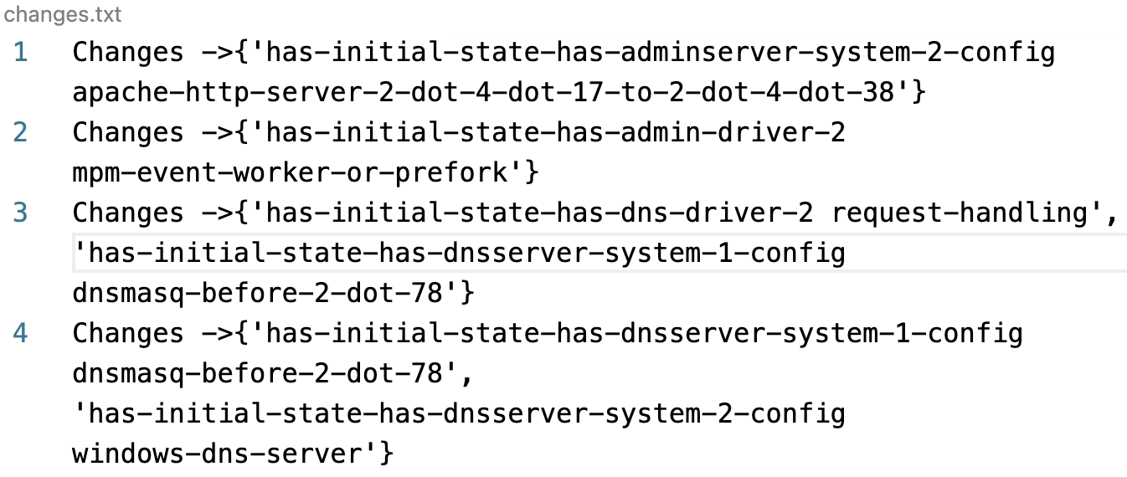
Impenetrability Analysis: Diverse Solutions
Generated PDDL Domain & Problem Files
Diverse sets of Solutions
AI
Changes to Model
Impenetrability Analysis
Validator
Yes

Slide 17
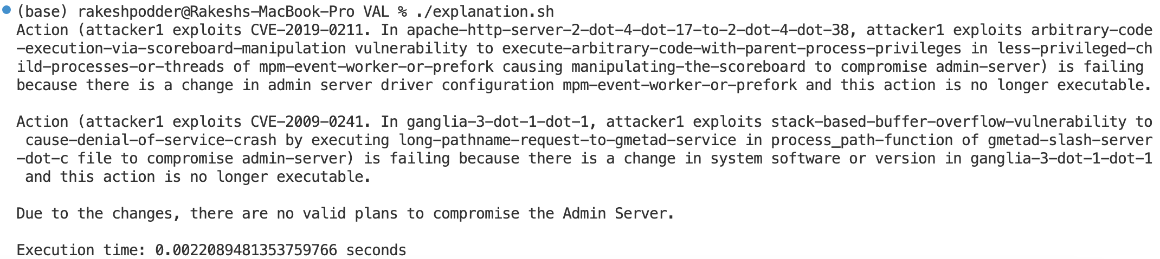
Impenetrability Analysis: Explanations & Instructions
Modified PDDL Domain & Problem
Generated PDDL Domain & Problem Files
AI
What-if analysis engine explains how resiliency is restored with selected changes
AI Planner
No
Validator
AI
LLM
Explanations

Slide 18
What-If Analysis: Attack Difficulty Analysis
Diverse sets of Solutions
Modified PDDL Domain & Problem
Generated PDDL Domain & Problem Files
AI
AI Planner
AI
Attack Difficulty Analysis
Validator
Changes to Model
LLM
Explanations

Slide 19
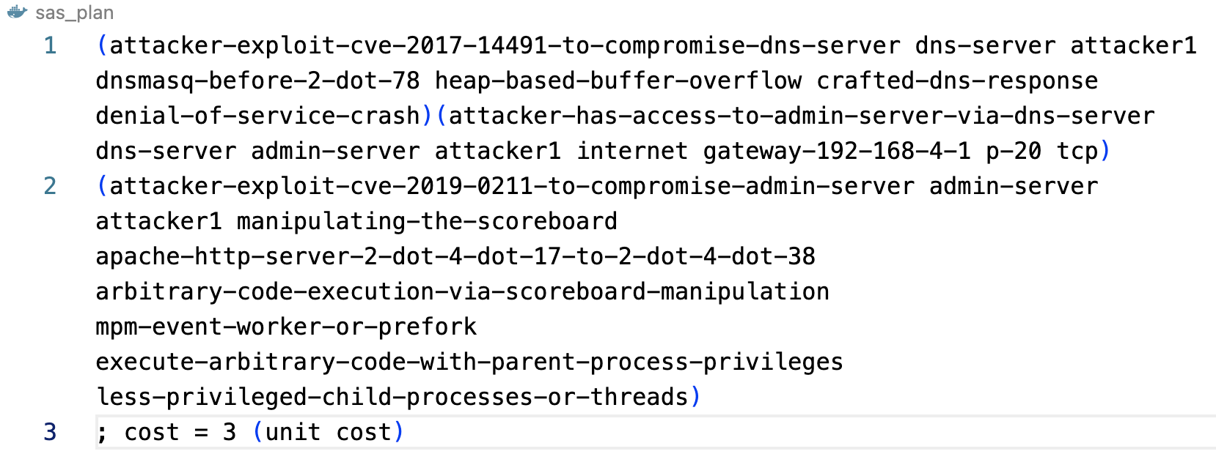
Attack Difficulty Analysis: Initial Difficulty
Goal: (exploited-admin admin-server)
Generated PDDL Domain & Problem Files
Initial Plan without any countermeasures: Attack Difficulty Metric = 3

Slide 20
Attack Difficulty Analysis: Diverse Solutions
Diverse sets of Solutions
Changes to Model
Impenetrability Analysis

Slide 21
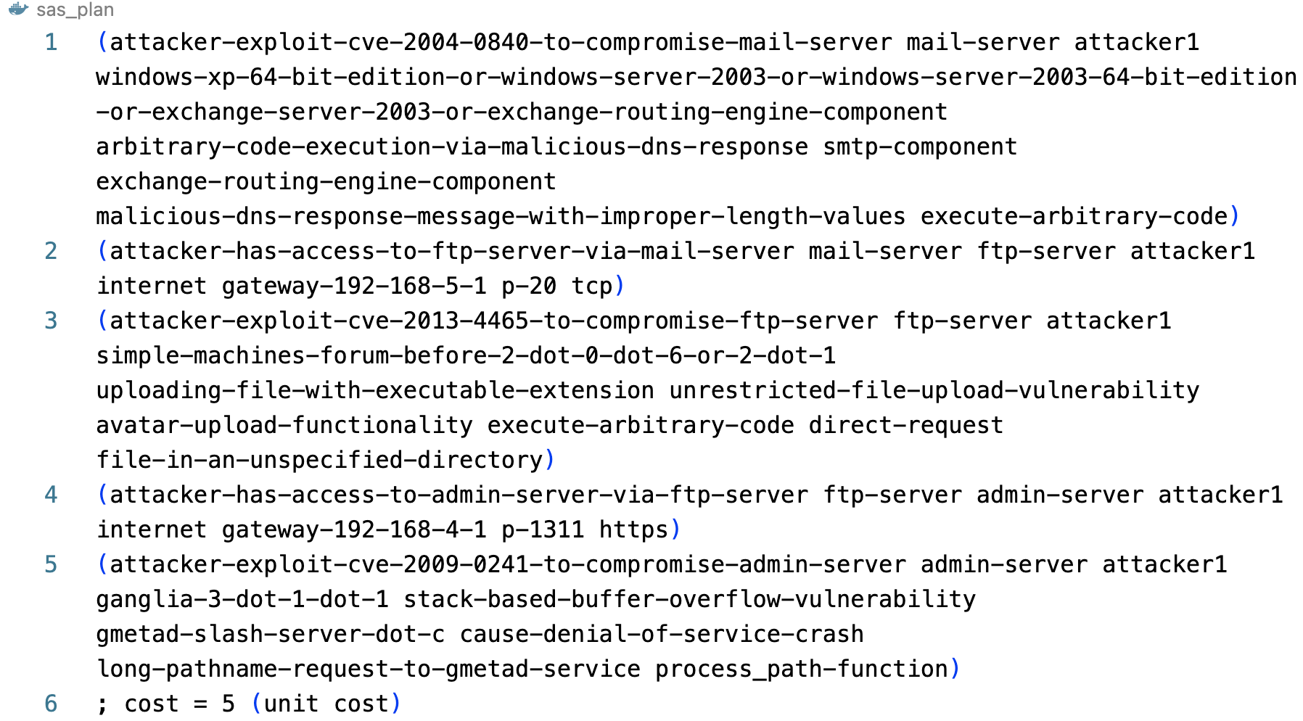
Attack Difficulty Analysis: Increased Difficulty
Applying change → {'has-initial-state-has-adminserver-system-2-config apache-http-server-2-dot-4-dot-17-to-2-dot-4-dot-38'}
Modified PDDL Domain & Problem
AI
Initial Plan with countermeasures: Attack Difficulty Metric = 5

Slide 22
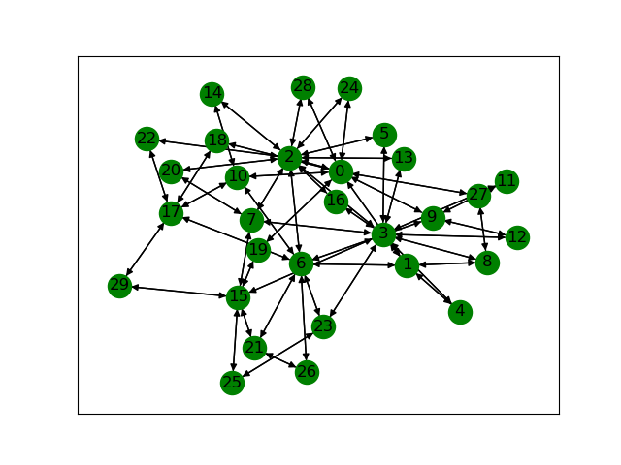
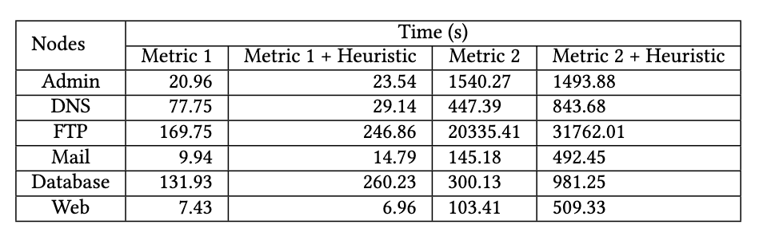
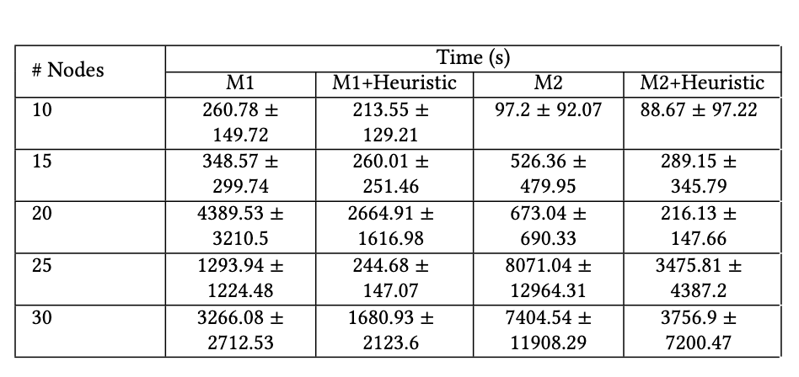
EVALUATION: Simulated Network
Table 1: Original Network
Figure: A network with 30 Nodes and 24 vulnerabilities
Table 2: For Simulated Data

Slide 23




It’s not only IT but OT also
Missing ?
Operation
Technology
Information
Technology
Attacker

Slide 24
Resiliency Graphs: Modelling the Interplay between Cyber Attacks and System Failures through AI Planning
Shadaab Kawnain Bashir

Slide 25




Motivation
Digitalization
Operational Efficiency
Industrial Control Units
Cyber Physical System
Attacker
System Failure

Slide 26




Problem Statement
Cyber Attack
Safety Events
Resilient System
Determine how cyber attack can trigger safety events to improve resiliency of CPS

Slide 27
Solution
AI Planning
Attack
Graph
Resiliency Graph
Fault
Tree
Present Resiliency Graph that integrates Attack Graph and Fault Tree

Slide 28
Workflow
Use Cases for Safety Events
Use Cases for Cyber Attacks
Domain & Problem for Base Model
NLP Based Extractor
Pre/Post Condition of Safety Events
Pre/Post Condition of Cyber Attacks
Base Model
Update
Consistency Check
PDDL Domain & Problem Generator
Domain & Problem for Optimistic Model
Planner
Plan
Domain & Problem for FT
Domain & Problem for AG
Generate Optimistic Model
Using Resilience Path Algorithm
Resiliency Graph

Slide 29
Workflow
Use Cases for Safety Events
Use Cases for Cyber Attacks
Technical Document
User Manuals
Maintenance Logs
Incident Report
CVE Descriptions
Network Topology
Configuration Files
System Logs
Domain & Problem for Base Model
NLP Based Extractor
Pre/Post Condition of Safety Events
Pre/Post Condition of Cyber Attacks
Base Model
Update
Consistency Check
PDDL Domain & Problem Generator
Domain & Problem for Optimistic Model
Planner
Plan
Domain & Problem for FT
Domain & Problem for AG
Generate Optimistic Model
Using Resiliency Path Algorithm
Resiliency Graph

Slide 30
Workflow
Use Cases for Safety Events
Use Cases for Cyber Attacks
NLP Based Extractor
Domain & Problem for Base Model
Pre/Post Condition of Safety Events
Pre/Post Condition of Cyber Attacks
Base Model
Update
Consistency Check
PDDL Domain & Problem Generator
Domain & Problem for Optimistic Model
Planner
Plan
Domain & Problem for FT
Domain & Problem for AG
Generate Optimistic Model
Using Resiliency Path Algorithm
Resiliency Graph

Slide 31
Workflow
Use Cases for Safety Events
Use Cases for Cyber Attacks
NLP Based Extractor
Domain & Problem for Base Model
Pre/Post Condition of Safety Events
Pre/Post Condition of Cyber Attacks
Base Model
Update
Consistency Check
PDDL Domain & Problem Generator
Domain & Problem for Optimistic Model
Planner
Plan
Domain & Problem for FT
Domain & Problem for AG
Generate Optimistic Model
Using Resiliency Path Algorithm
Resiliency Graph

Slide 32
Workflow
Use Cases for Safety Events
Use Cases for Cyber Attacks
NLP Based Extractor
Domain & Problem for Base Model
Pre/Post Condition of Safety Events
Pre/Post Condition of Cyber Attacks
Base Model
Update
Consistency Check
PDDL Domain & Problem Generator
Domain & Problem for Optimistic Model
Planner
Plan
Domain & Problem for FT
Domain & Problem for AG
For FT:
Domain Expert
For AG:
AGBuilder[1]
Generate Optimistic Model
Using Resiliency Path Algorithm
Resiliency Graph
[1] B. Bezawada, I. Ray, and K. Tiwary, “AGBuilder: An AI Tool for Automated Attack Graph Building, Analysis, and Refinement,” in Proc. of DBSec. Springer, 2019, pp. 23–42.

Slide 33
Workflow
Use Cases for Safety Events
Use Cases for Cyber Attacks
NLP Based Extractor
Domain & Problem for Base Model
Pre/Post Condition of Safety Events
Pre/Post Condition of Cyber Attacks
Base Model
Update
Consistency Check
PDDL Domain & Problem Generator
Domain & Problem for Optimistic Model
Planner
Plan
Domain & Problem for FT
Domain & Problem for AG
Generate Optimistic Model
Using Resiliency Path Algorithm
Resiliency Graph

Slide 34
Workflow
Use Cases for Safety Events
Use Cases for Cyber Attacks
NLP Based Extractor
Domain & Problem for Base Model
Pre/Post Condition of Safety Events
Pre/Post Condition of Cyber Attacks
Base Model
Update
Consistency Check
PDDL Domain & Problem Generator
Domain & Problem for Optimistic Model
Planner
Plan
Domain & Problem for FT
Domain & Problem for AG
Generate Optimistic Model
Using Resiliency Path Algorithm
Contains all Faults
Resiliency Graph

Slide 35
Workflow
Use Cases for Safety Events
Use Cases for Cyber Attacks
Domain & Problem for Base Model
Ground Truth
NLP Based Extractor
Pre/Post Condition of Safety Events
Pre/Post Condition of Cyber Attacks
Base Model
Update
Consistency Check
PDDL Domain & Problem Generator
Domain & Problem for Optimistic Model
Planner
Plan
Domain & Problem for FT
Domain & Problem for AG
Generate Optimistic Model
Using Resilience Path Algorithm
Resiliency Graph

Slide 36
Workflow
Use Cases for Safety Events
Use Cases for Cyber Attacks
NLP Based Extractor
Domain & Problem for Base Model
Pre/Post Condition of Safety Events
Pre/Post Condition of Cyber Attacks
Base Model
Update
Consistency Check
PDDL Domain & Problem Generator
Domain & Problem for Optimistic Model
Planner
Plan
Domain & Problem for FT
Domain & Problem for AG
Generate Optimistic Model
Using Resilience Path Algorithm
Resiliency Graph

Slide 37
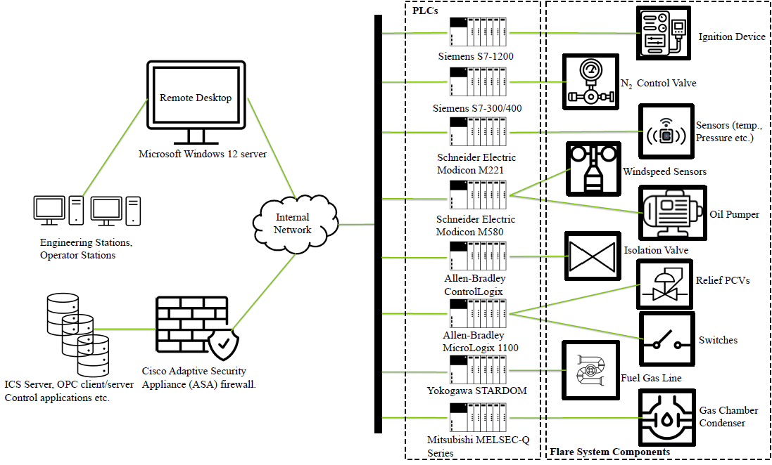
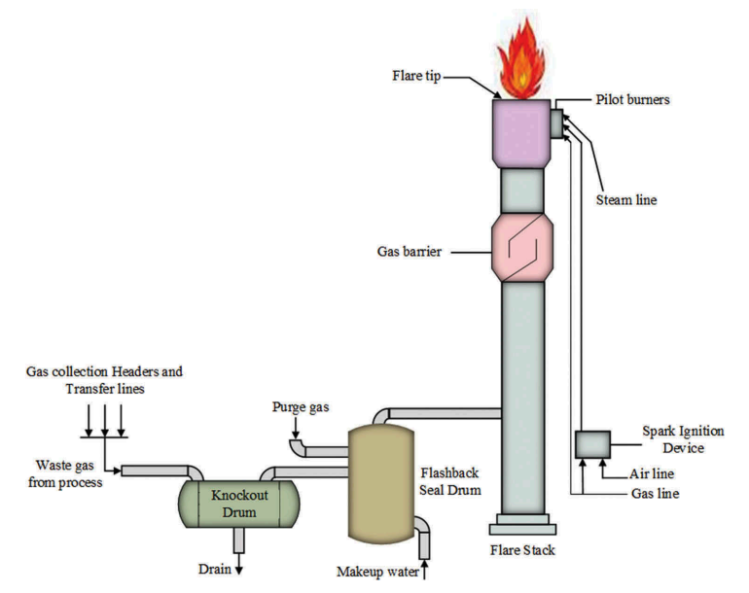
Resiliency Graph Analyses
Fig. Flare System
Fig. Overview of OT and IT component of Flare System
Notes:
The is a flare system we have used to analyse the proposed Resilency Graph and what can we achieve.
This is an overview of IT and OT part of flare system. It shows thee ICS that controlling various PLCs that controlling various physical component of flare system.

Slide 38
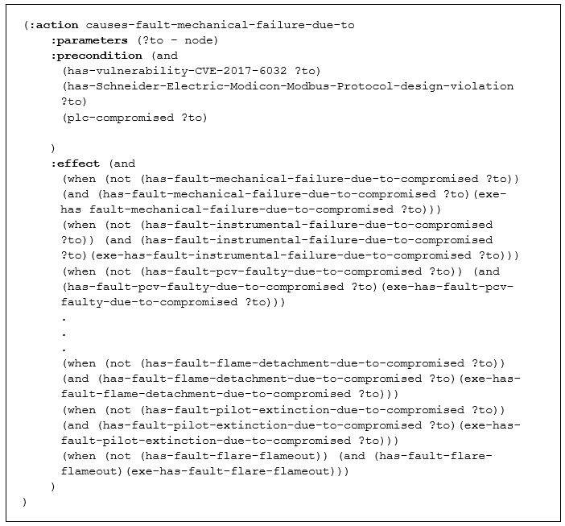
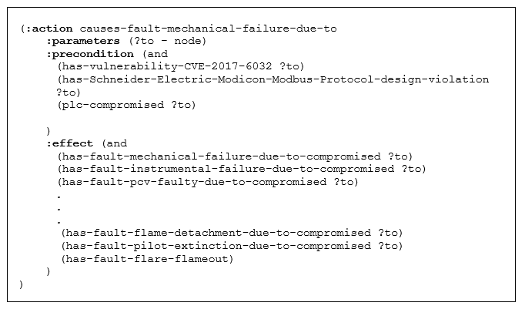
RG Capturing all Faults in CPS
Notes:
In the workflow I have mentioned that we have to mention the goal state in the problem file to create a resilience path between the system vulnerability and the corresponding system failure it can trigger. So to create the complete Resiliency Graph we have repeat the same process a number of times for all the fault that are present in the system. To solve this issue we modeled our domain in a different way so that we were able to capture all the faults that are present is the system all at once. And this is done updating the domain file using conditional effects. Using this method we were able to capture all faults without changing the algorithm.

Slide 39
Resiliency Graph - Visualization
Notes:
Here the green circles are initial states and red one is final state. What we want to find is the path, that’s we called resliency path.. Why? Because it could point the cascading failure in the system.

Slide 40
Resiliency Graph - Visualization
Notes:
Here the green circles are initial states and red one is final state. What we want to find is the path, that’s we called resliency path.. Why? Because it could point the cascading failure in the system.

Slide 41
Cascading Failure
Notes:
Here you can see that there exists an path from those initial conditions to the goal conditions, this shows the cascading failure in the system. Foor example by comproming the all Bradley plc the blocked value can be fail that could thrigger the next one till pilot extictions happens.

Slide 42
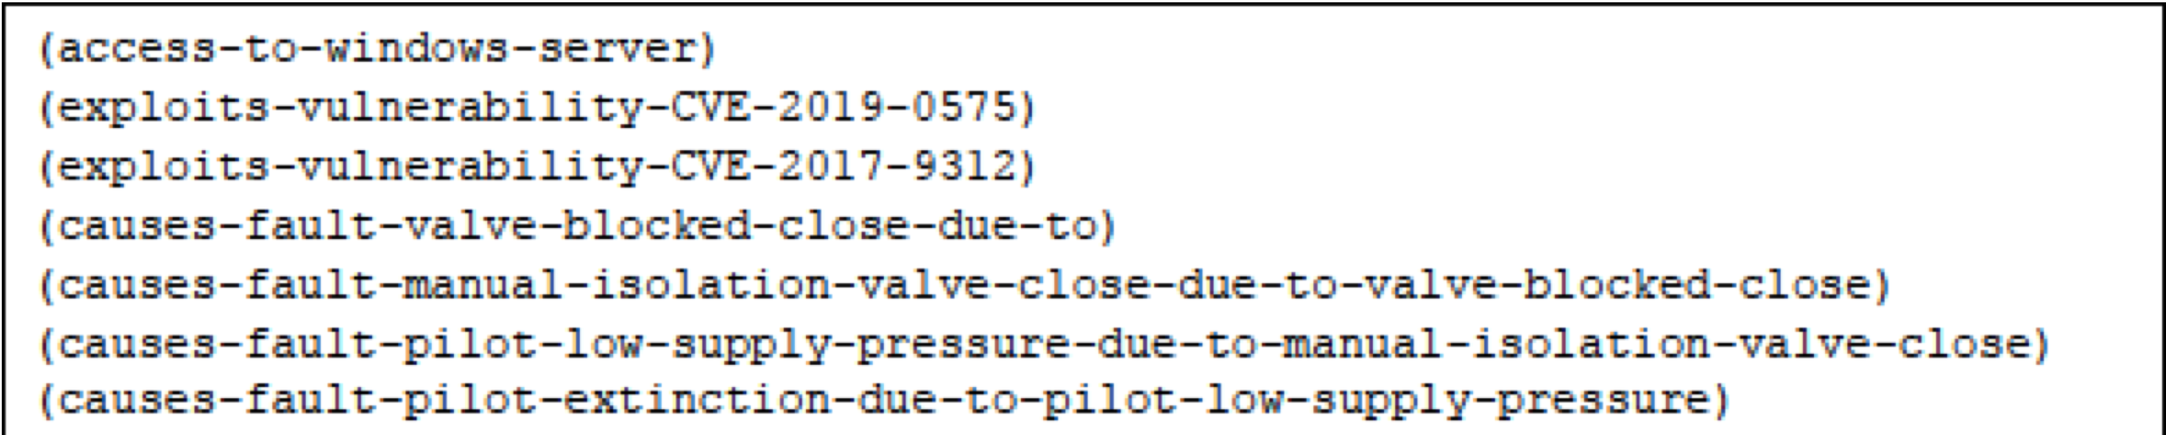
Cascading Failure
Fig. Resilience Path (RP) representation as an AI Plan.
Notes:
For better understanding I have explain via visualization but in actual scenario it’s is a plan given by the planner based on the optimistic model that we derived.

Slide 43
Conclusion
RG framework helps CPS operators evaluate vulnerabilities causing safety issues.
Reveals interdependencies among cyber threats, vulnerabilities, and safety hazards.
Able to analyze cascading failure in IT and OT system.
Potential to capture the effects in a supply chain attack.

Slide 44
Published Papers
I. Ray, S. Sreedharan, R. Podder, S. K. Bashir, and I. Ray, “Explainable AI for Prioritizing and Deploying Defenses for Cyber-Physical System Resiliency,” in 2023 5th IEEE International Conference on Trust, Privacy and Security in Intelligent Systems and Applications (TPS-ISA), pp. 184–192, IEEE, 2023
S. K. Bashir, R. Podder, S. Sreedharan, I. Ray, and I. Ray, “Resiliency Graphs: Modelling the Interplay between Cyber Attacks and System Failures through AI Planning,” in 2024 6th IEEE International Conference on Trust, Privacy and Security in Intelligent Systems and Applications (TPS-ISA), IEEE, 2024 (Best Paper Award)
R. Podder, T. Caglar, S. K. Bashir, I. Ray, S. Sreedharan, and I. Ray, “SPEAR: Security Posture Evaluation using AI Planner-Reasoning on Attack-Connectivity Hypergraphs,” in 30th ACM Symposium on Access Control Models and Technologies (ACM SACMAT), 2025.
R. Podder and S. Ghosh, "Impact of White-Box Adversarial Attacks on Convolutional Neural Networks," 2024 International Conference on Emerging Trends in Networks and Computer Communications (ETNCC), Windhoek, Namibia, 2024, pp. 1-9, doi: 10.1109/ETNCC63262.2024.10767521.
R. Talukdar, R. Podder, and I. Ray, “VKG2AG : Generating Automated Knowledge-Enriched Attack Graph (AG) from Vulnerability Knowledge Graph (VKG),” in 22nd International Conference on Security and Cryptography (SECRYPT), 2025.

Slide 45
Ensuring Firmware Security
Rakesh Podder
Colorado State University

Slide 46
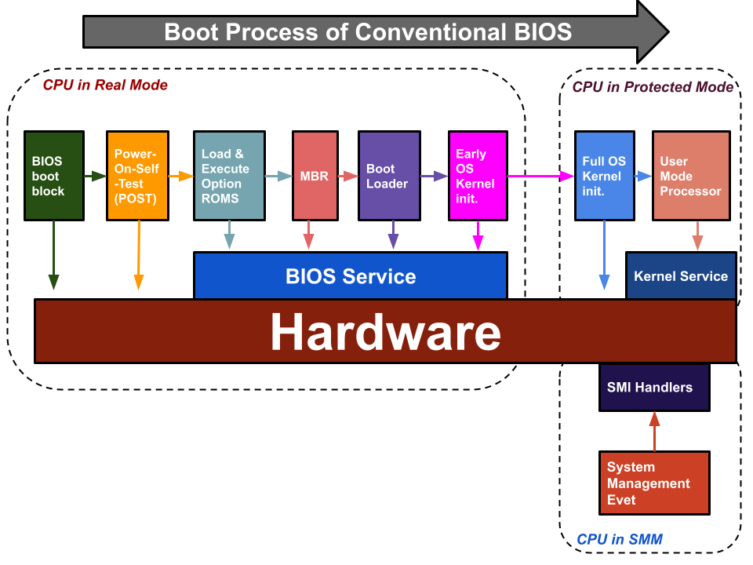
Objective: Ensuring Trustworthiness of Software
Tools and techniques used for software trust gets activated by operating system. (TPM,TEE etc.)
BIOS,UEFI, BMC and other types of firmware gets invoked before OS.
How to ensure that Firmware is trustworthy?

Slide 47
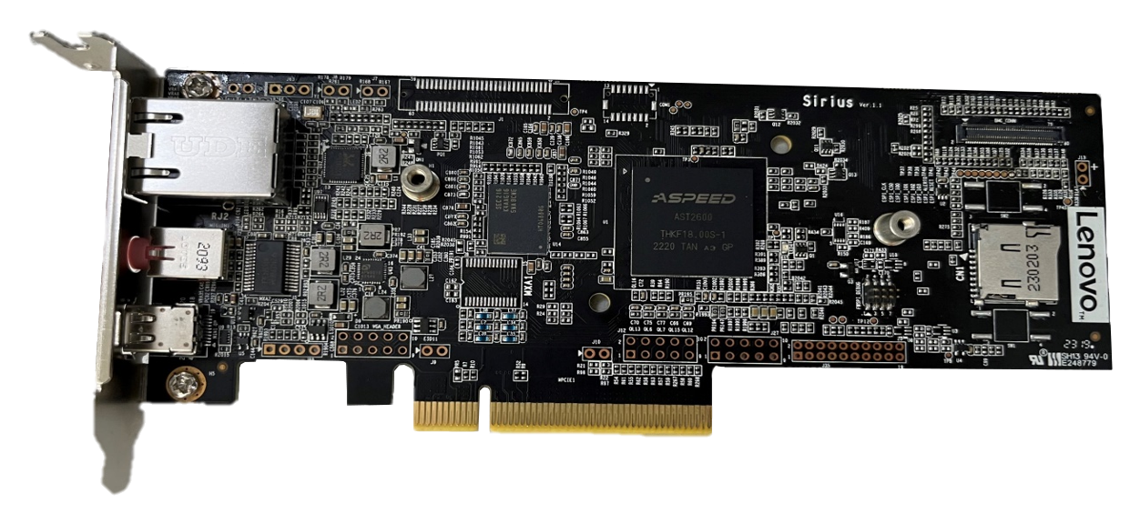


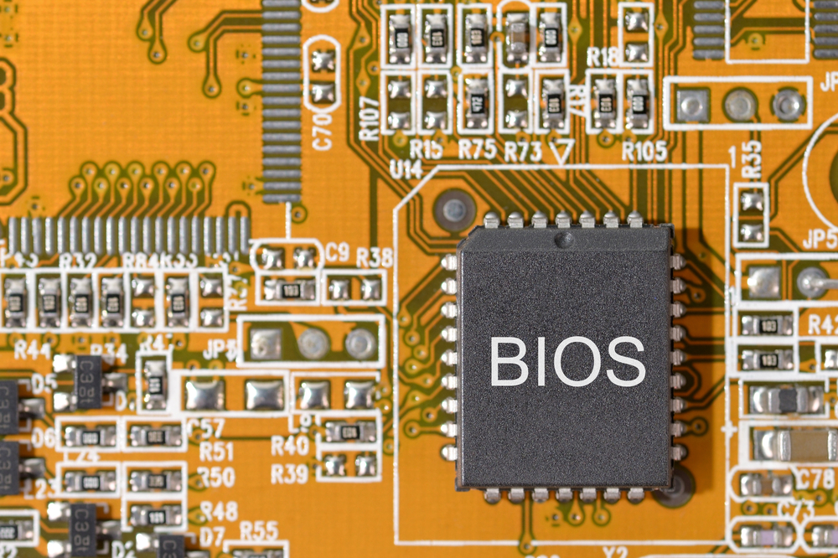
Protecting Firmware is Critical!
Baseboard Management
Controller (BMC)
If Compromised?
Encryption
Digital Signature
Certificate
Firmware
Does not MATTER!
Anything running on an untrusted firmware cannot be trusted!
UEFI/BIOS

Slide 48

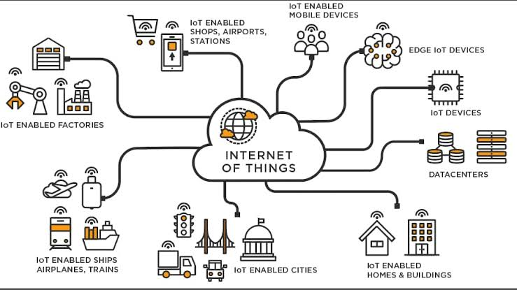
Scale of The Problem is Enormous

Slide 49
Ensuring Trustworthiness in F/W Lifecycle
Protection in
Transit (PIT)
Protocol
Secure Remote
Firmware Update
Protocol (S-RFUP)

Slide 50
Protection in Transit
Notes:
Table 2 reports that all CPNs of cyberattack scenarios are strongly connected components (SCC), This indicates that the state model generated by the CPN is acyclic.
It also reports many dead marking and dead transitions. Dead markings are states where the CPN is terminated.
The dead transitions are those transitions that never occur (a token may not visit them).
Verifying the dead markings signifies the values of the PIT protocol’s parameters where the PIT protocol is terminated, whereas verifying the dead transitions signifies why the PIT protocol did not execute a specific functionality.

Slide 51








Firmware Can be Tampered with Before They Reach End User
Did I get what I ordered?
Are all the parts Genuine?
Are all updates secure?
Components
Device and
Platform
Manufacturing
Distribution
and
Service Hubs
Delivery
Data Center
/Customer
Are replacement parts Genuine?
Malicious firmware modifications and compromised firmware(s) problem.

Slide 52





Protection in Transit Problem Statement
DEVICES
COMPANY
IN TRANSIT..
(Point of origin)
(Point of use)
As a device (laptop, workstation, smartphone etc.) is shipped from the point of origin (Vendor) to point of use (Owner of device), there is a potential for tampering with the device and installation of malware.

Slide 53

Protection in Transit Problem Statement
DEVICES
COMPANY
IN TRANSIT..
(Point of origin)
(Point of use)
Prevent device tampering during transit so as to prevent malware installation.

Slide 54


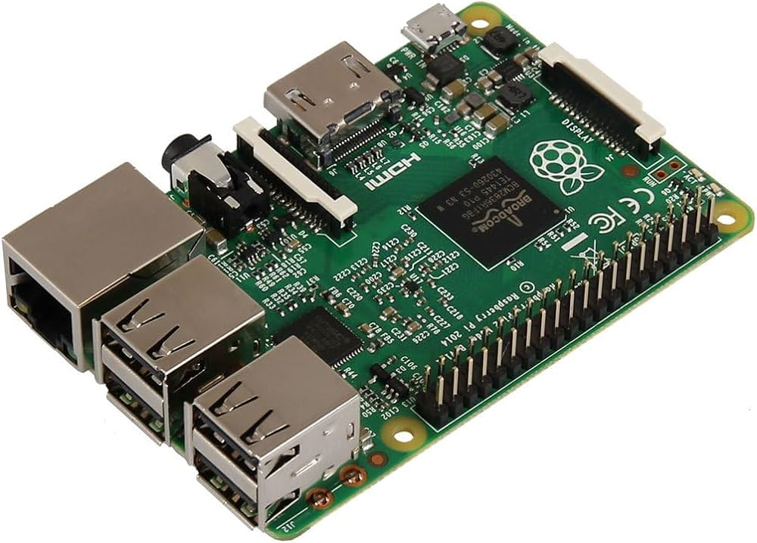
How to solve the Problem?
HRoT
DEVICES
COMPANY
IN TRANSIT..
(Point of origin)
(Point of use)
Lock device via BIOS/BMC during transit and allow to unlock only by an authorized user after proper authentication.

Slide 55
HRoT enabled Boot Process
HRoT enabled Boot Process

Slide 56
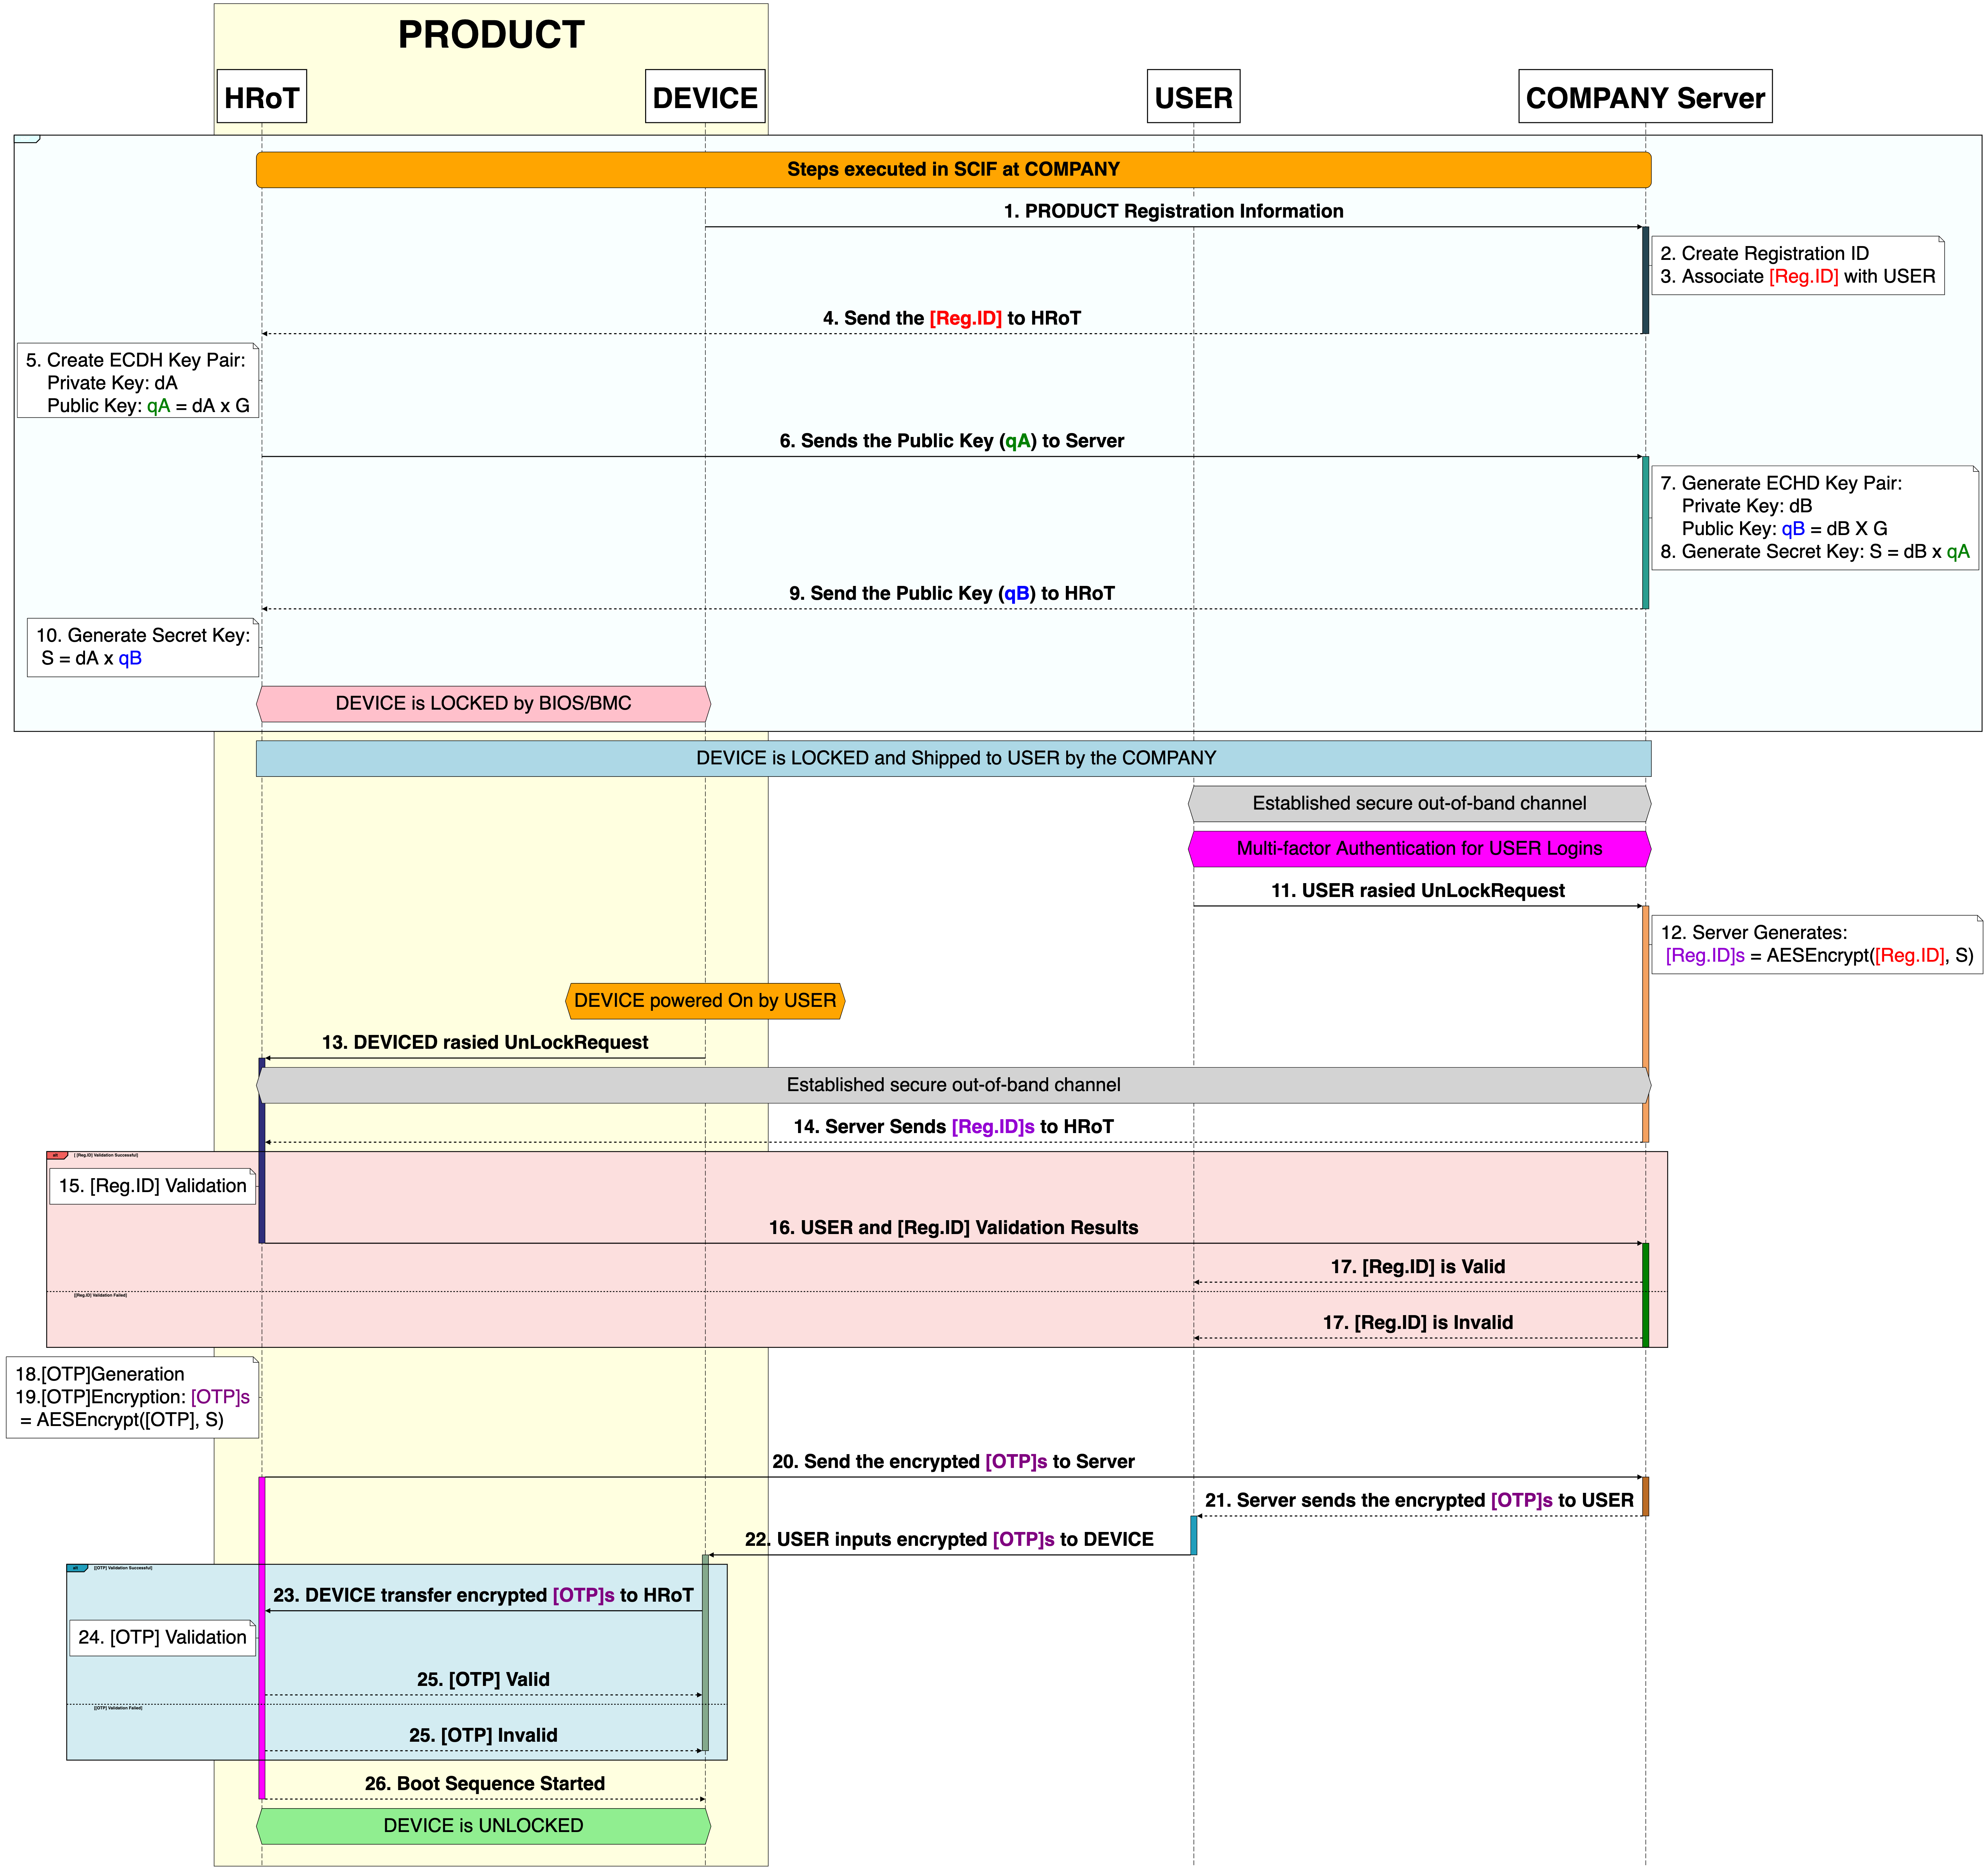
Proposed Protocol
Device Locking Steps
Shipping
Device Unlocking
Steps

Slide 57
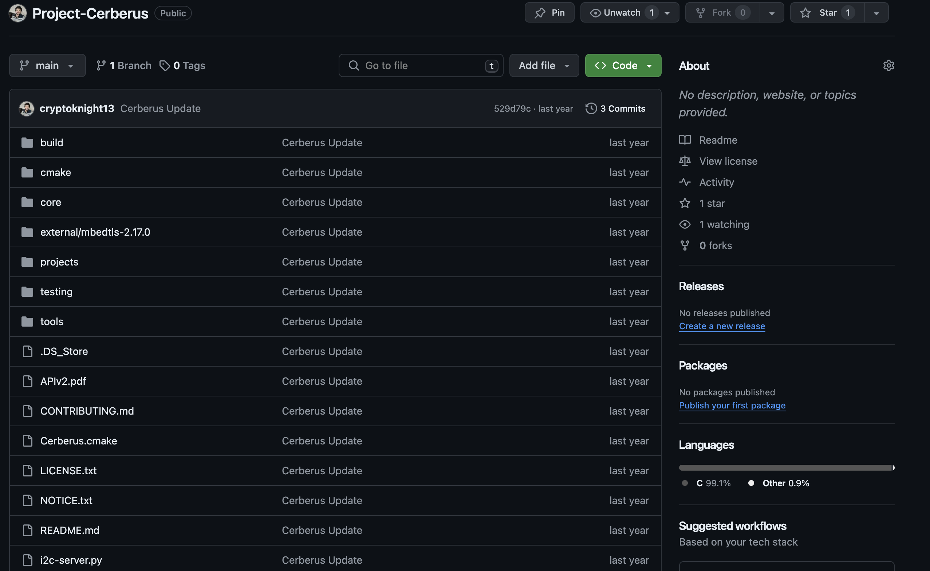



PIT Modified Open-Source Cerberus Embedded Framework
Core
attestation
. . .
I2C
. . .
pit
tmp
Contains all the API for Protection in Transit
Link: https://github.com/cryptoknight13/Project-Cerberus.git

Slide 58
Secure Remote Firmware Update
Notes:
Table 2 reports that all CPNs of cyberattack scenarios are strongly connected components (SCC), This indicates that the state model generated by the CPN is acyclic.
It also reports many dead marking and dead transitions. Dead markings are states where the CPN is terminated.
The dead transitions are those transitions that never occur (a token may not visit them).
Verifying the dead markings signifies the values of the PIT protocol’s parameters where the PIT protocol is terminated, whereas verifying the dead transitions signifies why the PIT protocol did not execute a specific functionality.

Slide 59
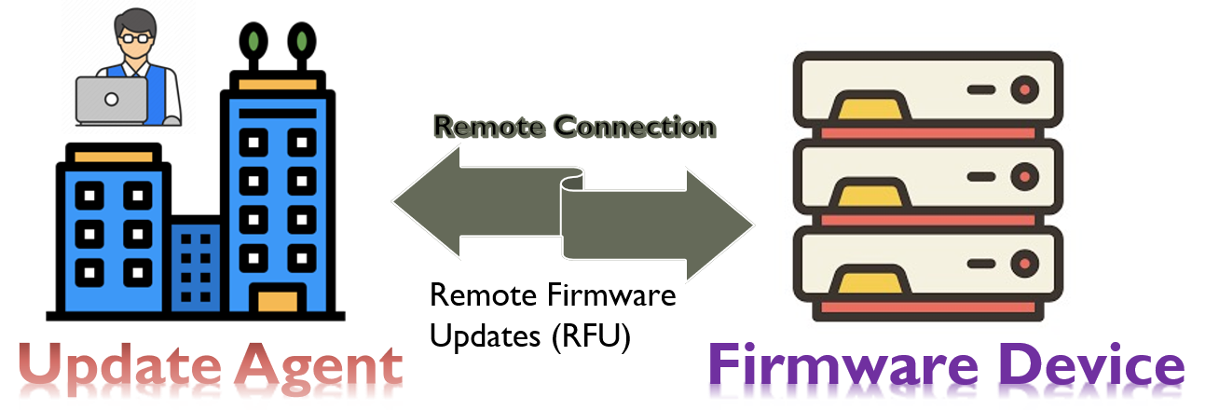
Remote Firmware Update (RFU)
Over - The - Air (OTA)
Dual-bank Update Schema
Delta Update Schema
Rollback Protection Schema
Notes:
Table 2 reports that all CPNs of cyberattack scenarios are strongly connected components (SCC), This indicates that the state model generated by the CPN is acyclic.
It also reports many dead marking and dead transitions. Dead markings are states where the CPN is terminated.
The dead transitions are those transitions that never occur (a token may not visit them).
Verifying the dead markings signifies the values of the PIT protocol’s parameters where the PIT protocol is terminated, whereas verifying the dead transitions signifies why the PIT protocol did not execute a specific functionality.

Slide 60
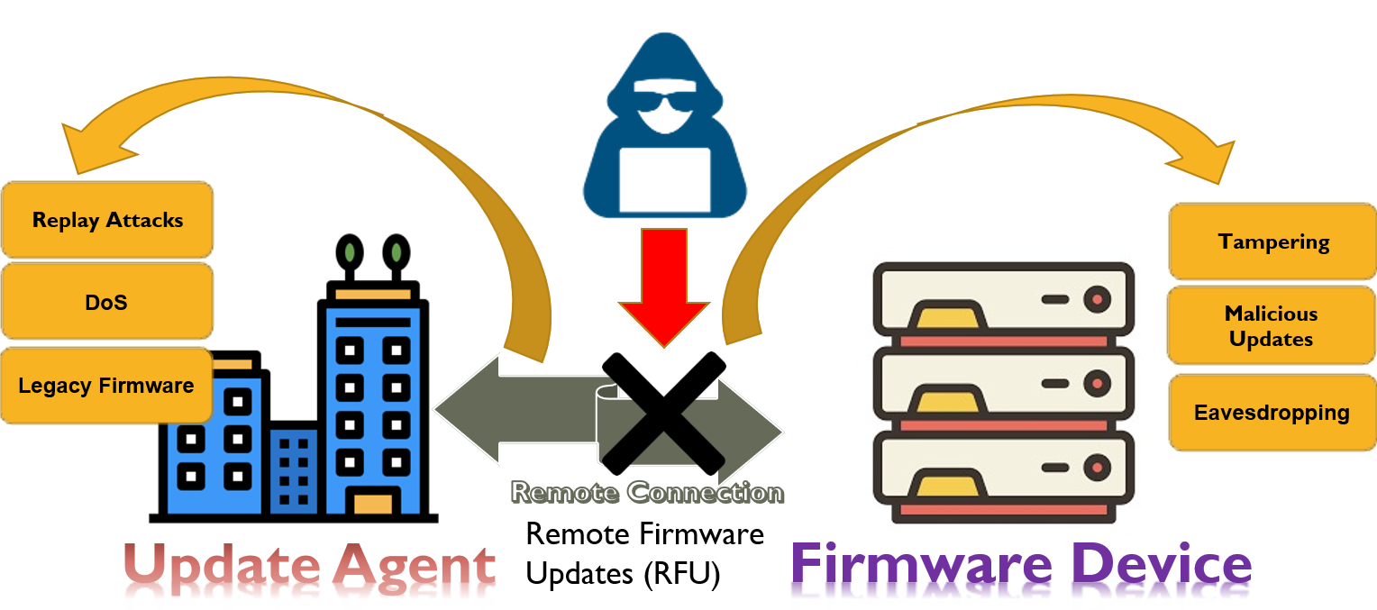
Remote Firmware Update (RFU)
Ensuring standard & secure remote firmware updates is pivotal to safeguarding devices from malicious intrusions, maintain device functionality, and protect sensitive data.
Notes:
Table 2 reports that all CPNs of cyberattack scenarios are strongly connected components (SCC), This indicates that the state model generated by the CPN is acyclic.
It also reports many dead marking and dead transitions. Dead markings are states where the CPN is terminated.
The dead transitions are those transitions that never occur (a token may not visit them).
Verifying the dead markings signifies the values of the PIT protocol’s parameters where the PIT protocol is terminated, whereas verifying the dead transitions signifies why the PIT protocol did not execute a specific functionality.

Slide 61
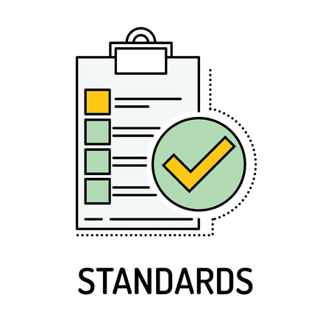

Problem with what we have!
Insecure firmware updates risk vulnerabilities and device could malfunction.
Traditional OTA update mechanisms can be insecure.
Diverse update protocols schema can create compatibility issues.
Design secure remote firmware update protocol using industry standards.
Notes:
Table 2 reports that all CPNs of cyberattack scenarios are strongly connected components (SCC), This indicates that the state model generated by the CPN is acyclic.
It also reports many dead marking and dead transitions. Dead markings are states where the CPN is terminated.
The dead transitions are those transitions that never occur (a token may not visit them).
Verifying the dead markings signifies the values of the PIT protocol’s parameters where the PIT protocol is terminated, whereas verifying the dead transitions signifies why the PIT protocol did not execute a specific functionality.

Slide 62
Platform Level Data Model (PLDM)
Standardized framework for system management
Enables structured control of hardware components
Used in data centers and servers
Binary encoding for efficient data transmission
Supports hardware queries, configuration, and diagnostics
Extensible for custom management tasks
Integrates with management tools

Slide 63
MCTP (Management Component Transport Protocol)
Industry-standard transport protocol for platform management
Designed for communication between management controllers and components
Enables remote management and monitoring of platform hardware
Supports various transport layers (e.g., SMBus, PCIe, etc.)
Provides a framework for secure communication
Enables efficient and standardized hardware management

Slide 64
Platform Level Data Model (PLDM) over MCTP Binding Specification
Reference: Platform Level Data Model (PLDM) over MCTP Binding Specification DMTF

Slide 65
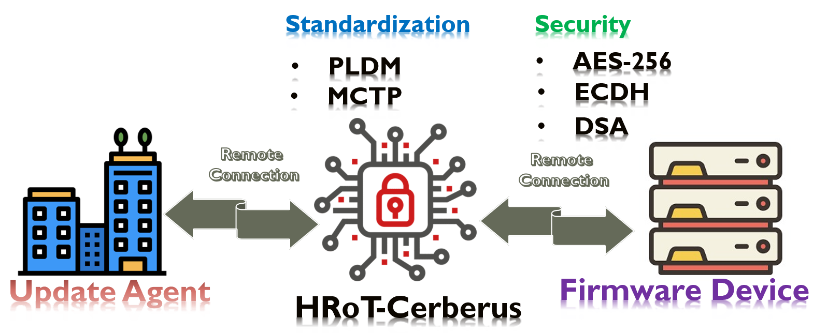
So, what’s the solution?
Establish a standard & end-to-end secure pipeline for remote firmware updates.
Notes:
Table 2 reports that all CPNs of cyberattack scenarios are strongly connected components (SCC), This indicates that the state model generated by the CPN is acyclic.
It also reports many dead marking and dead transitions. Dead markings are states where the CPN is terminated.
The dead transitions are those transitions that never occur (a token may not visit them).
Verifying the dead markings signifies the values of the PIT protocol’s parameters where the PIT protocol is terminated, whereas verifying the dead transitions signifies why the PIT protocol did not execute a specific functionality.

Slide 66
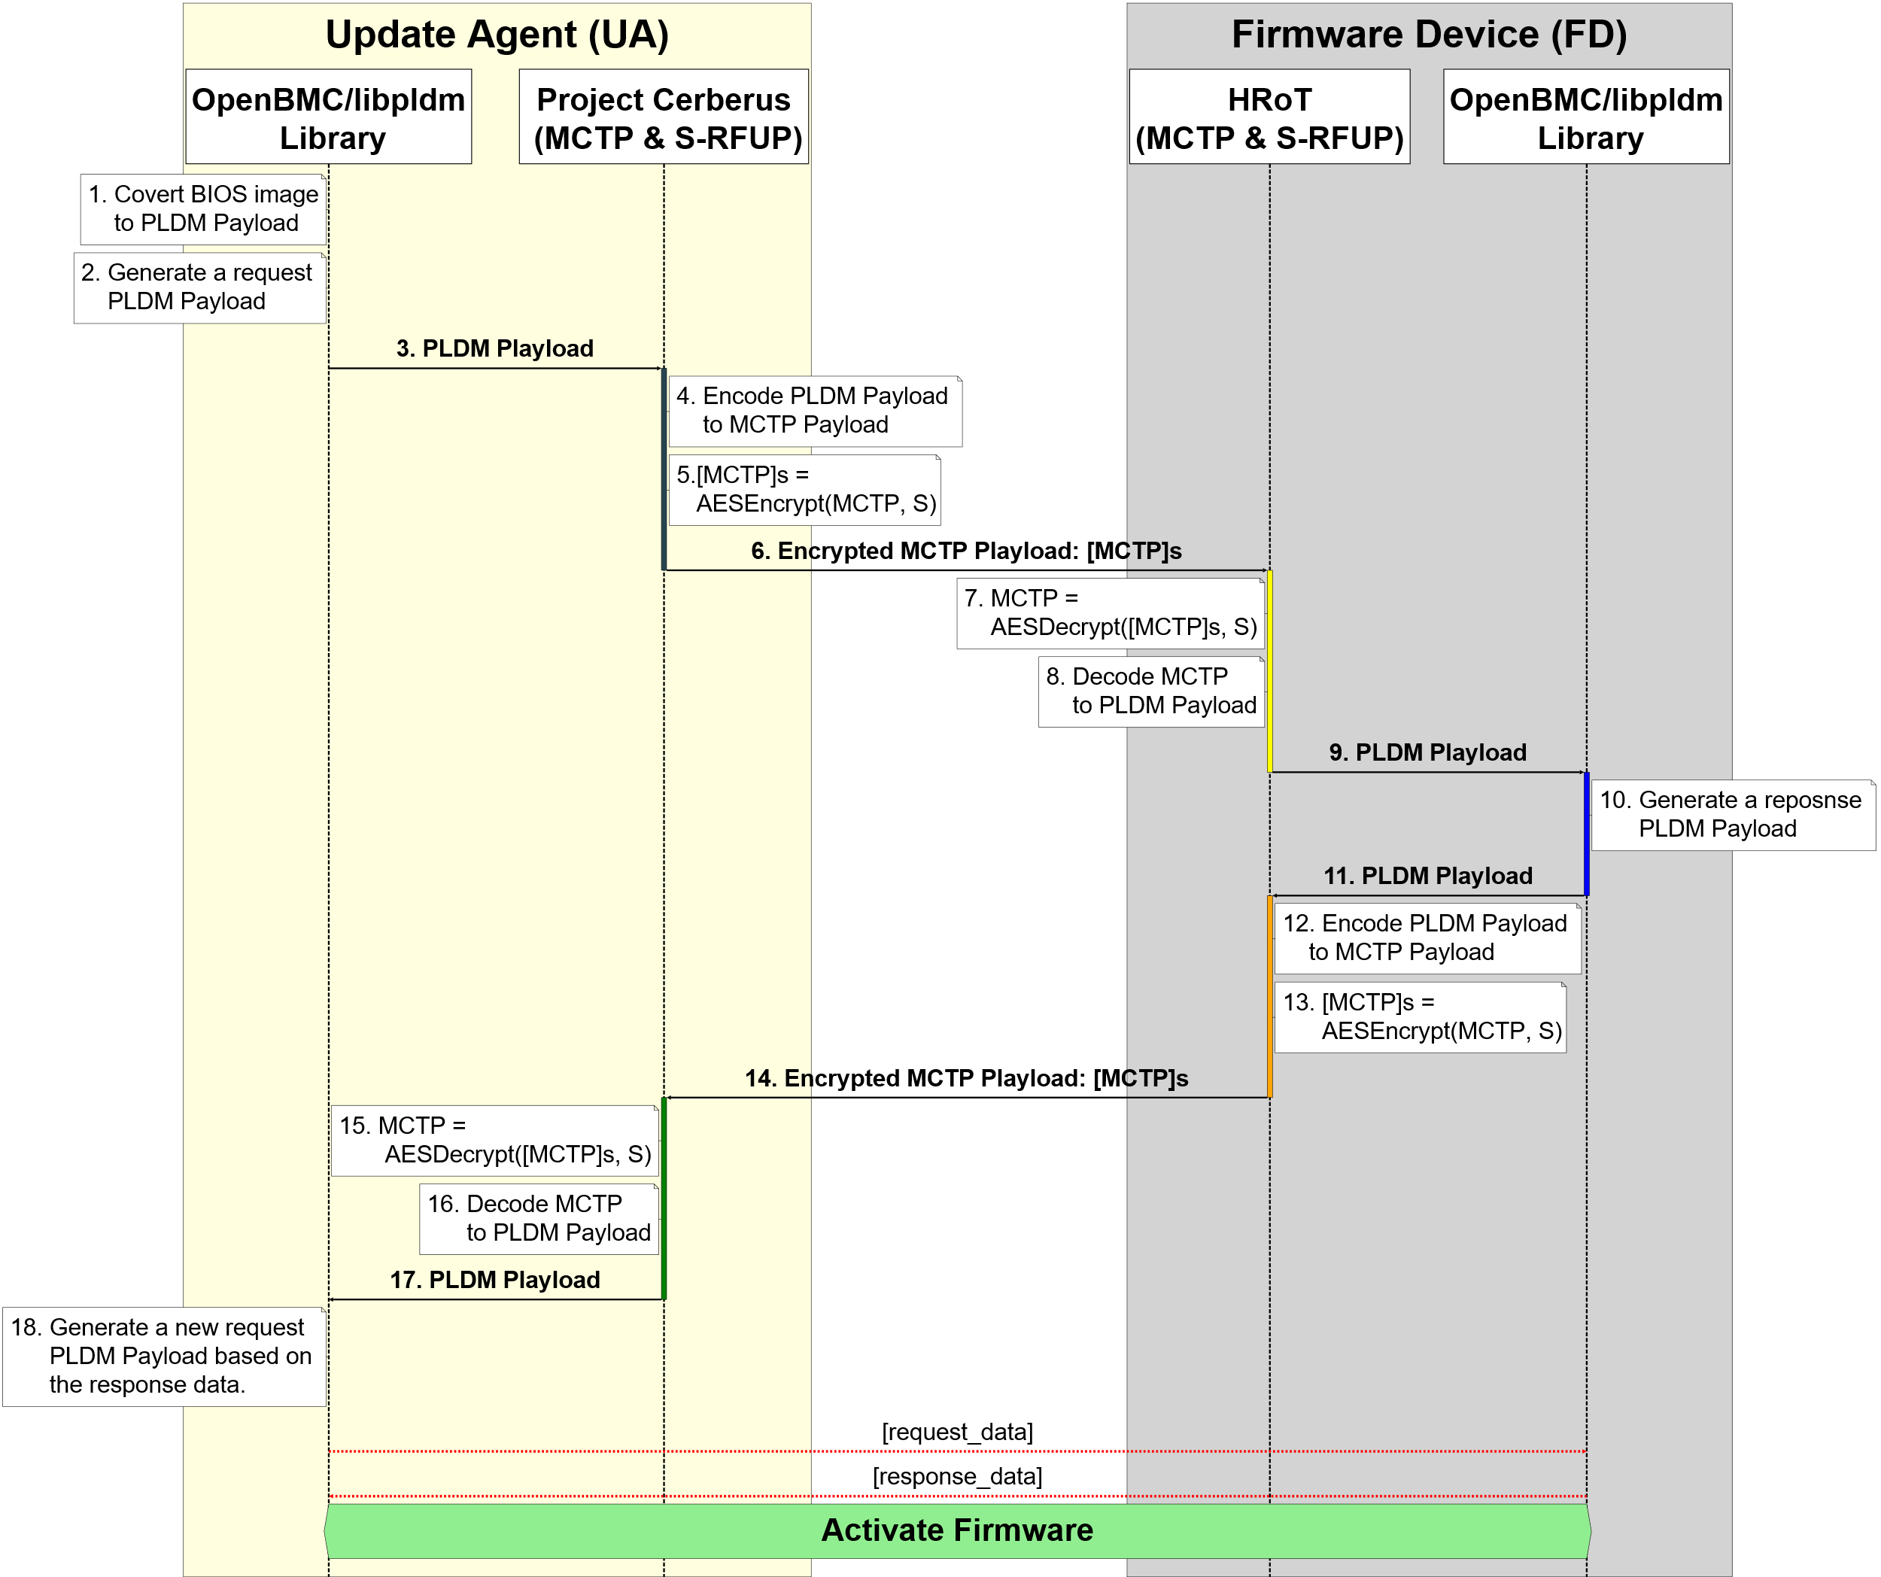
S-RFUP Firmware Update Process
Notes:
Table 2 reports that all CPNs of cyberattack scenarios are strongly connected components (SCC), This indicates that the state model generated by the CPN is acyclic.
It also reports many dead marking and dead transitions. Dead markings are states where the CPN is terminated.
The dead transitions are those transitions that never occur (a token may not visit them).
Verifying the dead markings signifies the values of the PIT protocol’s parameters where the PIT protocol is terminated, whereas verifying the dead transitions signifies why the PIT protocol did not execute a specific functionality.

Slide 67
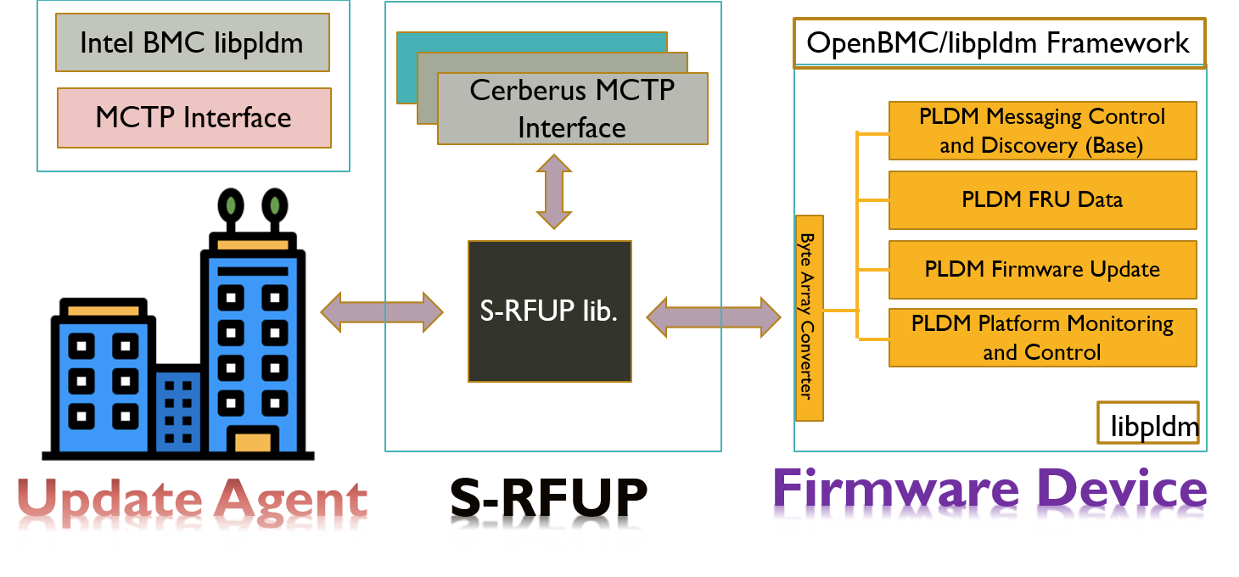
Libraries and Framework
Notes:
Table 2 reports that all CPNs of cyberattack scenarios are strongly connected components (SCC), This indicates that the state model generated by the CPN is acyclic.
It also reports many dead marking and dead transitions. Dead markings are states where the CPN is terminated.
The dead transitions are those transitions that never occur (a token may not visit them).
Verifying the dead markings signifies the values of the PIT protocol’s parameters where the PIT protocol is terminated, whereas verifying the dead transitions signifies why the PIT protocol did not execute a specific functionality.

Slide 68
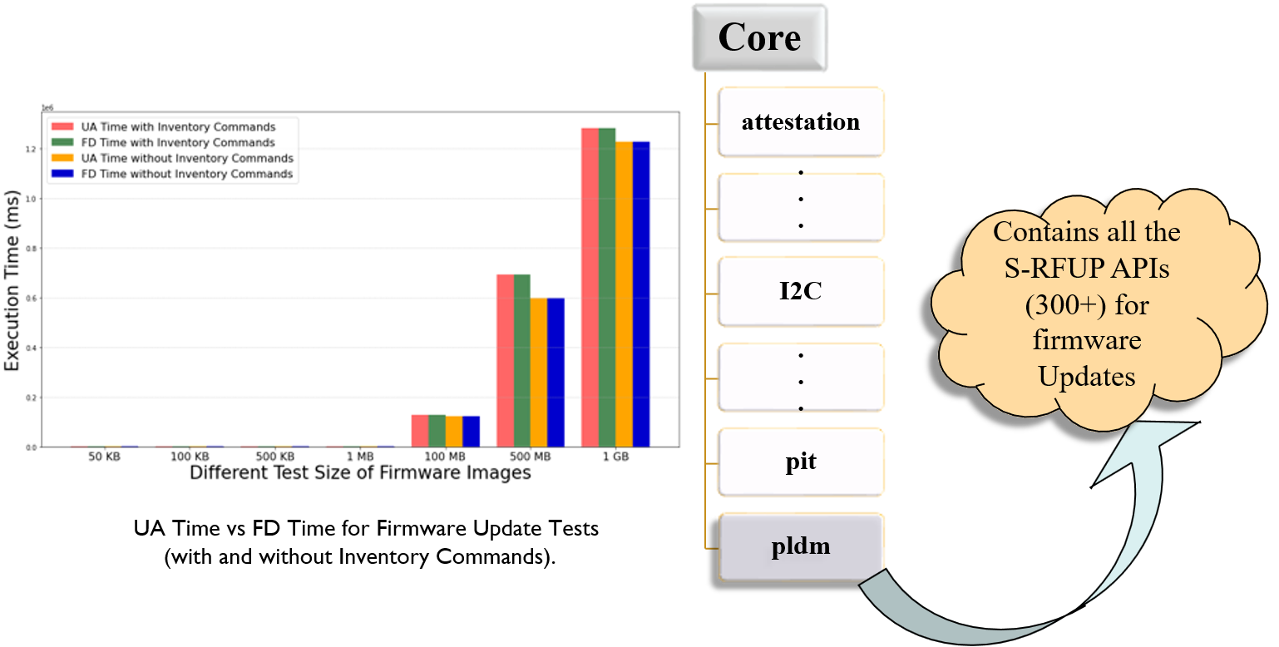
Evaluation
Notes:
Table 2 reports that all CPNs of cyberattack scenarios are strongly connected components (SCC), This indicates that the state model generated by the CPN is acyclic.
It also reports many dead marking and dead transitions. Dead markings are states where the CPN is terminated.
The dead transitions are those transitions that never occur (a token may not visit them).
Verifying the dead markings signifies the values of the PIT protocol’s parameters where the PIT protocol is terminated, whereas verifying the dead transitions signifies why the PIT protocol did not execute a specific functionality.

Slide 69
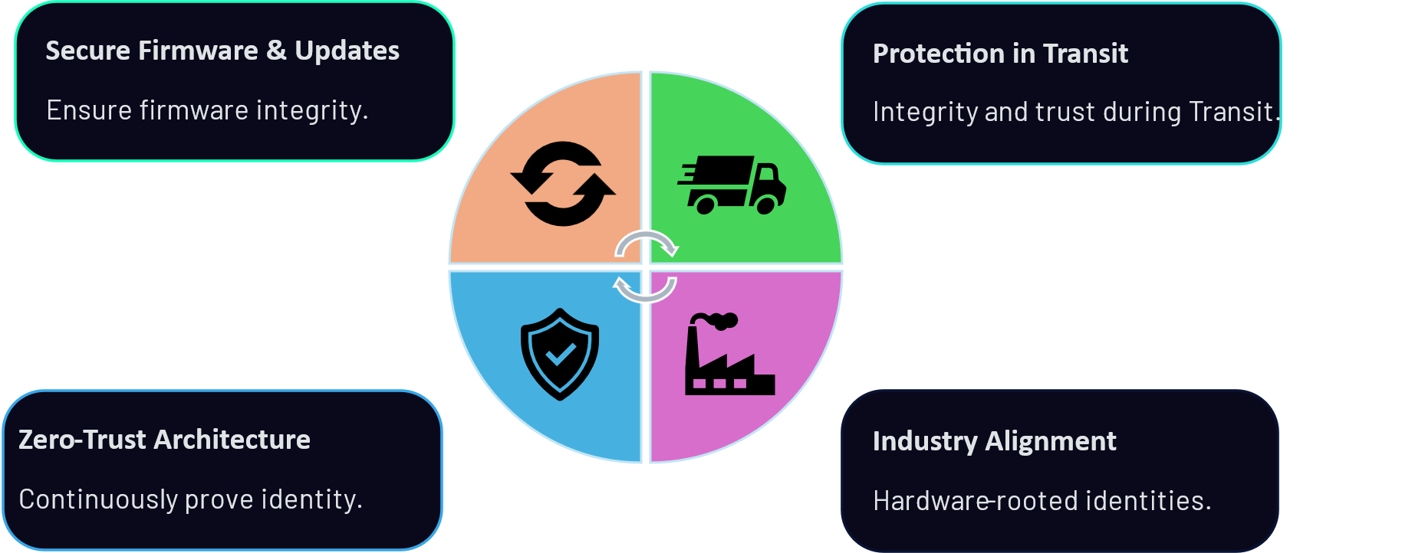
Future Work

Slide 70
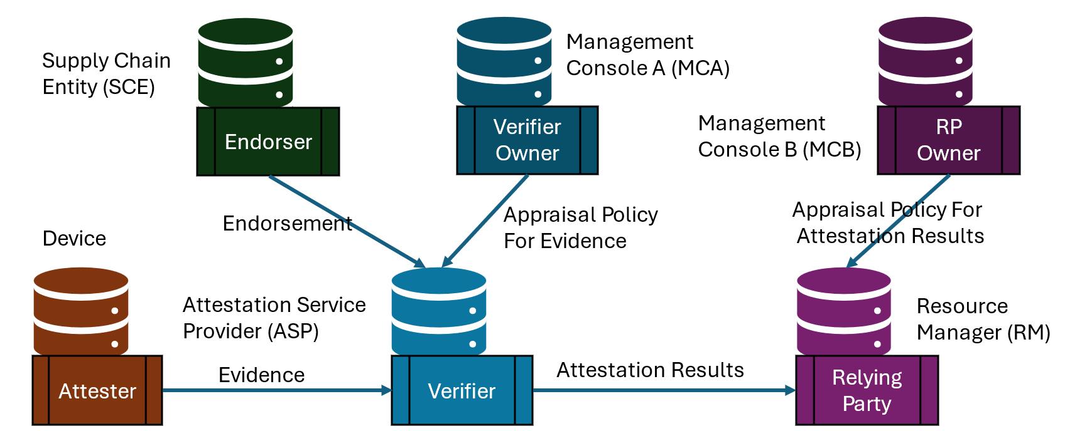
Future Work - DICE
Device Identifier Composition Engine (DICE) Architecture for Zero-Trust

Slide 71
Future Work - DICE
Hardware Root-of-Trust
Layered Attestation (DICE)
Remote Verification
Scalable Solution
Minimal trust anchor for devices.
Any change in firmware is evident.
Verify device security posture remotely.
Scales without special hardware.
Device Identifier Composition Engine (DICE) Architecture for Zero-Trust

Slide 72
Published Papers
Podder, Rakesh, Jack Sovereign, Indrajit Ray, Madhan B. Santharam, and Stefano Righi. "The PIT-Cerberus framework: preventing device tampering during transit." In 2024 IEEE 24th International Conference on Software Quality, Reliability and Security (QRS), pp. 584-595. IEEE, 2024. (Best Paper Award)
Podder, Rakesh, Mahmoud Abdelgawad, Indrakshi Ray, Indrajit Ray, Madhan Santharam, and Stefano Righi. "Correctness and security analysis of the protection in transit (PIT) protocol." In JSS.
Podder, Rakesh, Tyler Rios, Indrajit Ray, Presanna Raman, and Stefano Righi. "S-RFUP: Secure Remote Firmware Update Protocol." In International Conference on Information Systems Security, pp. 42-62. Springer, Cham, 2025.
T. Rhaimi, H. Aghayarzadeh, R. Podder, and I. Ray, “Formal Specification and Verification of Protection in Transit (PIT) Protocol Using UPPAAL,” in 30th ACM Symposium on Access Control Models and Technologies (ACM SACMAT), 2025.
R. Podder, J. Simental, E. Azizl, B. Mantha, and I. Ray, “CoDICE: Roll the DICE for Firmware Attestation,” in 41st Annual Computer Security Applications Conference (ACSAC), 2025. Submitted.
Notes:
Journal of Systems and software.

Slide 73
Thank You
Question?

