Slide 1
Security Hardening of Industrial Control Systems through Attribute Based Access Control
Department of Computer Science
Shwetha Gowdanakatte, Mahmoud Abdelgawad, and Indrakshi Ray
Ninth Annual Industrial Control System Security (ICSS) Workshop
October 2023
Austin, Texas, USA

Slide 2
Outline
Introduction
Background
PLC and their Security Vulnerabilities
NIST NGAC for PLC
Attack demonstration
Attack Model
DoS Attack on the PLC
Security Hardening
ABAC Gateway
Testbed
Prevention of DoS Attack with ABAC Gateway
Formal Verification
Use Case 1: PLC without ABAC Gateway
Use Case 2: PLC with ABAC Gateway
Formal Analysis
Conclusion & Future work

Slide 3
Industrial Control Systems (ICS)
Human Machine Interface (HMI)
Remote Monitoring and Control (RMC)
set points, parameter, control algorithms, constraints, process data
Programmable Logic Controller (PLC)
manipulated variable
controlled variables
Actuators
Sensors
Controlled Process
process outputs

Slide 4
Background: PLC and their Security Vulnerabilities
Programmable Logic Controllers
Rockwell Compact Logix
Engineering Framework: Studio 5000
Communication Protocol: Common Industrial Protocol (CIP)
Recent Vulnerabilities
CVE-2021-1392: Obtain a CIP password and add an authorized admin user
CVE-2021-22681: Bypass authentication to impersonate Studio 5000
CVE-2016-9342: Crafted TCP packets to the PLC

Slide 5
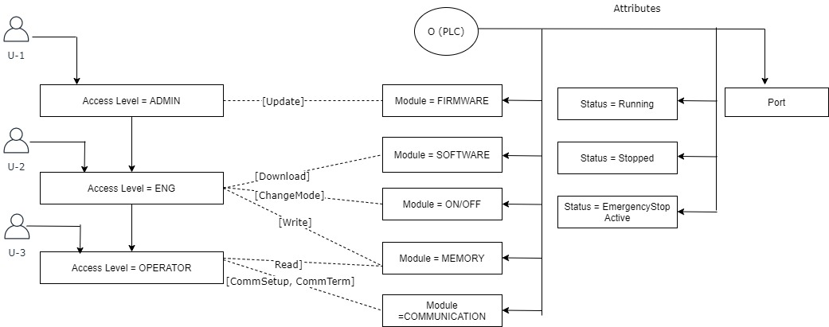
Background: NIST NGAC for PLC
Attribute-Based Access Control for PLC: Gowdanakatte et al. [1]
[1] Shwetha Gowdanakatte, Indrakshi Ray, and Siv Hilde Houmb. 2022. Attribute Based Access Control Model for Protecting Programmable Logic Controllers. In Proceedings of the ACM Workshop on Secure and Trustworthy Cyber-Physical Systems (CODASPY). ACM, Baltimore, MD, USA, 47–56.

Slide 6
Background: Policy Formalization
Each policy is expressed as a tuple
<{User Attribute}, {Resource Attribute},{Environmental Attribute},{operation}>
User Attributes
Access Level = {Operator, Engineer, Administrator}
Device ID
Resource (PLC) Attributes
Module = {Software, Firmware, Communication, Memory}
Status= {Stopped, Running, Emergency Stop Active}
Operating Mode = {Program, Test, Error, Remote}
Port
Environmental Attributes
User Access Time
User Access Location
Example Policy: Communication Setup
<{(User.AccessLevel ∈ {Operator, Engineer, Administrator), (User.Device = “Equip 21L OrgABC”)},
{(PLC.OperatingMode = Remote)}, {(Env. Access Time = 700 − 16 : 00EST),
(Env. Access Loc = OrgABC.local”)}, {CommSetup}>

Slide 7
Attack Model
Phase-1: Man-in-the-Middle (MITM) Attack
Establish communication
Engineering Workstation
PLC
Process communication
Intercept and capture packets
Attacker
Extract firmware version
Create Crafted TCP packets

Slide 8
Attack Model
Phase-2: Denial of Service (DoS) Attack
Attacker
Network
PLC
Init Comm.: PLC IP+Port 102
Init Comm.: PLC IP+ port 102
Challenge question
Challenge question
Challenge response
Challenge response
Session OK
Session OK
Crafted TCP Packets
Crafted TCP Packets

Slide 9
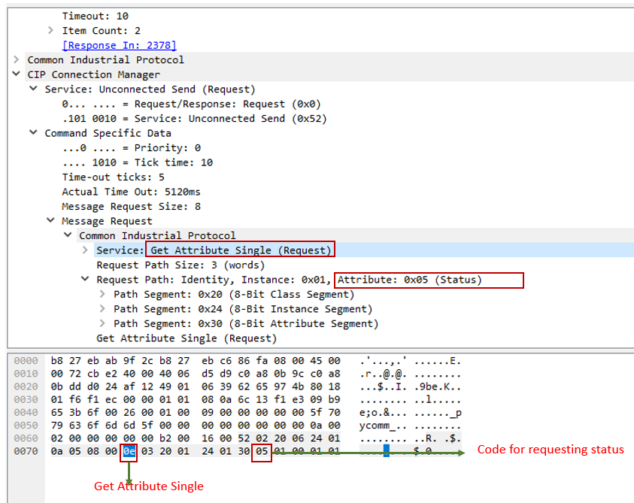
Attack Demonstration
Attack Setup
Engineering Workstation
Internet
Rockwell PLC
Phase 1: Man-in-the-Middle Attack

Slide 10
Attack Demonstration
Phase 2: DoS Attack
Result
Recoverable major fault on the PLC
Stopping the running process
Unavailability of PLC for further online requests
Caused DoS attack
Resolution
Manual restarting of the PLC through a power cycle
Clear major fault

Slide 11
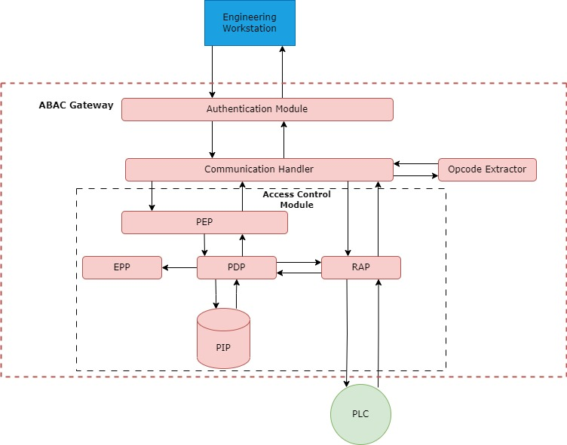
ABAC Gateway

Slide 12
Test Bed
Engineering Workstation
Wi-Fi
ABAC Gateway
Raspberry Pi3
LAN
Rockwell PLC
NGAC-ABAC Implementation on Raspberry Pi3
Python Vakt library
Example Policy

Slide 13
Test Bed
Crafted TCP Packet
Device ID of Engineering Workstation: ‘velpi’
Allowed device ID for establishing the communication with Compact Logix: ‘Equip21LOrgABC’
Communication Request Packet

Slide 14
Test Bed
Policy Verification for ‘Register Session’ Request
DoS attack prevented based on invalid device ID

Slide 15
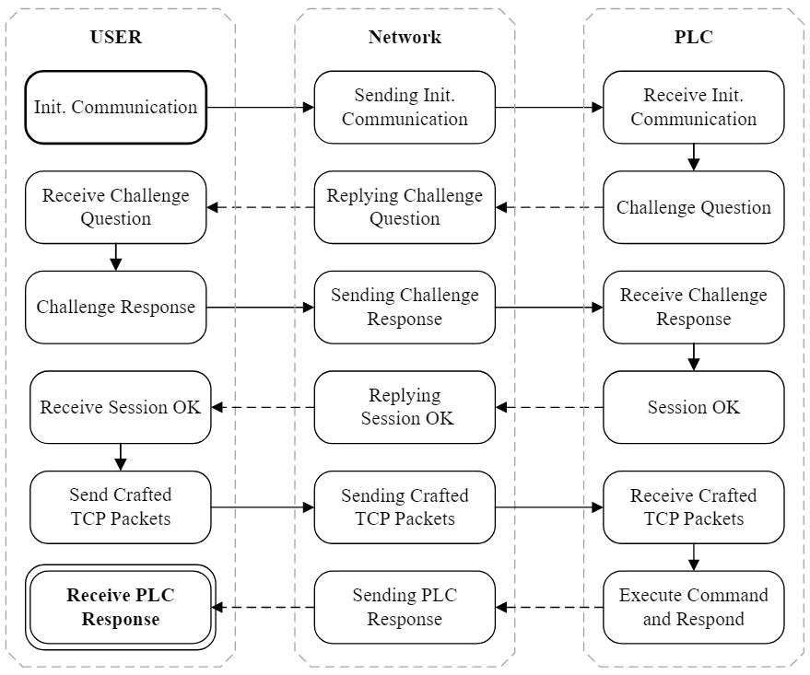
Verification: PLC Operates without ABAC Gateway
CPN Block Diagram
Three CPNs:
User, Network, and PLC
User sends a request packet to initialize communication with PLC
The PLC receives the request and replies with a challenge question
The user sends the challenge response, and the PLC confirms that the session is OK to be established.
The user sends a command to PLC to be executed and receives a response with PLC status

Slide 16
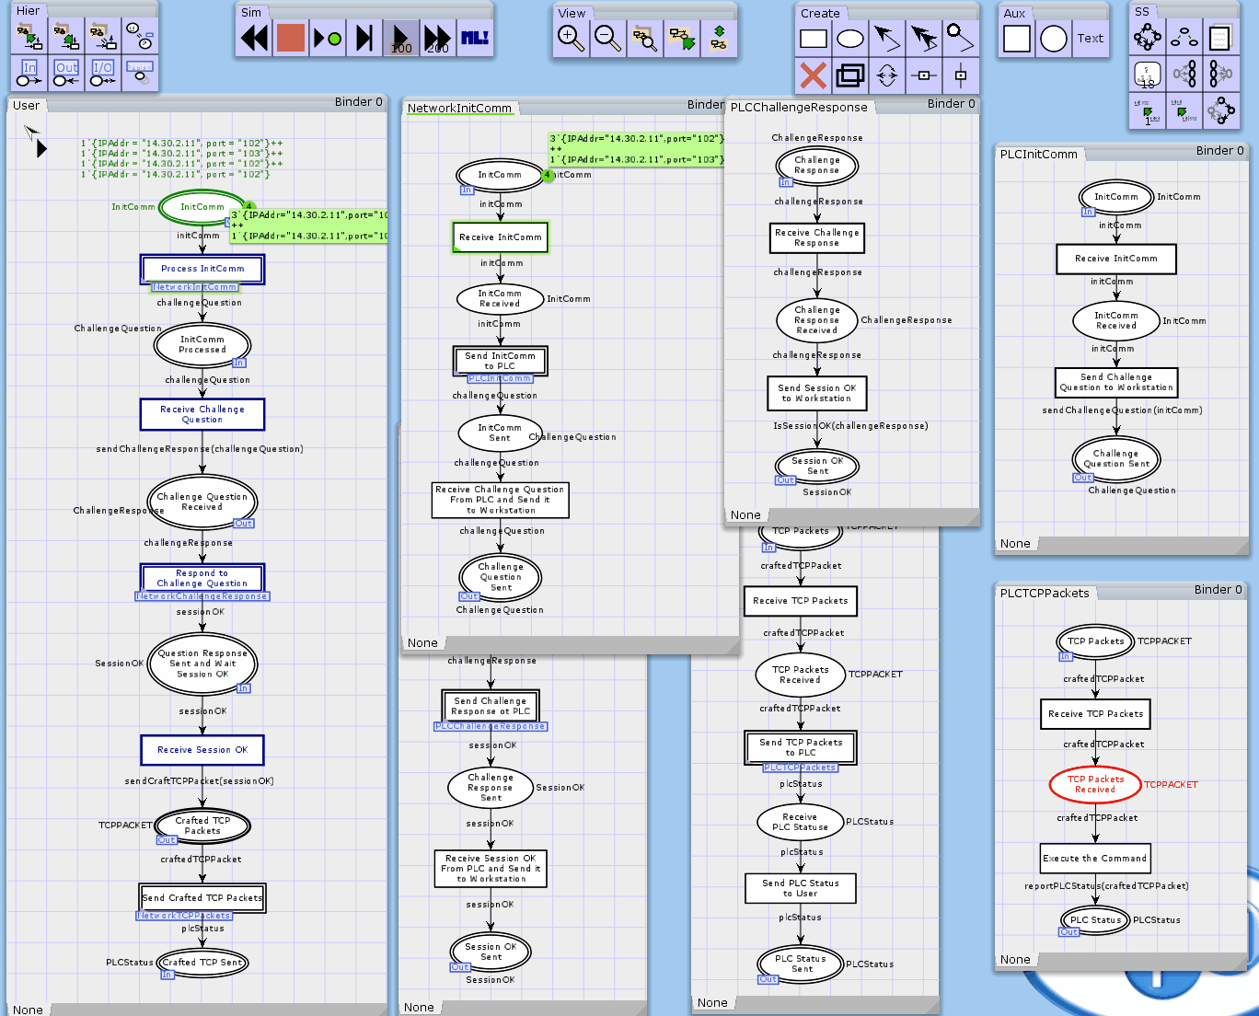
Verification: PLC Operates without ABAC Gateway
CPN Demo: TCP Packets traveling between User and PLC through Network

Slide 17
Verification: PLC Operates without ABAC Gateway
Testcases: CPN Tokens demonstrate legal access (first 3 tokens) and attacks (last 2 tokens)
TC#4: ATTACKER-1 impersonates USER and obtained the same access discretion, but DAC blocked its TCP request packet. (Testcase failed)
TC#5: ATTACKER-2 impersonates ADMIN, gained its discretion, and stopped the PLC. (Testcase passed)

Slide 18
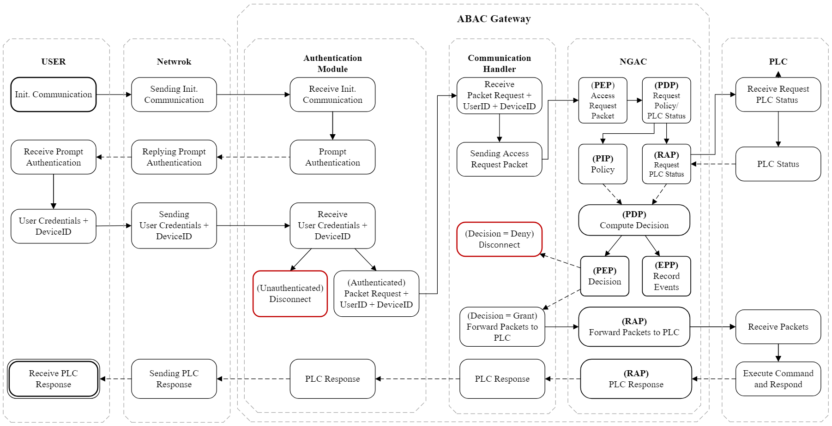
Verification: PLC Operates with ABAC Gateway
CPN Block Diagram: Four CPNs (User, Network, ABAC Gateway, and PLC)
ABAC Gateway: contains three sub CPN blocks: Authentication Module, Comm. Handler, and Access Control Module (NGAC)
Any TCP Packet sent from User to PLC must go through the ABAC Gateway

Slide 19
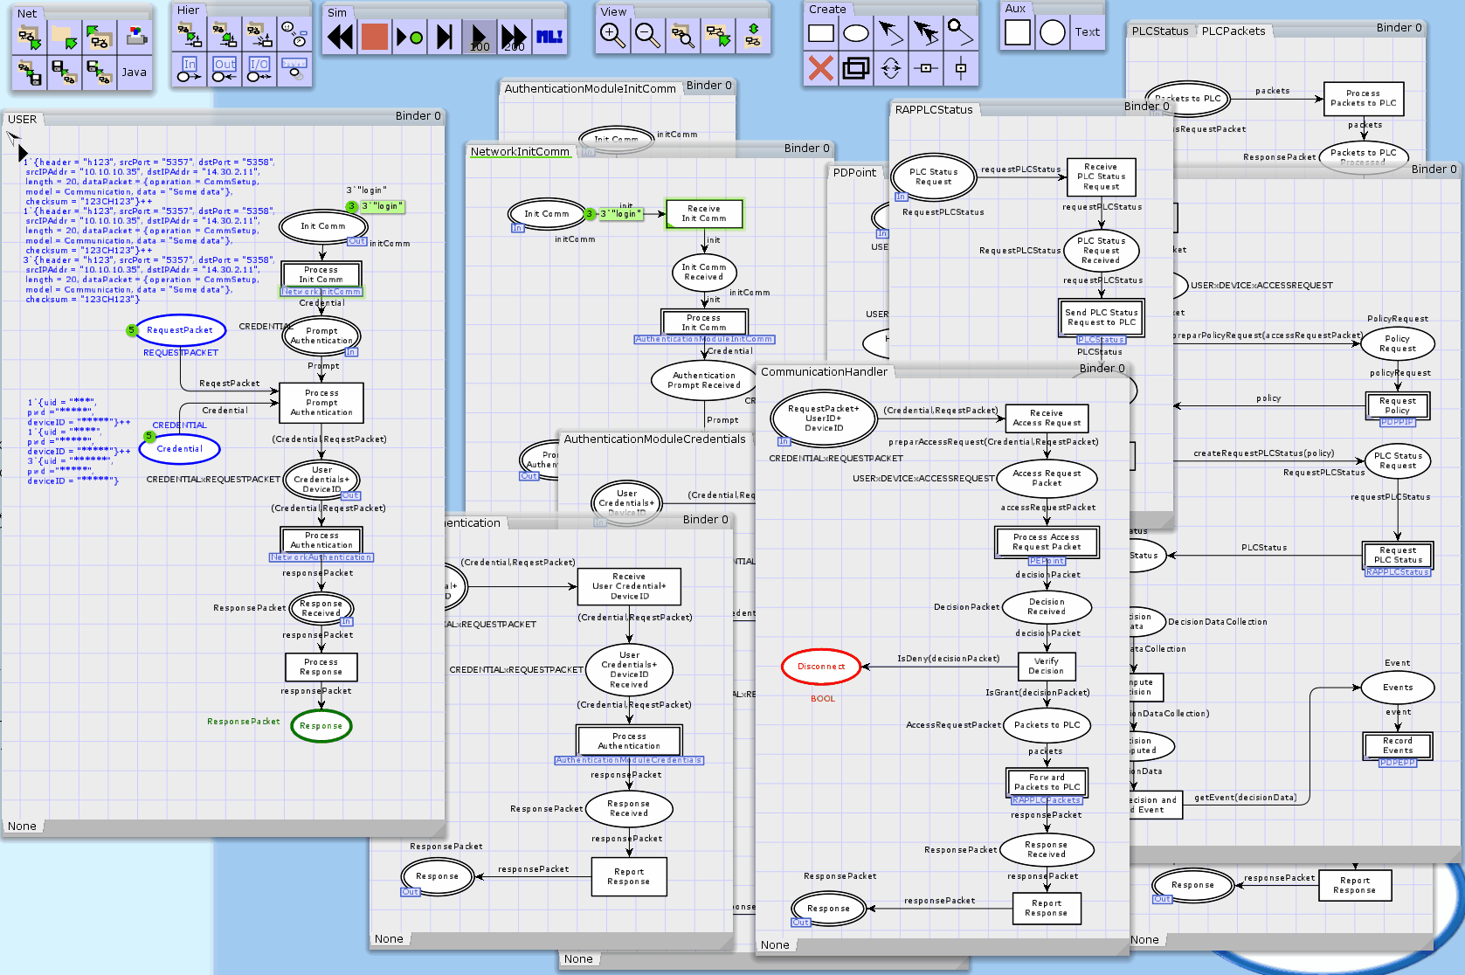
Verification: PLC Operates with ABAC Gateway
CPN Demo: TCP Packets traveling between User and PLC through Network and ABAC Gateway

Slide 20
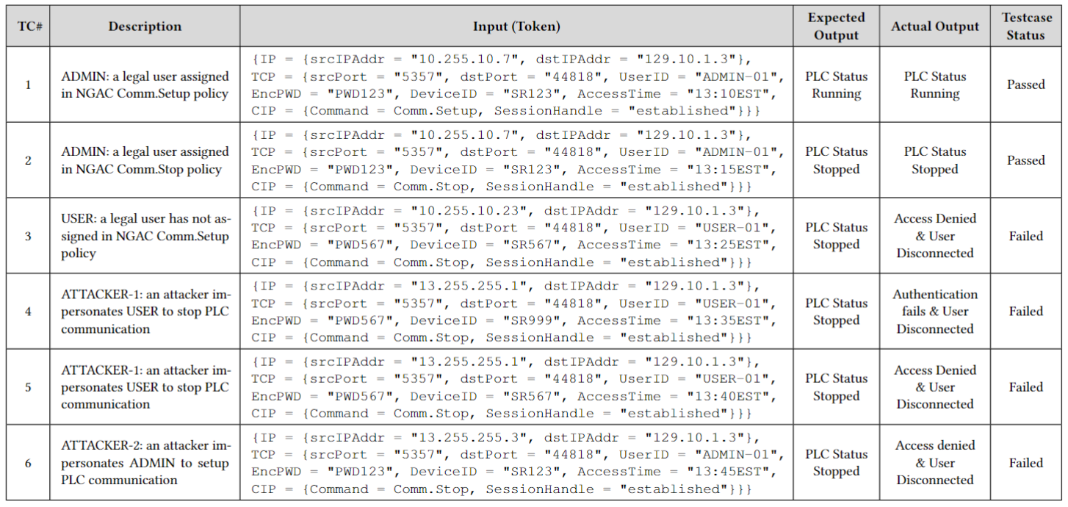
Verification: PLC Operates with ABAC Gateway
Testcases: CPN Tokens demonstrate legal access (first 3 tokens) and attacks (last 3 tokens)
TC#6: ATTACKER-2 impersonates ADMIN, sends setup command, but it is denied by the ABAC Gateway. (Testcase failed)

Slide 21
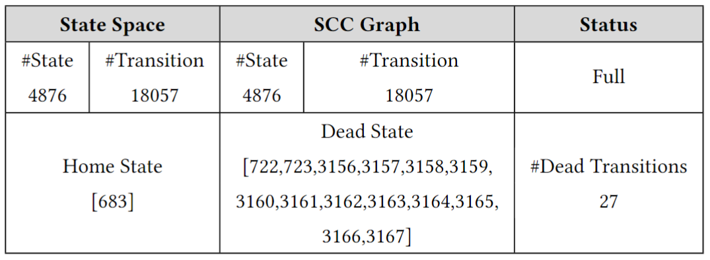
Formal Analysis
State-Space Analysis for Use Case 1
State-Space Analysis for Use Case 2
The authentication property: verifying the identity of a user, process, or device
The authorization property: verify that a requested action or service is granted for a specific resource
In DAC access control mechanism, the is no guarantee that the attacker cannot impersonate an administrator user with the full privilege
The ABAC gateway verifies the access based on NGAC policy comprising user attributes, environment, resource, and operation attributes

Slide 22
Conclusion
It may be impossible to patch all the vulnerabilities of ICS.
The solution is to protect against authentication vulnerabilities in PLC
We developed NIST NGAC Attribute-Based Access Control for PLC protection.
We built a testbed to demonstrate the ABAC Gateway
Formal Verification is executed to verify the PLC system in Use Cases
PLC operates without ABAC Gateway
PLC operates with ABAC Gateway
Result shows ABAC Gateway effectively hardens the PLC security

Slide 23
Future Work
Currently, we are investigating the use of NIST NGAC for the security hardening of other devices in an ICS environment.
Next, we will analyze the latency, performance, and throughput of the ICS due to the incorporation of the ABAC module

Slide 24
Acknowledgement
NSF
NIST
Cyber Risk Research
Statnett
AMI
ARL
New Push

Slide 25
Questions?
Thank you!

