Slide 1
COVID-19 Claims and Counterclaims in Twitter
Sina Mahdipour Saravani
Dr. Ritwik Banerjee
Dr. Indrakshi Ray
November 10, 2020

Slide 2
TOC
Motivation & Problem Statement
The Best Language Model
Related Work
Our Contributions
Experiments and Results
References

Slide 3
Motivation and Problem Statement

Slide 4
Motivation Role of Social Media
Widespread
Extremely effective in propagating information
Influencer accounts
Claims and their effects
Real-world effects

Slide 5
Problem Statement
Analyzing claims and counterclaims in Twitter social network
Natural Language Processing
Detecting claims and counterclaims using machine learning techniques
Social Media Analysis
Claim propagation, users’ relationships, influencer accounts

Slide 6
Problem Statement Solution Categories
Two approaches from a high-level point of view:
One End-to-End Classifier
Easy to build
Less accurate
Pipeline of Components
More complex
Better performance

Slide 7
Problem Statement Related NLP Tasks
Keyword extraction
Irony and sarcasm detection
Stance detection
Contradiction detection
Negation detection
Semantic entailment

Slide 8
The Best Language Model

Slide 9
The Best Language Model BERT
Bidirectional Encoder Representations from Transformers
Transform words and sentences into vector representations
Meaningful vectors in n-dimensional space
Embed contextual information
Trained on masked language modeling and next sentence prediction

Slide 10
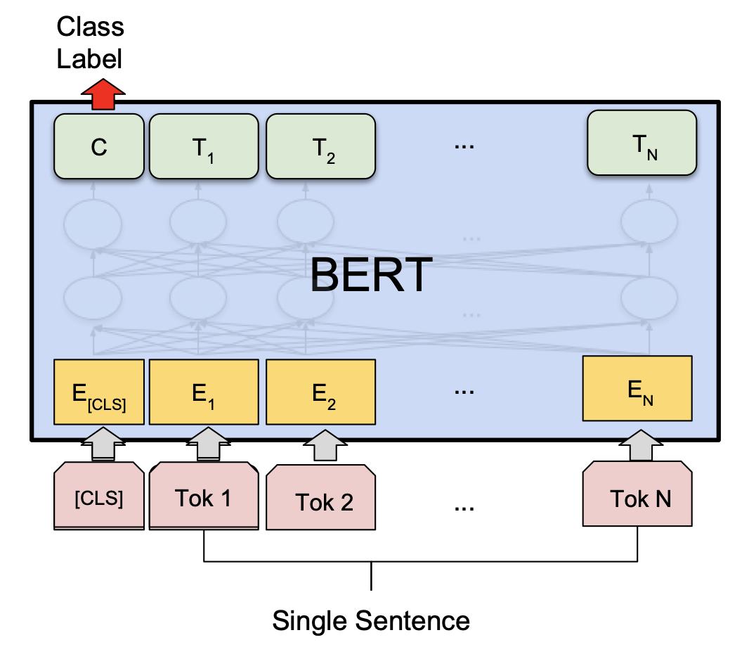
The Best Language Model BERT for Sentence Classification
Devlin, Jacob, Ming-Wei Chang, Kenton Lee, and Kristina Toutanova. "Bert: Pre-training of deep bidirectional transformers for language understanding." arXiv preprint arXiv:1810.04805 (2018).

Slide 11
Related Work

Slide 12
Related Work Irony Detection
Irony and sarcasm detection in Twitter
Sarcasm and Irony are types of figurative language
The speaker means the opposite of what they say
Objective:
Given a tweet and its context, understand if it is ironic

Slide 13
Related Work Irony Detection Shared Tasks
There are two related shared tasks:
SemEval 2018: Irony Detection in Tweets
Classification of a single tweet
Figurative Language 2020: Sarcasm Detection
Classification of a response tweet considering its context tweets

Slide 14
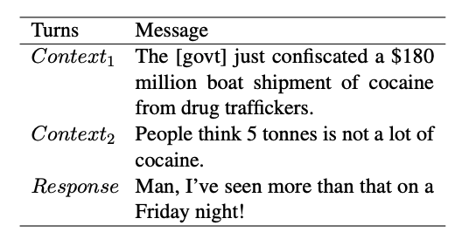
Related Work Irony Detection Datasets
SemEval dataset examples:
Figurative Language dataset example:
I just love when you test my patience!
Go ahead drop me hate, I’m looking forward to it.
Van Hee, Cynthia, Els Lefever, and Véronique Hoste. "Semeval-2018 task 3: Irony detection in english tweets." In Proceedings of The 12th International Workshop on Semantic Evaluation, pp. 39-50. 2018.
Ghosh, Debanjan, Avijit Vajpayee, and Smaranda Muresan. "A Report on the 2020 Sarcasm Detection Shared Task." arXiv preprint arXiv:2005.05814 (2020).

Slide 15
Related Work WLV
SemEval
Title:
WLV at SemEval-2018 Task 3: Dissecting Tweets in Search of Irony
Authors:
Omid Rohanian, Shiva Taslimipoor, Richard Evans and Ruslan Mitkov
University of Wolverhampton
Venue:
12th International Workshop on Semantic Evaluation (2018)

Slide 16
Related Work WLV
Details of the system
Breaking tweets into two parts
Tweet elements: text, hashtags, emojis
Using manual features
Binary contrast feature
Intensity feature based on sentiment score
Using word2vec embeddings
Using voting classifier with LR and SVM

Slide 17
Related Work WLV
Performance
Precision | 0.53
Recall | 0.83
F-1 | 0.65

Slide 18
Related Work RoBERTa-RCNN
SemEval
Title:
A Transformer-based approach to Irony and Sarcasm detection
Authors:
Rolandos Alexandros Potamias, Georgios Siolas, Andreas-Georgios Stafylopatis
National Technical University of Athens
Venue:
Neural Computing and Applications (2020)

Slide 19
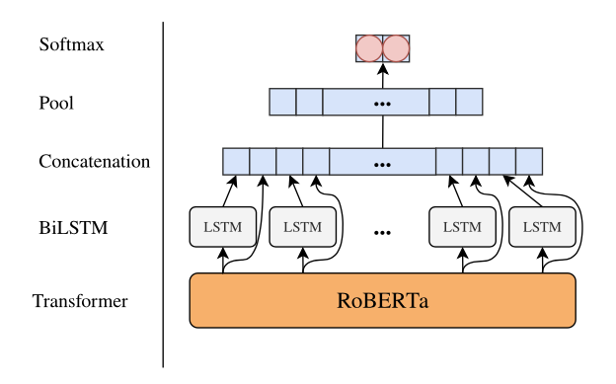
Related Work RoBERTa-RCNN
Potamias, Rolandos Alexandros, Georgios Siolas, and Andreas-Georgios Stafylopatis. "A transformer-based approach to irony and sarcasm detection." Neural Computing and Applications (2020): 1-12.

Slide 20
Related Work RoBERTa-RCNN
Use RoBERTa for capturing rich embedding for words
Use BiLSTM for capturing temporal relationships (time and logic)
Use CNN for capturing spatial relationships
Remove the RNN’s bias of dominance of later words
Notes:
Idea:
The outputs of well-performing pre-trained networks can be further improved if processed by other networks

Slide 21
Related Work RoBERTa-RCNN
Performance
Precision | 0.81
Recall | 0.80
F-1 | 0.80

Slide 22
Related Work Hierarchial BERT
FigLang
Title:
A Novel Hierarchical BERT Architecture for Sarcasm Detection
Authors:
Himani Srivastava, Vaibhav Varshney, Surabhi Kumari, Saurabh Srivastava
TCS Research
Venue:
The Second Workshop on Figurative Language Processing (2020)

Slide 23
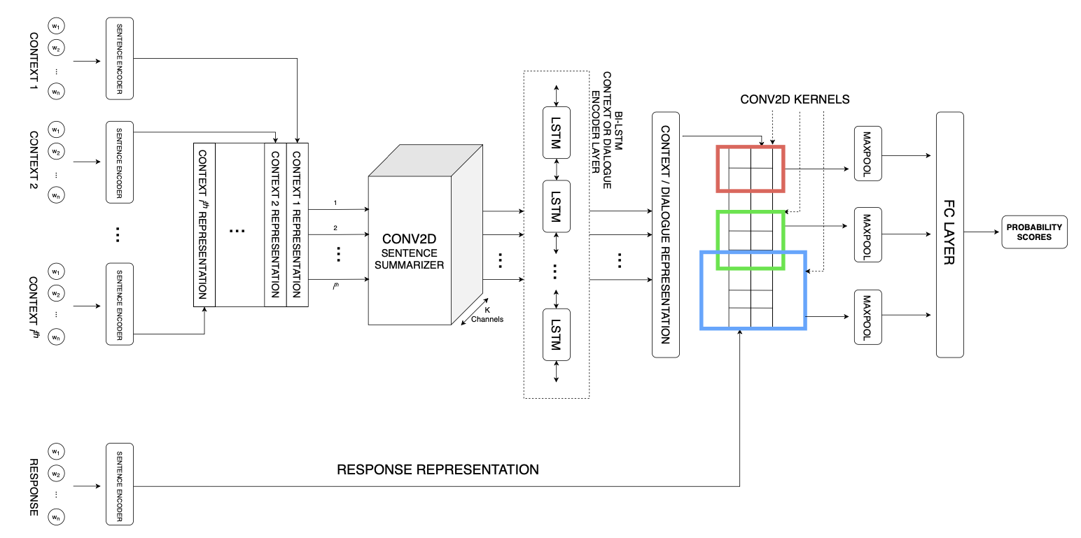
Related Work Hierarchial BERT
Srivastava, Himani, Vaibhav Varshney, Surabhi Kumari, and Saurabh Srivastava. "A novel hierarchical BERT architecture for sarcasm detection." In Proceedings of the Second Workshop on Figurative Language Processing, pp. 93-97. 2020.

Slide 24
Related Work Hierarchial BERT
Use BERT for initial sentence representation
Use CONV2D for summarizing the context representation
Use BiLSTM for representing the whole context sequence
Use CNN to obtain N-gram features between context and response

Slide 25
Related Work Hierarchial BERT
Performance
Precision | 0.74
Recall | 0.74
F-1 | 0.74

Slide 26
Related Work Miroblog
FigLang
Title:
Augmenting Data for Sarcasm Detection with Unlabeled Conversation Context
Authors:
Hankyol Lee, Youngjae Yu, Gunhee Kim
RippleAI and Seoul National University
Venue:
The Second Workshop on Figurative Language Processing (2020)

Slide 27
Related Work Miroblog
Three main contributions:
Architecture
CRA (Contextual Response Augmentation)
Different context lengths

Slide 28
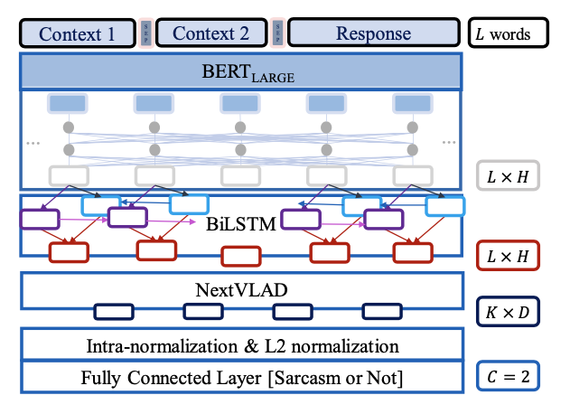
Related Work Miroblog
Lee, Hankyol, Youngjae Yu, and Gunhee Kim. "Augmenting Data for Sarcasm Detection with Unlabeled Conversation Context." arXiv preprint arXiv:2006.06259 (2020).

Slide 29
Related Work Miroblog
NeXtVLAD layer Architecture
Decompose vector to smaller low dimensional regions (CCN’s can be used here)
Use the difference of each descriptor from the cluster centroids (called VLAD vectors)
Sum all the region-level VLAD’s to achieve the whole representative
Apply a modified version of L2 normalization

Slide 30
Related Work Miroblog
CRA (Contextual Response Augmentation)
Generating negative examples by removing response tweets
Generating positive examples by back translation
Generating new data from unlabelled data:
Encode all responses from trainset by BERT
For an unlabeled data point, encode the response and find the 1000 most similar responses from the labeled dataset
Feed these 1000 candidates to BERT for NSP of the context of this data point and choose the one with highest confidence

Slide 31
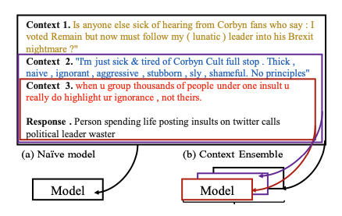
Related Work Miroblog
Lee, Hankyol, Youngjae Yu, and Gunhee Kim. "Augmenting Data for Sarcasm Detection with Unlabeled Conversation Context." arXiv preprint arXiv:2006.06259 (2020).
Notes:
Context Ensemble

Slide 32
Related Work Miroblog
Performance
Precision | 0.93
Recall | 0.93
F-1 | 0.93

Slide 33
Our Contributions

Slide 34
Our Contributions
01
Reproducing the results from some of the related work to build the best claim detection pipeline
02
Using domain-specific BERT model for irony detection

Slide 35
Implementations Keyword Extraction
How to stream tweets related to COVID-19?
Use domain keywords
TF-IDF: Term Frequency - Inverse Document Frequency
How important a word is to a document in a corpus of documents
Proportional to the number of times a word appears in a document, offset by the number of documents containing that word

Slide 36
Implementations Irony Detection Systems
WLV
BERT
RoBERTa
CTBERT-2
Customized BERT

Slide 37
Implementations CTBERT-2
CTBERT-2
Based on BERT_{LARGE} architecture (24 transformers, 1024 vector length)
Trained on COVID-19 related tweets collected by keywords
Collected approximately 22 million tweets after preprocessing

Slide 38
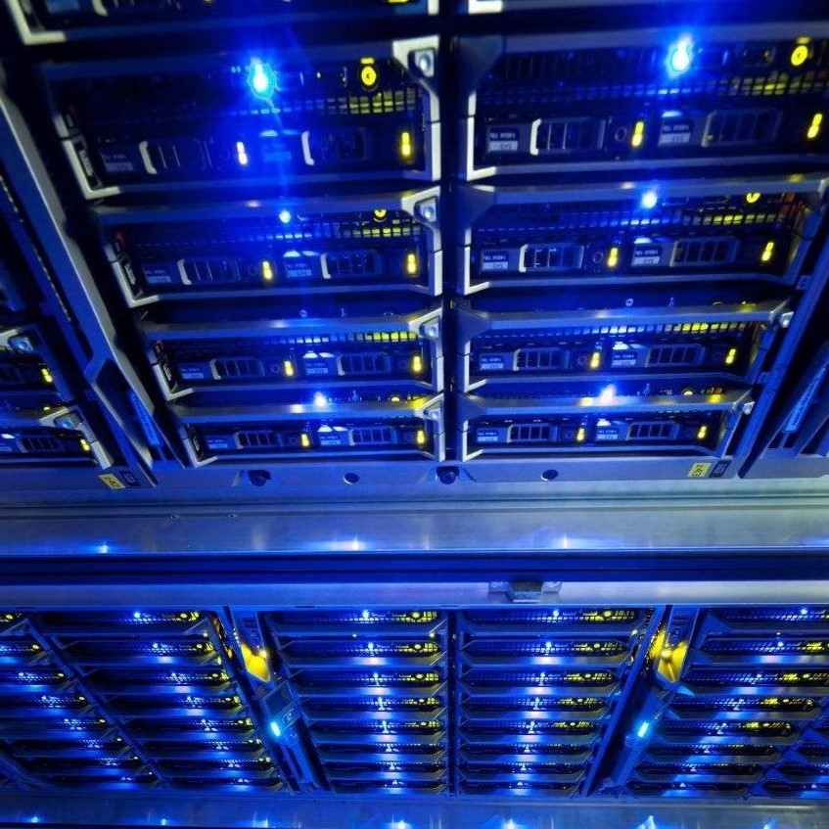
Implementations Where are we?
Implementing Miroblog irony detection architecture
Dataset collection using Twitter API

Slide 39
Experimental Results

Slide 40
Experimental Results Claim Detection Datasets
Available datasets:
CLEF2020
962 datapoints
COVID-19 Infodemic
504 datapoints

Slide 41
Experimental Results Claim Detection System
End-to-end CTBERT-1 Classifier results
Model | Dataset | Precision | Recall | F-1
CTBERT-1 | CLEF2020 | 0.77 | 0.90 | 0.83
CTBERT-1 | COVID-19 Infodemic | 0.76 | 0.93 | 0.84
CTBERT-1 | Union | 0.81 | 0.89 | 0.85

Slide 42
Experimental Results Irony Detection Systems (train/test split)
Model | # of epochs | Precision | Recall | F-1
BERT | 3 | 0.60 | 0.75 | 0.67
CTBERT2 | 4 | 0.74 | 0.95 | 0.83
RoBERTa | 3 | 0.58 | 0.71 | 0.64
RoBERTa | 4 | 0.65 | 0.70 | 0.67
RoBERTa | 5 | 0.58 | 0.70 | 0.64
RoBERTa-4FC | 3 | 0.57 | 0.62 | 0.59
RoBERTa-4FC | 5 | 0.61 | 0.65 | 0.63
RoBERTa_{LARGE} | 3 | 0.61 | 0.72 | 0.66
WLV | - | 0.58 | 0.80 | 0.67
WLV-Normalized | - | 0.65 | 0.67 | 0.66

Slide 43
Experimental Results Irony Detection Systems (5-fold CV)
Model | Precision | Recall | F-1
BERT | 0.65 | 0.71 | 0.68
CTBERT-2 | 0.79 | 0.76 | 0.77
RoBERTa | 0.68 | 0.74 | 0.70
WLV | 0.67 | 0.68 | 0.68

Slide 44
Conclusions and Future Work

Slide 45
Conclusions and Future work
Conclusions:
Architectures considering contradiction perform better in irony detection
WLV, Siamese Networks, VLAD
For social media data, domain-specific pretraining helps significantly
Future Work:
Explore contradiction detection systems as the second component

Slide 46
References
[1] Devlin, Jacob, Ming-Wei Chang, Kenton Lee, and Kristina Toutanova. "Bert: Pre-training of deep bidirectional transformers for language understanding." arXiv preprint arXiv:1810.04805 (2018).
[2] Van Hee, Cynthia, Els Lefever, and Véronique Hoste. "Semeval-2018 task 3: Irony detection in english tweets." In Proceedings of The 12th International Workshop on Semantic Evaluation, pp. 39-50. 2018.
[3] Ghosh, Debanjan, Avijit Vajpayee, and Smaranda Muresan. "A Report on the 2020 Sarcasm Detection Shared Task." arXiv preprint arXiv:2005.05814 (2020).
[4] Potamias, Rolandos Alexandros, Georgios Siolas, and Andreas-Georgios Stafylopatis. "A transformer-based approach to irony and sarcasm detection." Neural Computing and Applications (2020): 1-12.
[5] Srivastava, Himani, Vaibhav Varshney, Surabhi Kumari, and Saurabh Srivastava. "A novel hierarchical BERT architecture for sarcasm detection." In Proceedings of the Second Workshop on Figurative Language Processing, pp. 93-97. 2020.

Slide 47
References
[6] Lee, Hankyol, Youngjae Yu, and Gunhee Kim. "Augmenting Data for Sarcasm Detection with Unlabeled Conversation Context." arXiv preprint arXiv:2006.06259 (2020).
[7] Fialho, Pedro, Luísa Coheur, and Paulo Quaresma. "To BERT or Not to BERT Dealing with Possible BERT Failures in an Entailment Task." In International Conference on Information Processing and Management of Uncertainty in Knowledge-Based Systems, pp. 734-747. Springer, Cham, 2020.

Slide 48
Questions?
Thanks for listening!

