Slide 1
Diptendu Kar
diptendu.kar@colostate.edu

Slide 2
Meltdown and Spectre
Meltdown was independently discovered and reported by three teams:
Jann Horn (Google Project Zero),
Werner Haas, Thomas Prescher (Cyberus Technology),
Daniel Gruss, Moritz Lipp, Stefan Mangard, Michael Schwarz(Graz University of Technology)
Spectre was independently discovered and reported by two people:
Jann Horn (Google Project Zero) and
Paul Kocher in collaboration with, in alphabetical order, Daniel Genkin (University of Pennsylvania and University of Maryland), Mike Hamburg (Rambus), Moritz Lipp (Graz University of Technology), and Yuval Yarom (University of Adelaide and Data61)
Somewhat related with subtle differences. (will see later)

Slide 3
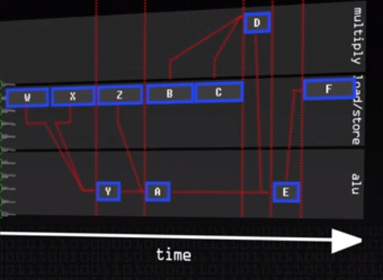
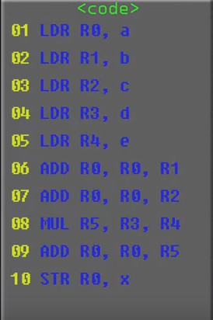
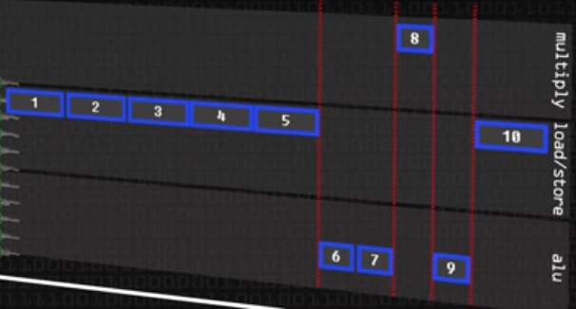
Out of order execution
Example code : x = a +b +c + d * e

Slide 4
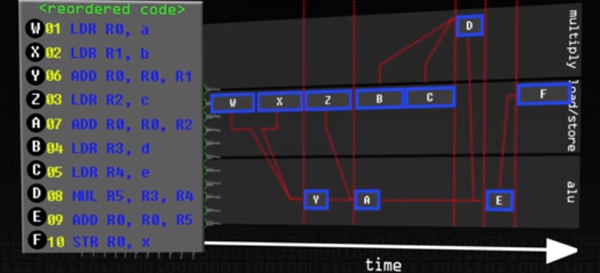
Out of order execution (2)

Slide 5
Spectre Basics
Spectre exploits speculative execution and branch prediction to leak data from a processor via covert channel (cache lines).
Spectre can only read memory from the current process, not the kernel or other physical memory.
Spectre breaks the isolation between different applications. It allows an attacker to trick error-free programs, which follow best practices, into leaking their secrets.
Spectre is harder to exploit than Meltdown, but it is also harder to mitigate.

Slide 6
Speculative Execution
Modern processors perform speculative execution.
They execute instructions in parallel or before that are likely to be executed after a branch in code. (if/else)
These instruction may never be really executed , so a sort of CPU snapshot is taken at the branch so the execution can be “rolled back” if needed.
If(foo_array[index1] ^ foo_array[index2] == 0) {
result = bar_array[100]
} else {
result = bar_array[200]
}

Slide 7
Branch Prediction
How does the CPU know which side of the branch (if/else) to speculatively execute.
Branch prediction algorithms are trained based on current executions.
AMD states that ‘Ryzen’ processors have and artificial intelligence neural network to predict this.
The CPU learns which branch will be executed from previous executions of the same code.
Incorrect branch predictions causes “rollback” of instructions.
Old register states are preserved, can be restored.
Memory writes are buffered, can be discarded.
Cache modifications are not restored !

Slide 8
Spectre Effects
The Spectre vulnerability does not allow an unprivileged process to read privileged memory (as we saw in Meltdown).
Spectre does allow code executing in victim process to access data it should not have access to (e.g. JavaScript Sandbox)
This is most useful in a browser where one tab may contain attacker code while another tab contains sensitive information that should not be accessible to the attacker.
From one VM to another.

Slide 9
Overview of how Spectre works
If (x < array1.size)
y = array2[array1[x] * 256] ;
Execution without speculation is safe.
CPU will never read array1[x] for any x >= array1.size
Execution with speculation can be exploited.
Attacker sets up some condition.
Train branch predictor to assume ‘if ’ is likely to be true.
Make array1.size and array2[] uncached.
Attacker detects cache change (using FLUSH + RELOAD or EVICT + RELOAD)
E.g. next read to array2[i * 256 ] will be faster if i = array1[x], since this got cached during misspeculation.
Note: only a few instructions are needed to run speculatively. But CPUs can run many more (180 on avg., 200 on Haswell)

Slide 10
Violating Javascripts Sandbox

Slide 11
Spectre vs Meltdown
 | Meltdown | Spectre
Allows kernel memory read | Yes | No
Leaks arbitrary user memory | Yes | Yes
Could be executed remotely | Sometimes | Definitely
Most likely to impact | Kernel integrity | Browser memory
Found to work in | Intel | Intel AMD ARM

Slide 12
Mitigations
There are patches against Meltdown for Linux ( KPTI (formerly KAISER)), Windows, and OS X.
There is also work to harden software against future exploitation of Spectre, respectively to patch software after exploitation through Spectre ( LLVM patch, MSVC, ARM speculation barrier header).

Slide 13
Thank You
Thoughts..

