Slide 1
Towards Signature-Based IDS Schemes for Heavy Vehicles
Noah Cain, Subhojeet Mukherjee

Slide 2
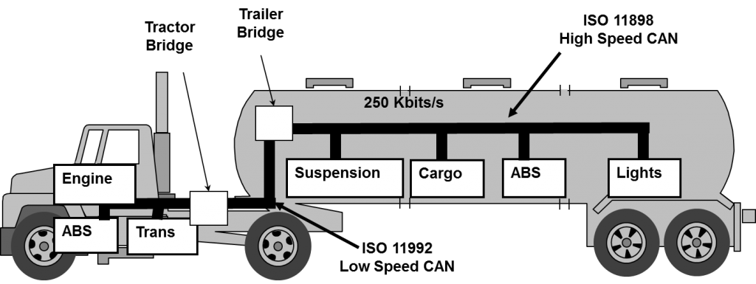
The Big Picture
Signature Database
PENJ1939
The CAN bus in passenger and commercial vehicles has been intruded into.
Make the ECUs obey commands
Disrupt communication.
Leading to grave consequences.
Different attack vectors and payloads, since 2005.
The Miller and Valasek jeep exploits from DEF CON 2013
Mukherjee and Burakova introduced newer ones on commercial vehicles
Can we make use of the existing attack signatures to design rules that be evaluated against CAN traffic to deterministically flag an attack?
Send Connect
Send Decreased Message Size in ACK
…..
Your Friendly Neighbourhood
Mr. SigIDS

Slide 3
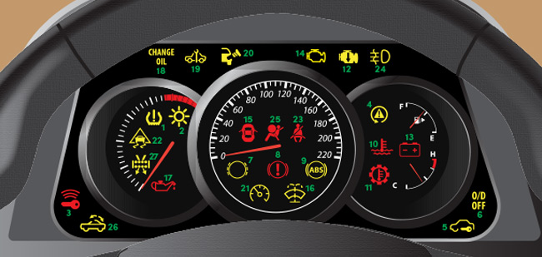
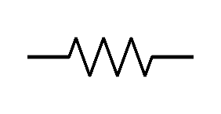
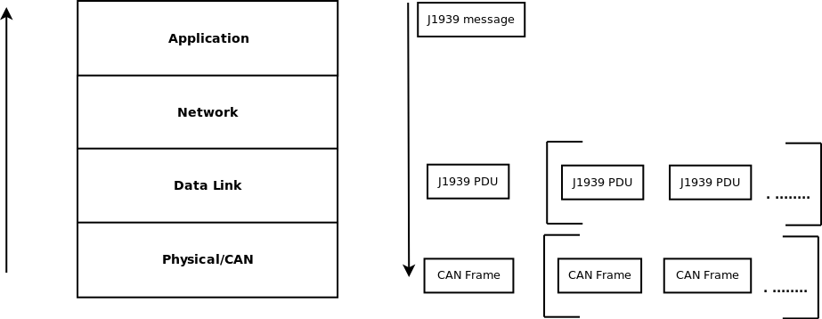
In-Vehicular Communications
Messages composed at the Application layer.
Contain state information
RPM, ambient temperature, brakes pressed etc.
Transmitted as sequence of bits on the CAN bus
Bundled into J1939 PDU/ CAN Frame
ECUs receive, interpret and use messages
Eg. RPM displayed on the dash
Engine
Instrument
Cluster
Cab Controller

Slide 4
J1939 Message Interpretation
CAN frame is obtained
start-of-frame and end-of-frame bits are used.
CAN specific bits are removed to obtain a J1939 PDU
PDU has a 29 bit identifier and 64 bits data
Parameter Group Number (PGN) is obtained.
Eg. PGN 64993 from the example above.
Associated Suspect Parameter Numbers (SPNs) are obtained from J1939 Digital Annex.
Eg. SPN 2609, SPN 7853
SPNs bits extracted using Length and Starting bit position
SPNs interpreted using Resolution and Offset.
SPN 2609 [Cab/AC Refrigerant Compressor Outlet Pressure] -> 01100100₂*16₁₀ + 0₁₀ -> 100*16 -> 1600 kPa.

Slide 5
Attacks in a Nutshell [J1939 specific and CAN->J1939]
Reconnaissance
Interpret protocol workflow
Already public for J1939
Interpret triggers
An ECUs response to a particular command
Interpret proprietary information
Very little to infer
Personal Information
Phone numbers, destination etc.
ECU diagnostics
Firmware info, fault codes etc.
Signature IDS
Overload bus
Inject string of 0’s.
Overload ECU
Exhaust buffer with requests.
Disrupt protocol
Claim all connections to prevent multi-packet message transfer.
Changing message on the fly is difficult due to timing constraints.
Spurious messages can be injected
Snoop in and alter protocol workflow. Eg.
Alter message size in buffer allocation message.
Hijack address claim to masquerade ECU.
Command ECUs
Eg. Command high RPM to an ECU.
Spoofing dash values.

Slide 6
Signature-based IDS for J1939-based Systems : Pros and Cons
Pros
Speed of detection
In-vehicular IDS has real-time requirements.
Less distraction for drivers
False positive rate is expected to significantly lower.
Ahead of anomaly or specification based detection
Detecting those attacks which abide by all specifications.
Significantly lower false-positive rates
Cons
Sig-database needs to be updated.
If database is public, it needs to sync with in-vehicle detection unit.
0-day detection will fail
Newer DOS techniques might succeed.
Early research on CAN security have advised against it
Mutter (2009), Hoppe(2008)
Situation is still almost the same.

Slide 7
The Challenges
How does Mr. SigIDS know what to look for?
Need rules. Eg.
Look for a string of 64 0’s in a packet.
Look for a bad packet size after connection initiation.
How does Mr. SigIDS interpret a rule?
Need a formal language.
Binary operators:- AND, OR
Standard terminology and constructs.
Regex based filtering maybe!!
Addressing packet level details:- ID, PGN, SPN etc.
Need to be stateful
If connection init was seen, and buffer size was agreed upon, new buffer size < original buffer size is buffer-overflow ATTACK!!.
Where does Mr. SigIDS find the signatures?
Publicly accessible signature database
Pen J1939 [ACM CCS’17]
How does Mr. SigIDS execute rules?
Sniffing engine
Signature Engine
Where should Mr. SigIDS be deployed?
Signature Database
PENJ1939
Send Connect
Send Decreased Message Size in ACK
…..
Your Friendly Neighbourhood
Mr. SigIDS

Slide 8
Presentation Outline
Is there an existing technology which does something similar in the CAN domain?
No.
How about the IP domain?
SNORT, in the IP domain
Can we customize SNORT to fit the CAN domain?
What does CAN specification-based IDS literature suggest?
Can we use some terminologies as primitives?
Eg. msg.transmission_rate > 100ms
Can we use some operators these authors have used/introduced?
Eg. ∀msg[ msg∈connection ⋀ buf_size>100]
What about time-based ordering for stateful detection?
Noah
I

Slide 9
Snort: IDS/IPS for TCP, UDP, ICMP, and IP
Detection rules in Snort form a flexible language, generically of the form:
action proto src_ip src_port direction dst_ip dst_port (options)
Where action can activate another rule, drop-and-log the suspect packet, send an email alert to an administrator, or anything else – it can even run other programs if necessary.
Options are additional filters, allowing for finer-grained control over which packets do or don’t trigger actions.
Notes:
Protocols are listed in the title, ports don’t legally apply to IP rules, direction is either -> or <> (one-way or bidirectional. Bidirectional rules are a shorthand for simply duplicating the rule with source and destination addresses swapped.) Image from snort.org

Slide 10
So what does an actual Snort rule look like?
alert tcp any any -> any any (msg:”Sample alert”;)
Sends an alert on any tcp packet.
alert tcp $EXTERNAL_NET any -> 129.82.0.0/16 80 (msg:”Sample alert”;)
Sends an alert on any tcp packet sent from an address matching the variable $EXTERNAL_NET to CSU on port 80
Rules are capable of even more flexibility with actions which wake up other rules!
Notes:
From http://www.vorant.com/files/EZ_Snort_Rules.pdf http://cybernations.wikia.com/wiki/War_Pigs

Slide 11
Dynamic rules? Yes! One rule can wake up another!
activate tcp any any -> 192.168.1.21 22 (content:"/bin/sh"; activates:1; \
msg:"Possible SSH buffer overflow"; )
dynamic tcp any any -> 192.168.1.21 22 (activated_by:1; count:100;)
This pair of rules would start recording packets after a packet with payload containing the string “/bin/sh” was sent to address 192.168.1.21 on port 22.
Notes:
Rules from http://archive.oreilly.com/pub/h/1393

Slide 12
Ok, but how does Snort filter against packet bodies?
The simplest and fastest way is with a rule that has a ‘content’ option. There are several modifier keywords for the content option, including:
rawbytes (compare against the binary packet content without decoding)
nocase (compare against packet contents without regard for case)
offset (specify where in the packet body to start searching)
within (specify a distance from a previous match to continue inspection)
Slower approaches include the perl-compatible regex matcher or even comparing hashed contents of packets.

Slide 13
Snort Rule Quirks
Syntax checking is complicated. Other tools exist for verifying the validity of a ruleset, like dumbpig: https://github.com/leonward/dumbpig
Rules can include (Perl-compatible) regex-based packet matching with the ‘pcre’ option, allowing extremely precise filtering of payloads
Rule order matters: a packet is matched down the list, one rule at a time, until Snort finds a rule saying what to do with THIS packet. Rules are ordered (by default) in the sequence ‘Alert, Pass, Log’, which is to say that Alert rules are checked before Pass rules, which are in turn checked before Log rules.
Usually, rule lists are obtained from a third party because it’s easy to write a bad Pass rule. Rules need to be specific! Find the truffles amid the traffic.
Notes:
http://www.gingerandnutmeg.com/wp-content/gallery/other-european-photos/img_1460.jpg

Slide 14
But trucks don’t use TCP, UDP, ICMP, and IP!
Snort is open source, and the IP rule engine could reasonably be adapted to the CAN protocol, while TCP or UDP could be adapted to higher-level layers of the protocol stack, depending on the need to preserve state.
Significantly, Snort is capable of tracking TCP state with the ‘flowbits’ rule option:
flowbits:<keyword>[bits/bats>],[<GROUP_NAME>]; bits ::= bit[|bits] bats ::= bit[&bats]
https://www.snort.org/faq/readme-flowbits
Notes:
https://i.pinimg.com/originals/03/89/4e/03894e734c69bb9c4371c59e0d7e8159.jpg

Slide 15
Customizing SNORT to Suite J1939-Based Networks
Convert TCP/IP- based keywords and constructs into J1939 standards
Thankfully SAE J1939 protocol stack is modelled on the ISO/OSI 7 layer model.
Need for logical operators and existential quantifiers.
Write complex rules.
Train/Program the SNORT engine to understand the new constructs.
Add a data interpreter module to the SNORT engine
Allows matching to ID constructs:- PGN, Destination Address, Source Address etc. Eg.
activate connection_protocol any -> Engine (content:"PGN:61441"; activates:1; msg:"Possible buffer overflow"; )
Allows matching to Data constructs:- SPN, values Eg.
activate command any -> Engine (content:”SPN_0:3000"; activates:1; msg:"Possible high RPM injection"; )
Include STATEFULNESS, based on previous or upcoming messages
activate request_protocol any -> Engine (content:”SPN_597:01"; previous:”SPN_0:3000” activates:1; msg:"Possible high RPM injection while brakes pressed"; )
Train DUMBPIG to verify rules written for the J1939 based SNORT

Slide 16
Some Efforts in Formally Specifying ECU Operation Standards
“An Approach to Specification-based Attack Detection for In-Vehicle Networks” Larson, Nilsson, Johnsson (2008 IEEE)
∀msg [ msg ∈ SYNC.request ⇒ CUR.time >= PREV.time + ECU.objdir(1006h)]
Useful on a host based IDS
If messages are identified uniquely (they are in J1939) these constructs can be useful.
Does not address the statefulness property fully
What if we need access to history beyond PREV?
“Using Semantic Technologies to Mine Vehicular Context for Security”, Narayanan, Mittal, Joshi (2016 IEEE)
hasComponent (vehicle, distanceSensor) ⋀ hasStateValue (vehicleSpeed, “high”)........
Not as flexible as above.
Single message based, can be adapted to stateful if messages are buffered.
“Defensing Malicious Attacks of Vehicular Network in Runtime Verification Perspective”, Zhang, Feng, Wang (2016 IEEE)
Suggest using Uppal to design Finite Automata
Can be very useful in maintaining state
Can be computation + space intensive on the detection unit

Slide 17
Deployment Specifics
An extra ECU on the network
Will not hinder ECU response time
Deterrence will be difficult
Host based detection
Possible deterrence
ECU response time might be slower
Fleet management
Human intervention might not be required for Signature based IDS, so this might be an overkill
Slow
Deterrence will need remote access.

Slide 18
Thoughts??

