Slide 1
Security of Internet-of-Things
KYLE HAEFNER, MAALVIKA BACHANI, JORDAN PETERSON, NOAH CAIN
INDRAKSHI RAY, INDRAJIT RAY
COMPUTER SCIENCE DEPARTMENT
COLORADO STATE UNIVERITY

Slide 2
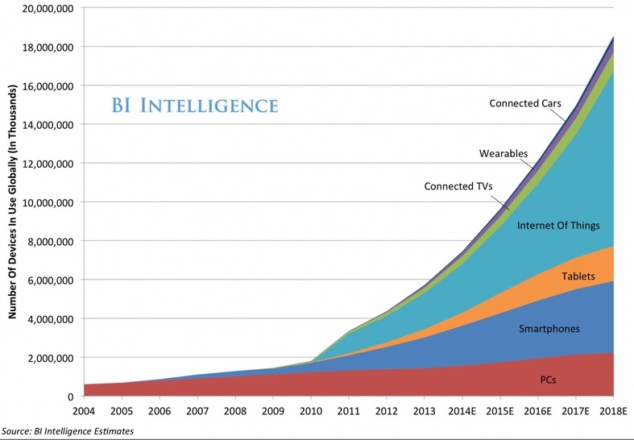
TODAY’S SMART HOME
Number of devices in a typical home is predicted to increase significantly
Home residential network is a flat network where any device can connect to any other device
Home devices usually have unrestricted access to the Internet
Devices are heterogeneous with respect to computation, communication, and storage capabilities and use a variety of heterogeneous protocols
Trends in growth of IoT since 2004
Typical Family Home Could Contain More Than 500 Smart Devices by 2022[1]

Slide 3
WHY NEED SECURE AND STRONG INFRASTRUCTURE
Security with IoT is a big concern
46% of the researchers say that IoT has the potential to become a risk on their network
IoT devices are often constrained w.r.t computation, communication, and storage capability
Manufactures are sacrificing security for performance and cost reduction
Due to diversity in the nature of IoT protocols, there are no common standards followed for communication
We need an infrastructure to address the security needs of a smart home taking into account device and protocol diversity

Slide 4
Secure Internet-of-Things: Projects
Penetration testing of individual devices in smart homes
Access control enforcement in a smart connected home

Slide 5
Penetration Testing

Slide 6
PEN-TESTING: EVALUATING CURRENT SECURITY STANDARDS
Tested the available devices following IP standards
Dlink Camera
Home Lighting system (AwoX)
Musiac Music System
Common Observations
Most of the devices do not use any kind of encryption (they have their web pages in http, if any)
Once credentials are entered, they are sent over the http request using a trivial encoding scheme (base64)
Once the malicious entity is in the network, it can control other devices on the network
light controls, light colors can be easily changed
Control music operation, push any audio(mp3 file) over http post
Using man in the middle attack, the credential and live feed can easily captured

Slide 7
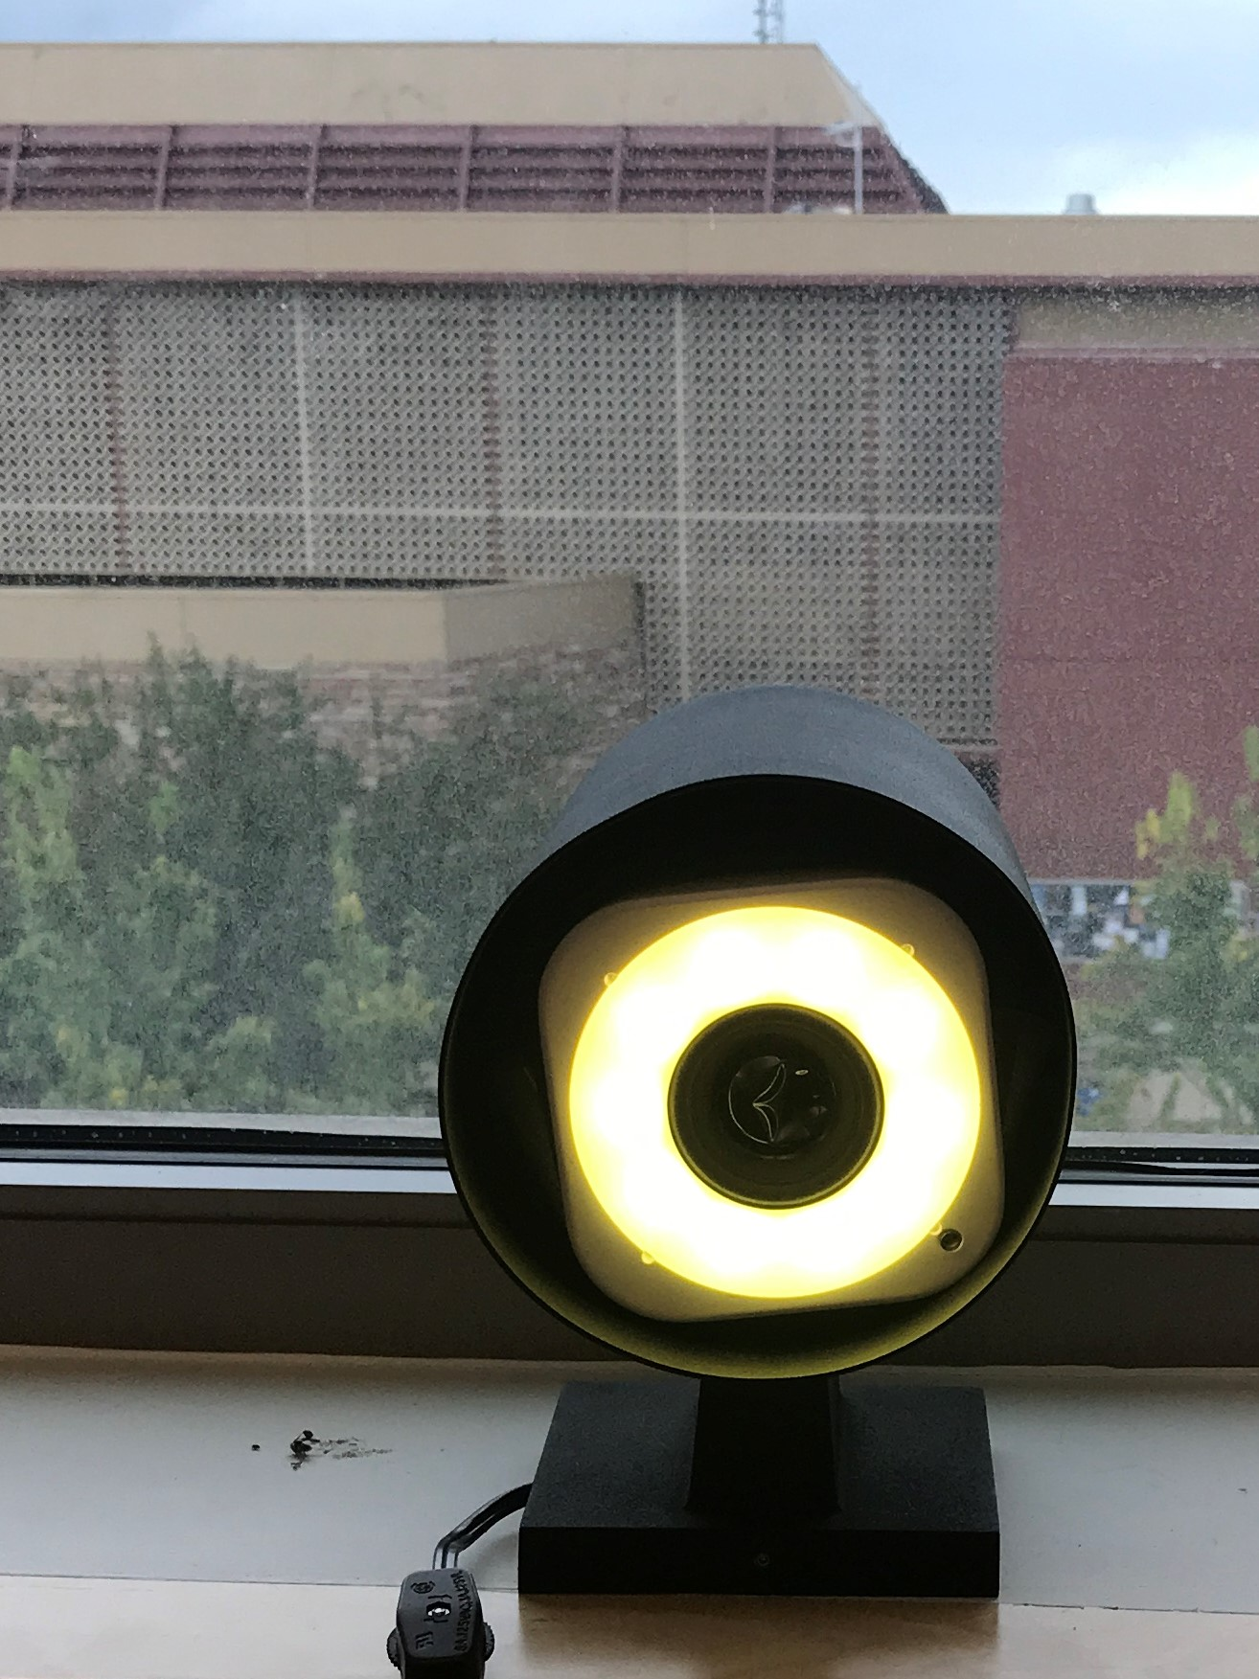
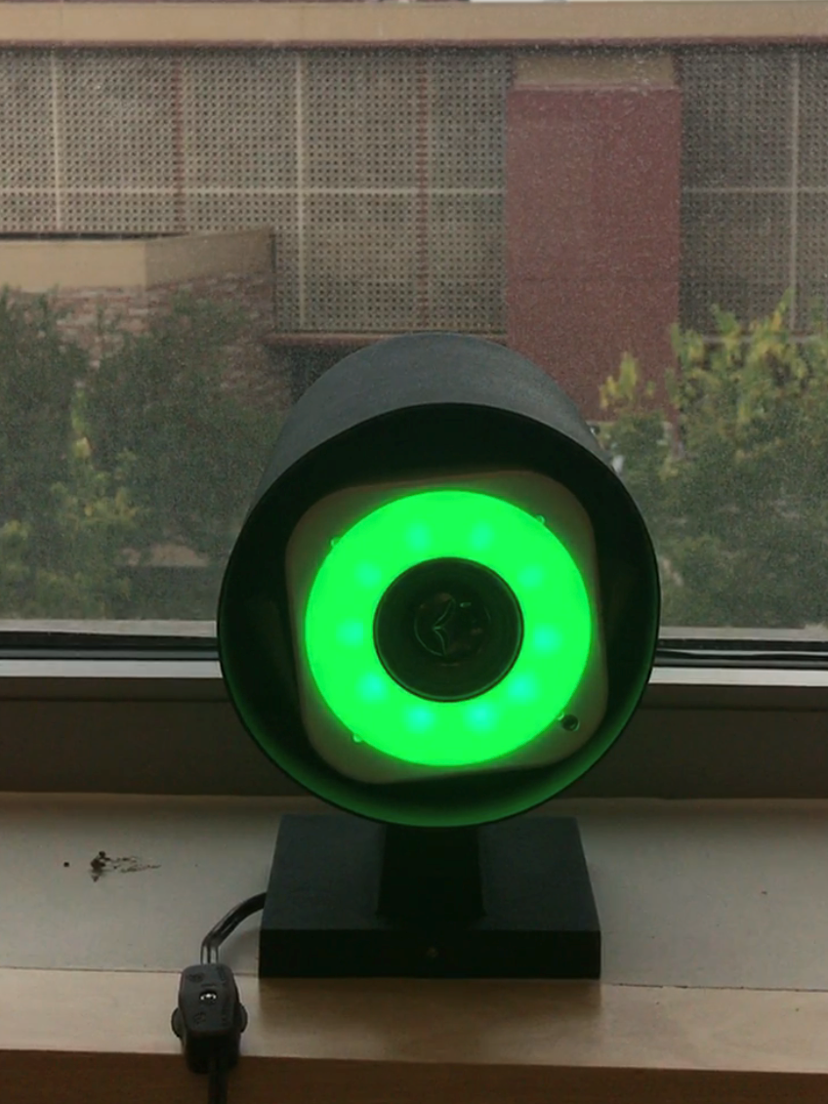
PEN-TESTING: RESULTS
Lighting System Demo
A simple http post request can control the light and sound system
Payload: ‘Content-Type’:’application/x-www-form-urlencoded’ ‘red’:255 ‘green’:200 ‘blue’:0
Python script to toggle the colors of the light
Payload: ‘Content-Type’:’application/x-www-form-urlencoded’ ‘red’:5 ‘green’:255 ‘blue’:5

Slide 8
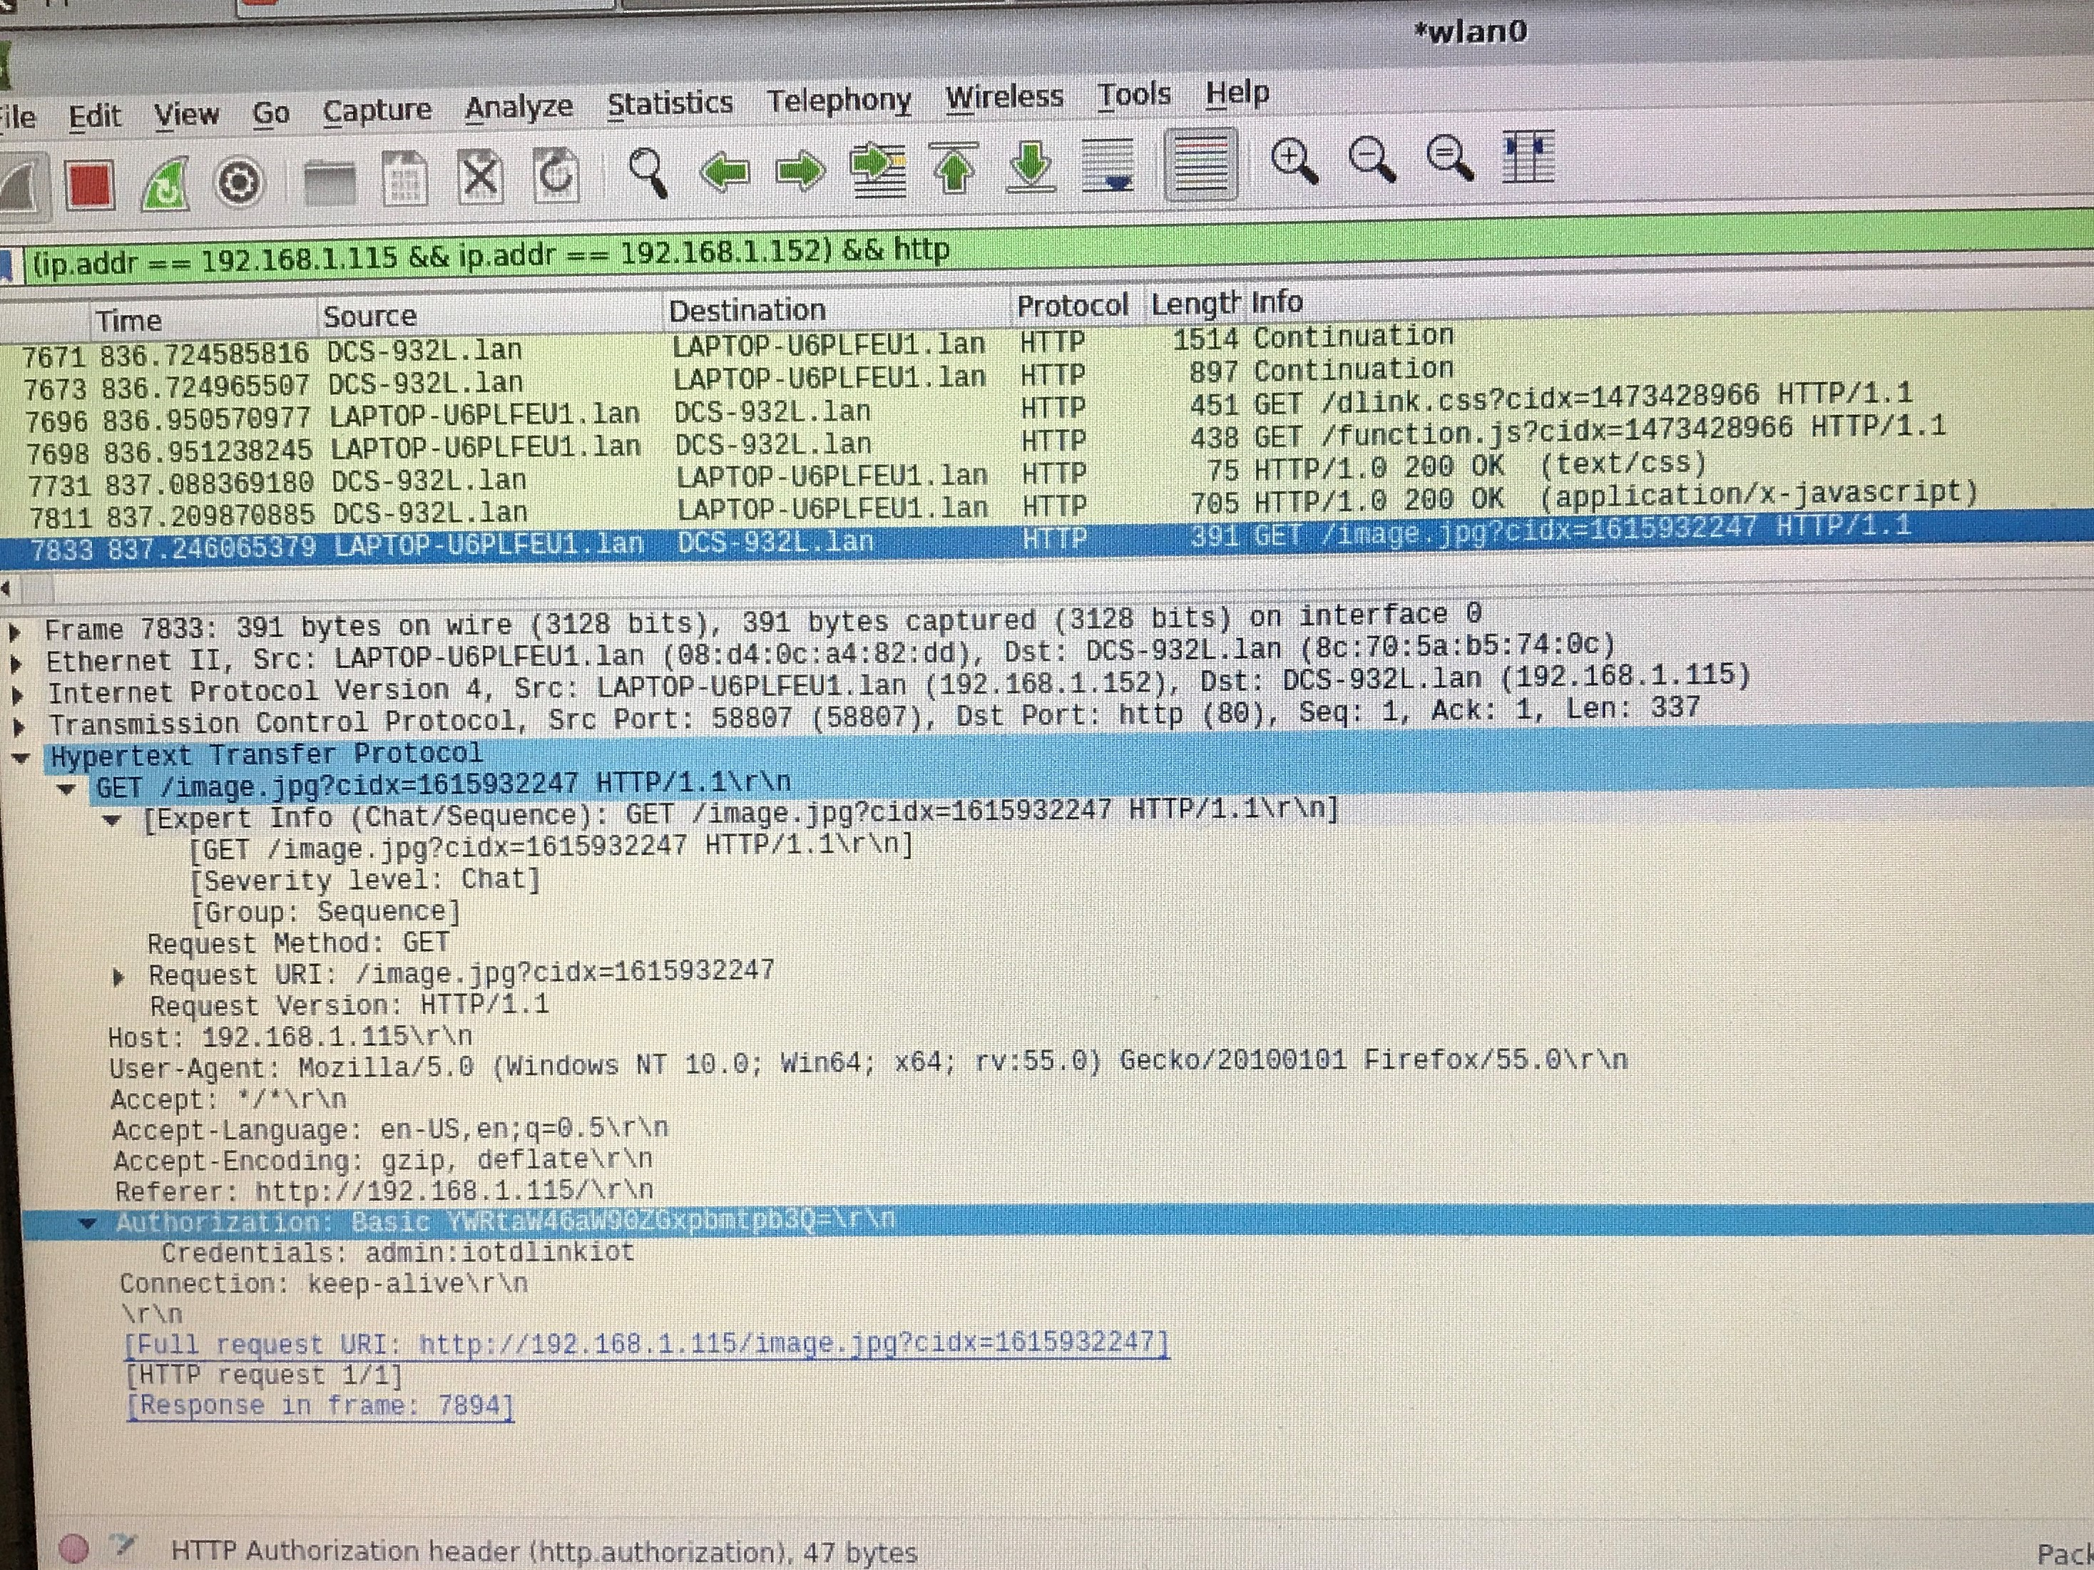
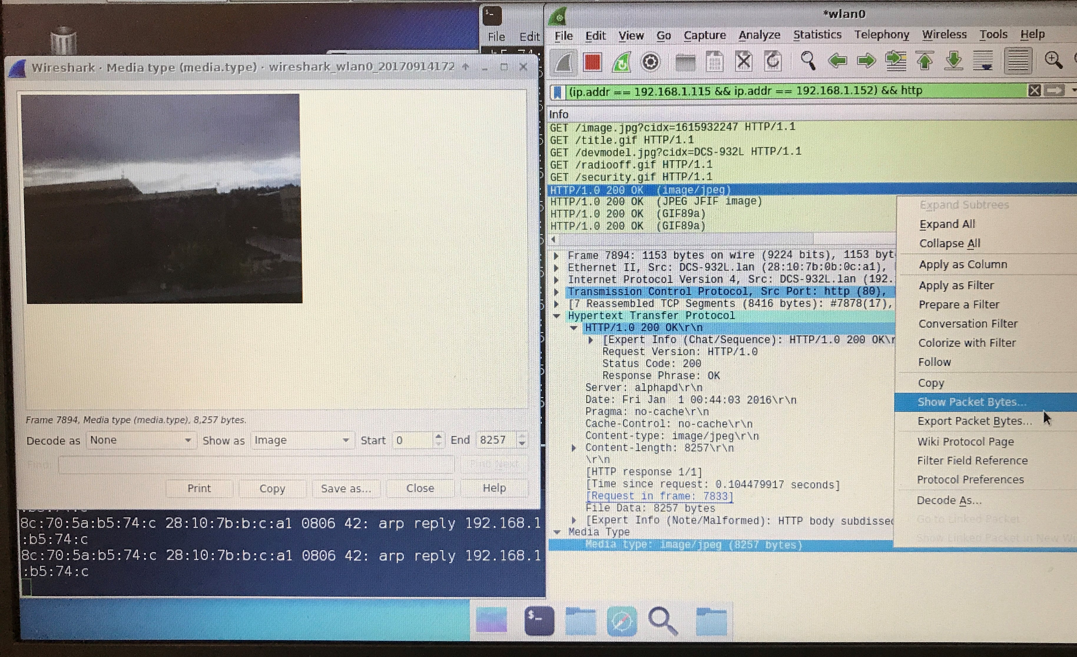
PEN-TESTING: RESULTS
Dlink Camera Demo
A man in the middle attack using arpspoofing can result in tracking all the camera traffic. The two main problem observed in this device were:
Firefox with every tab selection on the admin page sends the admin credentials in the form of http GET request. These credentials are encrypted using a very trivial encoding scheme i.e., (SPECIFY THE SCHEME). This is shown in figure 1
The screen captures are sent without any encryption as a part of http GET
PASSWORD: iotdlinkiot
Figure 1: Admin credentials revealed
Figure 2: Live feed captured on Wireshark

Slide 9
Access Control

Slide 10
SECURING SMART HOME USING MICRO SEGMENTATION AND TRUST ZONE
Why Micro Segmentation?
Home network is a flat network
No infrastructure security; have to rely on security of the device
“Drone hacks room full of smart light bulbs, from outside the window” – The Verge
“The team demonstrated the threat by infecting a Hue lamp with a virus that then spread by jumping from one lamp to its neighbors, whether the lights were on the same private network or not.”
Hence, we need a to divide the network into segments where devices communicate on “Need to Know basis”. Even if a device is affected in one zone, the attack should not penetrate to other zones
What does Trust Zones signify?
Virtual area within the network occupied by devices having similar functionality
We need some level of isolation
Segregate high risk devices from low risk devices

Slide 11
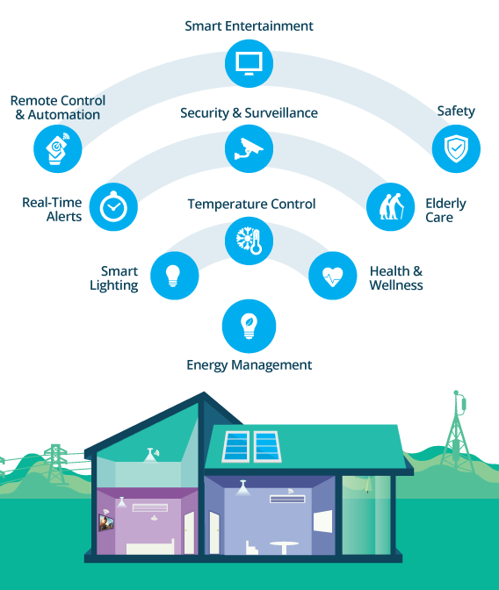
APPROACH
Micro-Segmentation
Segregate devices into various zones based on their primary function
Security, Entertainment, Automation, Health, Consumer Comfort
Devices are assigned to trusted or un-trusted zone based on the trust score
This trust score is based on their profile on the network and known vulnerabilities (CVE)
Establish Device Profile
Based on device identity
Knowledge - What do we know about the device
Device’s primary function
Security, Home Automation, Entertainment, Health
Device Attributes
Patch level, Encryption, Public Certificate
Experience
Past behavior on the network
Notes:
Trust Model: Strategy for Risk Management

Slide 12
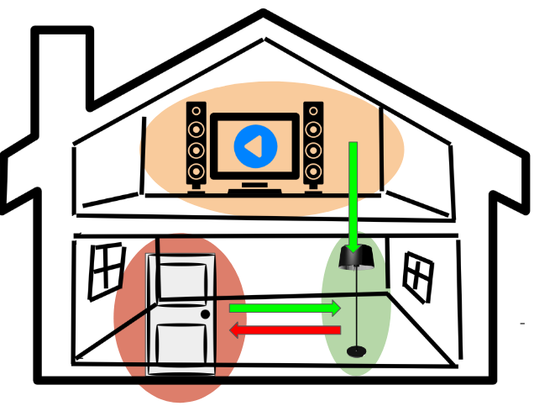
APPROACH
Static Attributes
OpenVswitch, RYU Controller
Match on VLAN ID
Source Destination Address
Packet size and frequency
Dynamic Attributes
Established by a Learning Module
Apply machine learning to communication flows
For example, learn how a light bulb behaves on network
Re-iterates the model to adapt to changing device behavior or adding a new device of same type
Apply trust scores based on function, attributes, and historic behavior
Apply rules on flow across domain

Slide 13
Proposed Framework An attribute based approach
Open vSwitch
Policy File
<Subject>
<SubjectMatch
MatchID = xacml:2.0:function:string equal>
<AttributeValue DataType = “XML:schema#string”>
Home-user
</AttributeValue>
<SubjectAttributeDesignator>
Health
</SubjectAttributeDesignator>
</SubjectMatch>
</Subject>
Data from Sensors
Trust Application
(RYU Controller + IoTivity)
Admin Application
Environment Parameter such as Location, State
Device’s Information, Zone Details

Slide 14
Proposed Framework An attribute based approach
Open vSwitch
Policy File
<Subject>
<SubjectMatch
MatchID = xacml:2.0:function:string equal>
<AttributeValue DataType = “XML:schema#string”>
Home-user
</AttributeValue>
<SubjectAttributeDesignator>
Health
</SubjectAttributeDesignator>
</SubjectMatch>
</Subject>
Data from Sensors
Trust Application
(RYU Controller + IoTivity)
Admin Application
Environment Parameter such as Location, State
Device’s Information, Zone Details

Slide 15
Proposed Framework An attribute based approach
Open vSwitch
Policy File
<Subject>
<SubjectMatch
MatchID = xacml:2.0:function:string equal>
<AttributeValue DataType = “XML:schema#string”>
Home-user
</AttributeValue>
<SubjectAttributeDesignator>
Health
</SubjectAttributeDesignator>
</SubjectMatch>
</Subject>
Data from Sensors
Trust Application
(RYU Controller + IoTivity)
Admin Application
Environment Parameter such as Location, State
Device’s Information, Zone Details

Slide 16
Proposed Framework An attribute based approach
Open vSwitch
Policy File
<Subject>
<SubjectMatch
MatchID = xacml:2.0:function:string equal>
<AttributeValue DataType = “XML:schema#string”>
Home-user
</AttributeValue>
<SubjectAttributeDesignator>
Health
</SubjectAttributeDesignator>
</SubjectMatch>
</Subject>
Data from Sensors
Trust Application
(RYU Controller + IoTivity)
Admin Application
Environment Parameter such as Location, State
Device’s Information, Zone Details

Slide 17
Proposed Framework An attribute based approach
Open vSwitch
Policy File
<Subject>
<SubjectMatch
MatchID = xacml:2.0:function:string equal>
<AttributeValue DataType = “XML:schema#string”>
Home-user
</AttributeValue>
<SubjectAttributeDesignator>
Health
</SubjectAttributeDesignator>
</SubjectMatch>
</Subject>
Data from Sensors
Trust Application
(RYU Controller + IoTivity)
Admin Application
Environment Parameter such as Location, State
Device’s Information, Zone Details

Slide 18
Proposed Framework An attribute based approach
Open vSwitch
Policy File
<Subject>
<SubjectMatch
MatchID = xacml:2.0:function:string equal>
<AttributeValue DataType = “XML:schema#string”>
Home-user
</AttributeValue>
<SubjectAttributeDesignator>
Health
</SubjectAttributeDesignator>
</SubjectMatch>
</Subject>
Data from Sensors
Trust Application
(RYU Controller + IoTivity)
Admin Application
Environment Parameter such as Location, State
Device’s Information, Zone Details

Slide 19
Current Progress
Device Fingerprinting and Zoning
Device identity is one of the key component that is needed to evaluate trust level of a device in the home infrastructure
Will enable the automatic zone assignment based on device operation identification
Deploying IoTivity Clients
We need a certain protocol standard to start with to define the device attribute and capabilities
IoTivity Pluggable Server Module creation
Following IoTivity standards, will give a discrete set of device capabilities
There are numerous protocol standards that exists in a smart home
Pluggable component will enable to replace or add other specific model based on protocols

Slide 20
Device Finger Printing
Identify IoT devices on a network with high certainty and automate the procedure
Approach 1: Understand how common fingerprinting is implemented. Tailor existing methodologies to IoT devices
Nmap
Wireshark remote scan
Other fingerprinting software such as Vulnerability Scanner
Observations:
These software probe devices with TCP and UDP packets
compares device responses with a database of known responses
Some assigns an in-depth point system to each response.Then, it displays a confidence percentage alongside a guess of the OS/firmware
Outcome:
Developed a python script to crawl through a local network and scan for active addresses and gather running service data
Script is not able to gather service data for all services, mostly data that services broadcast in headers

Slide 21
Device Finger Printing
Approach 2
Explore other IoT web components that does device identification such a shodan.io. Shodan is a search engine that lets the user find specific types of device connected to the internet using a variety of filters
Observations
shodan.io might be using web crawlers to traverse web accessible ip addresses
Then probes the devices for service information
Stores this data in a database
When a user or developer searches for an address, shodan.io retrieves the data regarding that address from it’s database
Plan of action
Need to set up a web accessible device to scan with shodan.io
Track the device messages in order to gather shodan.io’s messages

Slide 22
Device Finger Printing
Approach 3 (Exploratory): Using machine learning tools, establish device identity and characterize a particular device to a specific type
Will use the data and attributes collected from Approach 1 and Approach 2
Extract IP header Information such Source and Destination Address, TTL
Track Packet Size, Packet Sequence, Packet Frequency
Trying to identify the attributes that uniquely characterizes a device
Build a classifier, depending on the attributes for a device category
When a new device is discovered, using our model we will attempt to identify it and place it into a class

Slide 23
IoTivity Server and Client System
Why IoTivity?
We need to establish some standards for communication
Most of the IoT hardware companies such as Samsung, Intel, etc. are a part of it
IoTivity is an emerging standard.
We have set up IoTivity on Particle Photons, Raspberry Pi Zero and Intel Edision board with IoTivity’s Fridge Clients, Garage Clients etc. running on it
Developed a server application, that sends coap:// and coaps:// request to the IoTivity Device and fetches the resources
We are working on categorizing the resources extracted from the device

Slide 24
Future Challenges
Device finger-printing
Vulnerability testing for the devices
Define and regulate inter-zone and intra-zone communication
Address communication issues for device that belong to more than one zone
Design machine learning mechanisms to identify a safe change in device behavior from a malicious behavior

Slide 25
Thank you! Any questions

