Slide 1
A Precedence Graph-Based Approach to Detect Message Injection Attacks in J1939-Based Networks
Subhojeet Mukherjee, Jacob Walker, Indrakshi Ray
Colorado State University
Jeremy Daily
University of Tulsa

Slide 2


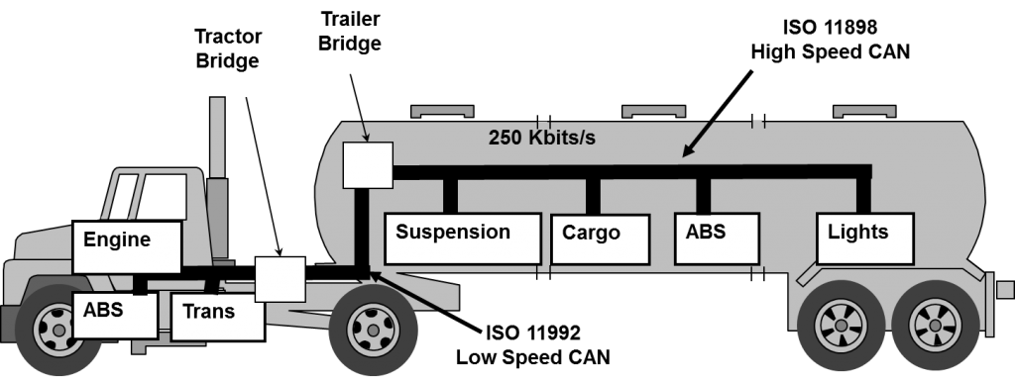
The Issue at Hand
Embedded devices control driving critical operations. (ECUs)
ECUs Communicate over multi-master broadcast CAN bus.
Remote attack surfaces like Bluetooth and telematics unit.
Message injections.
  Commands
    Eg. commanding high RPM to Engine.
  Fuzz test/ Probing
    Does the engine respond to a command?
Detect Intrusions
  Raise alarm
IDS

Slide 3
Challenges
Commands are perfectly legitimate messages.
  Use message frequency or bus load?
    Bursty traffic can be seen during security critical scenario like hard-braking.
  Need a different approach.
False positives are a distraction to the driver.
  Regular driving or safety critical scenario need to flagged as benign.
Real-time detection required
  Malicious injections can cause havoc in quick time.
  Need to minimize the time between injection and flagging.
Readily deployable across
  Different models of commercial vehicles
  Driven in various conditions
  By different drivers.
  Supervised learning algorithms can be difficult to train.
    Huge collection of diverse training dataset required.

Slide 4
This Paper ….
Does
Does not
Present a technique to model message flow on a CAN bus.
  The model reflects driving and engineering aspects of the vehicle.
Suggest two features which can quantify normality/abnormality in message traffic.
Differentiate between benign but abnormal driving behavior and malicious injections.
Detect possible message injections in almost real time.
Introduce a new attack.
Discuss implementation or deployment related aspects of the proposed solution.
Discuss, in details, timing and other overheads typically associated with embedded systems security.
Discuss prevention techniques or reactions, once possible injections have been detected.

Slide 5
Outline of Presentation
Overview of In-Vehicle Communication Technologies [CAN and SAE J1939]
Reports and Report Precedence Graphs (RPG)s
Using Report Precedence Graphs (RPG)s to Characterize Network Intrusions
  Normalized Graph Flux Capacity (NGFC)
  Edge Weight Skewness (EWS)
Detecting Intrusions in Real Time
Analysis and Discussion
Conclusion and Future Work

Slide 6
Table of Contents
Overview of In-Vehicle Communication Technologies [CAN and SAE J1939]
Reports and Report Precedence Graphs (RPG)s
Using Report Precedence Graphs (RPG)s to Characterize Network Intrusions
  Normalized Graph Flux Capacity (NGFC)
  Edge Weight Skewness (EWS)
Detecting Intrusions in Real Time
Analysis and Discussion
Conclusion and Future Work

Slide 7
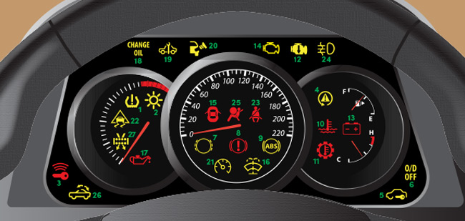

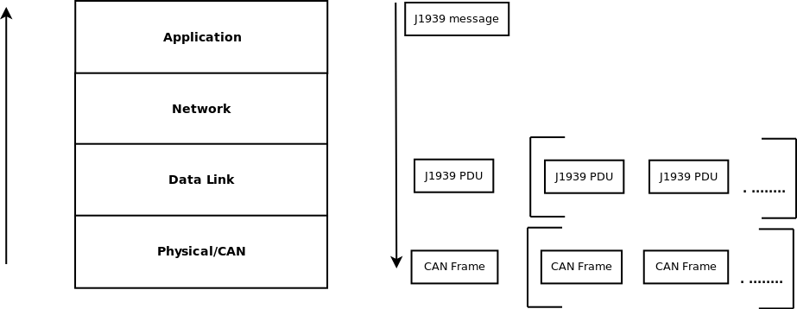
In-Vehicular Communications
Messages composed at the Application layer.
  Contain state information
    RPM, ambient temperature, brakes pressed etc.
Transmitted as sequence of bits on the CAN bus
  Bundled into J1939 PDU/ CAN Frame
ECUs receive, interpret and use messages
  Eg. RPM displayed on the dash
Engine
Instrument
Cluster
Cab Controller

Slide 8
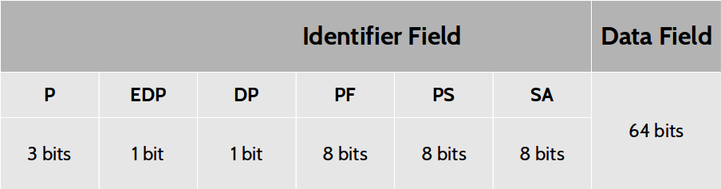

J1939 Message Interpretation
  CAN frame is obtained
    start-of-frame and end-of-frame bits are used.
  CAN specific bits are removed to obtain a J1939 PDU
  PDU has a 29 bit identifier and 64 bits data
  Parameter Group Number (PGN) is obtained.
    Eg. PGN 64993 from the example above.
  Associated Suspect Parameter Numbers (SPNs) are obtained from J1939 Digital Annex.
    Eg. SPN 2609, SPN 7853
  SPNs bits extracted using Length and Starting bit position
  SPNs interpreted using Resolution and Offset.
    SPN 2609 [Cab/AC Refrigerant Compressor Outlet Pressure] -> 01100100₂*16₁₀ + 0₁₀ -> 100*16 -> 1600 kPa.

Slide 9
Table of Contents
Overview of In-Vehicle Communication Technologies [CAN and SAE J1939]
Reports and Report Precedence Graphs (RPG)s
Using Report Precedence Graphs (RPG)s to Characterize Network Intrusions
  Normalized Graph Flux Capacity (NGFC)
  Edge Weight Skewness (EWS)
Detecting Intrusions in Real Time
Analysis and Discussion
Conclusion and Future Work

Slide 10
Reports
sSPN
  Binary values.
  denote states of various vehicular functional parameters.
  Eg. 2 bit SPN 597 has 2² states
    00 : Brakes released
    01 : Brakes depressed
    10 : Reserved
    11 : Error
Example Report
  {(597,00₂,00₂),(598,01₂,00₂)}
  Denotes
    (Brake pedal released, Clutch pedal depressed).

Slide 11
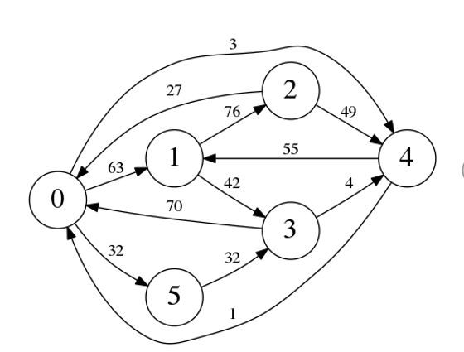
Report Precedence Graphs (RPGs)
Engineering aspects
  61443 < 65265 < 61440.
Driving aspects
  Reports 2, 3, 4, 5 all occur.
  Report 2 is never preceded by 5.

Slide 12
Table of Contents
Overview of In-Vehicle Communication Technologies [CAN and SAE J1939]
Reports and Report Precedence Graphs (RPG)s
Using Report Precedence Graphs (RPG)s to characterize message injections
  Normalized Graph Flux Capacity (NGFC)
  Edge Weight Skewness (EWS)
Detecting Intrusions in Real Time
Analysis and Discussion
Conclusion and Future Work

Slide 13
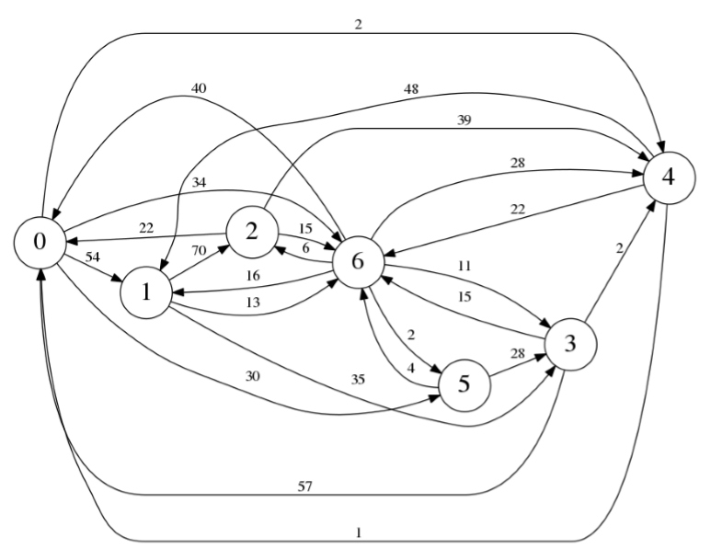
Detect The Injection??
HINT:
  Injections have an inherent randomness associated with them.
  It is difficult for the attacker to predict exact sequence of operations
    If an attack report is preceded by report r_{t1} at time t1 it can be preceded by r_{t2} at t2.

Slide 14
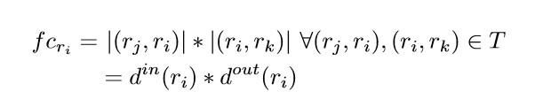

Quantifying the Randomness
Normalized Graph Flux Capacity (NGFC)
Flux Capacity
  Used to denote number of two edge paths passing through a node.
  Denotes a lack adherence to a particular pattern.
  Eg. fc_{r6} = 6*6 = 36
Normalized Graph Flux Capacity
  Denotes the amount of randomness observed in an RPG.
  Eg. 0.12 -> 0.27 after injection.

Slide 15
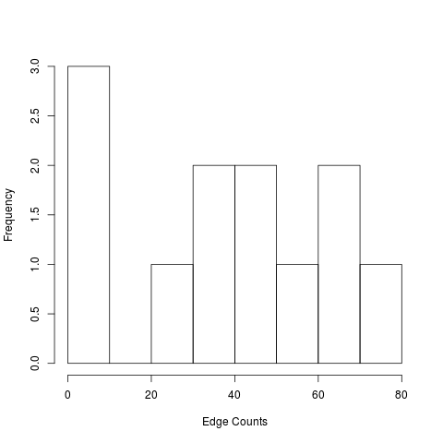
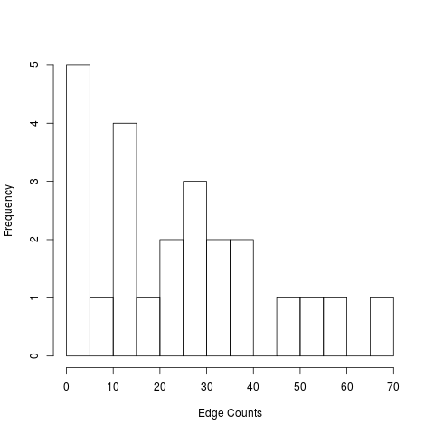
Quantifying the Randomness
Edge Weight Distribution Skewness (EWS)
Under attack, the edge count’s distribution are far more right-skewed.
Normal traffic resulted in a measure of -0.113 whereas attack traffic resulted in 0.745.

Slide 16
Table of Contents
Overview of In-Vehicle Communication Technologies [CAN and SAE J1939]
Reports and Report Precedence Graphs (RPG)s
Using Report Precedence Graphs (RPG)s to characterize message injections
  Normalized Graph Flux Capacity (NGFC)
  Edge Weight Skewness (EWS)
Detecting Intrusions in Real Time
Analysis and Discussion
Conclusion and Future Work

Slide 17
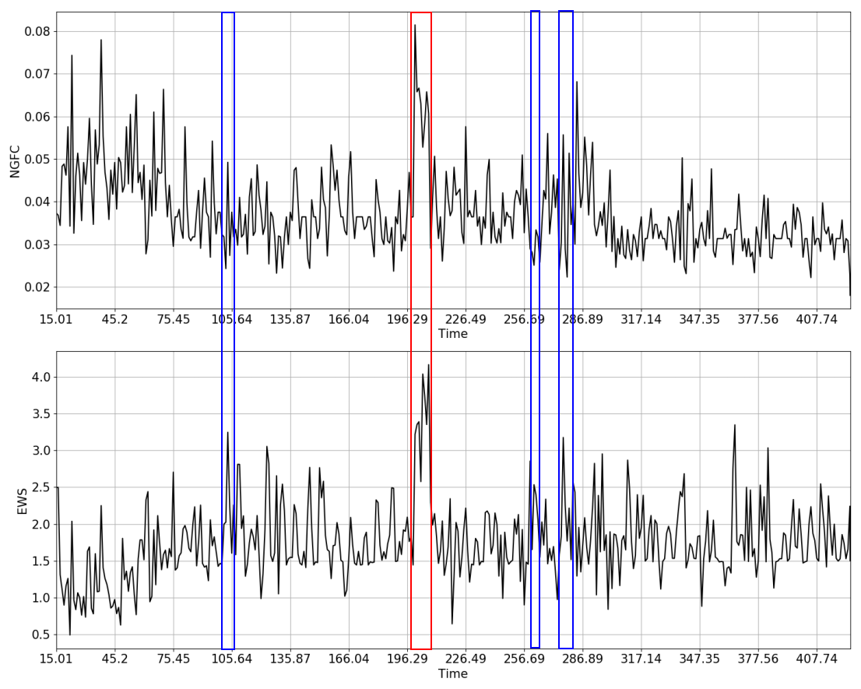
Vehicular Behavior as NGFC and EWS Time Series
Normal Driving
  Both time series fluctuate around a base value, with some small positive peaks
Legitimate Command Injections [Blue box]
  Behavior of ECU injection is programmed, and so does not show significant abruptness.
Malicious Command Injections [Red box]
  Simultaneous abrupt peaks, unnatural behavior leading to random low count precedencies

Slide 18
Time Series Based Detection
Generating RPG in real time from Bus Traffic
Initiate empty RPG
Add new node if a report r is not contained in R
Add edge from current node to new node.
Calculate NGFC and EWS from RPG
Reached
sampling window
Update edge weight

Slide 19
Time Series Based Detection
Detecting Injections
Augmented Dickey-Fuller unit-root test
Simple/Holt’s Exponential Smoothing
Has short trend
Calculate forecast band with/without trend
NGFC and EWS Buffer
……
Moving window of 30 predictor values
Out
Of
Band
Compare NEW NGFC and EWS value with band
No
YES

Slide 20
Table of Contents
Overview of In-Vehicle Communication Technologies [CAN and SAE J1939]
Reports and Report Precedence Graphs (RPG)s
Using Report Precedence Graphs (RPG)s to characterize message injections
  Normalized Graph Flux Capacity (NGFC)
  Edge Weight Skewness (EWS)
Detecting Intrusions in Real Time
Analysis and Discussion
Conclusion and Future Work

Slide 21
Evaluation Preliminaries
Metrics
Dataset
Attack Simulation
Detection Percentage
  Percentage of windows detected.
    Normal Traffic detection percentage (NDI)
    Legitimate Command Injection detection percentage (LDI)
    Malicious Command Injection detection percentage (MDI).
  At least .25 sec of associated traffic in a window.
Precision
  Ability of our approach to avoid false positives.
The Kenworth Dataset
  PACCAR MX powered Kenworth tractor
  410 seconds of drive cycle
  3 hard brakes
  Steady driving
The Peterbilt Dataset
  2008 Peterbilt straight crane truck with a Paccar PX-8 engine
  74 seconds
  1 hard brake
  Erratic driving.
Message with PGN 0 inserted into previously recorded traffic.
  Command to Engine to sustain high RPM
No existing messages overwritten.
Traffic Replayed.
Experiment factors
  Start time
    Begin, Middle, End
  Duration
    1, 7, 15 sec
  Probability
    .1, .5, .9

Slide 22
Results

Slide 23
Summarized Results and Discussion
Attack Detection Percentage
  Inversely related with confidence level
    Less accuracy with increased confidence.
    Fairly High at 80% and 90% confidence levels: around 60%.
    Lower at 99% confidence: prediction band widened to include peaking NGFC and EWS values that are possible attacks.
  Most injection attempts detected at 80 and 90 % confidence
    22 and 21 of 27 attempts for Peterbilt Dataset
    24 and 24 of 27 for Kenworth Dataset
  Similar results on both datasets.
Normal Traffic and Legitimate Traffic Detection
  Extremely low
    Average of less than 1% for normal traffic and 9% percent for legitimate command injection.
  Fairly high values of precision: around 60% on Kenworth and 70% on Peterbilt.
General Performance Upper bounds
  CPU load can be reduced by using dedicated network node for IDS
  Linearly dependent on the size of RPG produced in 1 sec.
    Size depends on number of reports.
    45 and 25 reports seen for Kenworth and Paccar Dataset during entire runtime.
      Expected lower in 1 sec.

Slide 24
Table of Contents
Overview of In-Vehicle Communication Technologies [CAN and SAE J1939]
Reports and Report Precedence Graphs (RPG)s
Using Report Precedence Graphs (RPG)s to characterize message injections
  Normalized Graph Flux Capacity (NGFC)
  Edge Weight Skewness (EWS)
Detecting Intrusions in Real Time
Analysis and Discussion
Conclusion and Future Work

Slide 25
Conclusion and Future Work
Conclusion
Future Work
We proposed precedence graph based, real time IDS for heavy vehicles
Proved efficacy by testing our IDS on real-world data with injected messages
Extend analysis process to ascertain optimum confidence bands for detection procedure
Extend approach to detect other malicious activities
  Message integrity violations
  Attacks at lower layers of J1939 protocol stack

Slide 26
Questions???

