Slide 1
PenJ1939
CSU Heavy Vehicle Security Team

Slide 2
Heavy Vehicle Security
Commercial vehicles use SAE J1939
More susceptible to attacks because of such a common protocol stack
Very similar attack surfaces to passenger vehicles
But attacks are more financially motivated
Timely and effective solutions are needed
https://www.wired.com/2016/08/researchers-hack-big-rig-truck-hijack-accelerator-brakes/
Notes:
Heavy duty vehicles make up 80% of the land transportation of goods in the US, so it makes sense that if the trucks are secure while driving then the goods and driver are as well. But there has been some research done on the security with the computer networks of these heavy duty trucks and it has shown that the common SAE J1939 protocol that truck networks use for internal communication are vulnerable to exploits. Since it is used in most heavy vehicles, J1939 vulnerabilities that affect one truck can most likely cause a similar effect on all others under the same standard. In order to prevent these attacks, effective solutions must be found before any sort of attack should occur.

Slide 3
Testing Environments
Researchers need access to either real trucks or real-world data, but…
No collection of automotive exploits and attack data exist
Commercial trucks are expensive
From $120,000 to $180,000 for newer models
No publicly accessible testbed exists that we know of
Notes:
In order for researchers to arrive at such solutions, they (researchers) need to be able to test their findings on a real truck or use real-world data of known attacks. However, there are no known repositories of attack data, and commercial trucks are expensive, costing about $120,000 to an upwards of $180,000 for models of the year. These are also no known publicly accessible testbeds that we know of.

Slide 4
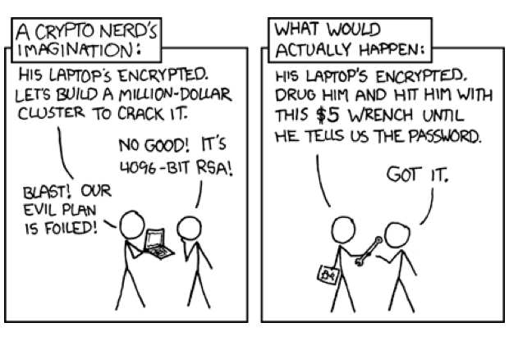
Competing On Security
In other fields, best practice has been to create and adhere to standards
J1939 Standard is lacking in security recommendations
SAE attempting to incorporate more security features into the protocol
Security by obscurity is easily exploited

Slide 5
Our Solution: PenJ1939
PenJ1939:
Vulnerability testing platform that allows users to have access to real hardware.
Exploit database for J1939 protocol and ECU attacks

Slide 6
Features of PenJ1939
Webpage
Simple UI with access to scripting tools, vulnerability database, and user forum
Testbed
Scripting toolbox with live python editor
Database
Database for vulnerabilities and exploits
Sort by product, protocol, etc
Extensive Privacy and Access Controls
Gives manufacturers peace of mind
Allows for responsible and safe disclosure of vulnerabilities

Slide 7
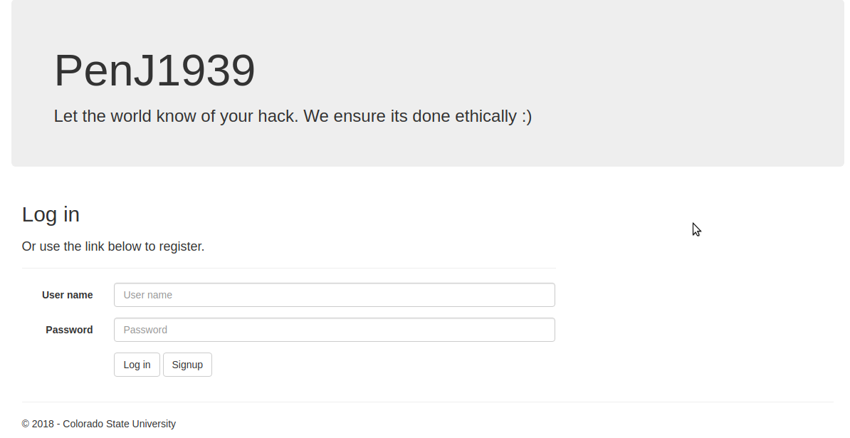
PenJ1939: Web-based User Interface
Access to exploit database
Search scripts and modules
Contribute exploits found
Upload and download scripts
Scripting toolbox
Python interface
Live J1939 traffic
Notes:
Grants verified users access to the Pen1939 database and testbed through a web interface where they can develop scripts, contribute their data, and distribute their findings to other users and stakeholders.

Slide 8
Notes:
Like state before, user must be verified and registered to ensure ethical use of the testbed.

Slide 9
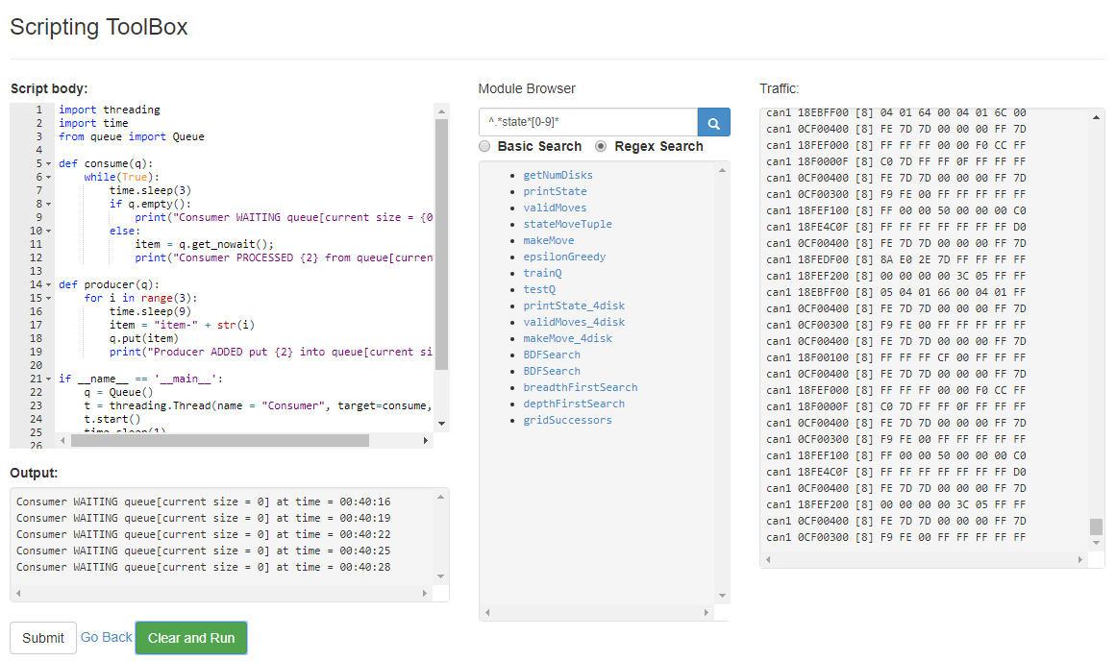
Develop
Framework implemented with Python Development Interface
Script testing
Browse module library
Live J1939 traffic displayed
Notes:
The first feature on the interface is for Development
Attack scripts written in Python,

Slide 10
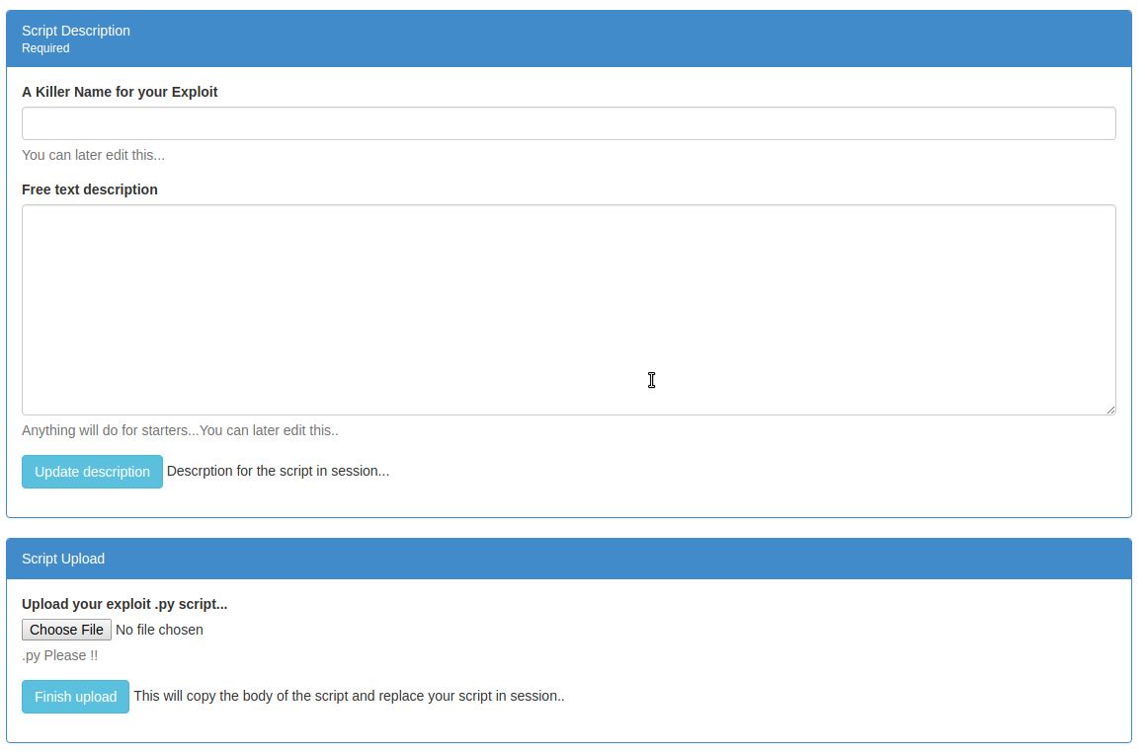
Contribute
Scripts can be uploaded to the database after verification
Annotations for scripts and modules
Notes:
The second feature is Contribution
Scripts with errors are rejected
Annotation for scripts/modules increase visibility [easier for people to find and understand/read]

Slide 11
Distribute
Basic- and Regex-based search on documentation, body and annotation
Accessible developer information
Download other scripts for use with testing and research
Notes:
The third is Distribution
Access to developer information which was collected at registration and login.

Slide 12
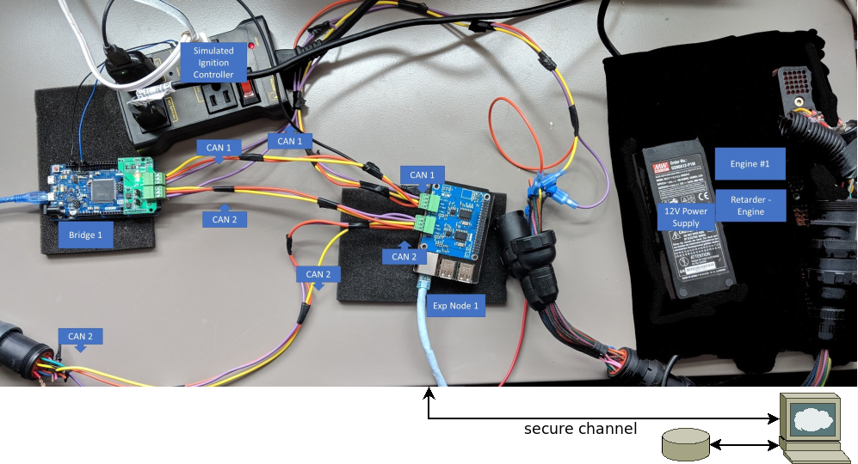
PenJ1939: Testbed Architecture

Slide 13
PenJ1939: Physical Testbed Features
Current Components:
Engine controller
2 CAN backbones
Arduino Bridge
Raspberry Pi Network Interface
Easily expanded
Easily swap broken hardware
Emulate power cycling to ensure repeatable tests

Slide 14
PenJ1939: Database and Access Control
Vulnerabilities
Users can privately submit vulnerabilities to manufacturers
Exploit Scripts
Exploit scripts can be reviewed by peers/manufacturers before being publicly available
Saved CAN bus data
Allows users manufacturers to see real test data of exploits
Component information
Manufacturers can optionally mask proprietary CAN messages as well as other information about testbed components
User information and permissions
User information is safely stored and users are allowed specific access to testbed and database resources based on their role

Slide 15
Future Features
Forum and Reputation system
Allow users and manufacturers to have both public and private forums for vulnerabilities and exploit scripts
Reputation system to encourage users to continue to use system, and generate constructive competition
Recovery
Ability to save state (Adump and load memory from ECUs)
Multiple user sessions on testbed
Possible virtualization of ECU components

Slide 16
Thank you!
What are your questions?

