Slide 1
Real-Time Attack Detection in CPS
PDDLAssistant: An Automation Tool for Attack Graph Construction and Maintenance
Kushagra Tiwary and Indrajit Ray
Department of Computer Science
Colorado State University
Fort Collins, CO-80523

Slide 2
Project Overview
How can we integrate threats across different domains and understand the sequence of events leading to the attack?

Slide 3
Introduction
Attack
Sequence of actions taken by the user and the attacker that can lead to a compromised state in the system
Attack Graphs → Widely accepted computer security situational awareness model
→ Captures cause-effect relationships between system configuration, activities and vulnerabilities
→ Provides semantically rich representation of attacks

Slide 4
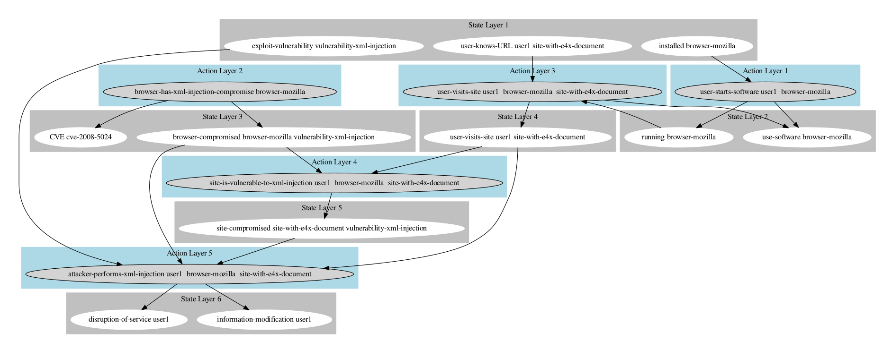
Example of an Attack Graph
PDDLAssistant
Fig: Attack graph for CVE-2010-5024 from the National Vulnerability Database

Slide 5
Motivation
→ In large systems, attack graphs can become very complex and too unwieldy to be manually created or updated
Cause-effect relationships are high in number
Cause-effect relationships can be very intricate
Cause-effect relationships may interfere/interact with each other in unexpected ways
→ Manual creation of attack graphs is error prone and requires considerable domain expertise and skill set
→ There is need for an automated process to generate attack graphs from vulnerability descriptions and event logs

Slide 6
Attack Graph Automation
Problem : Generating attack graph automatically and incrementally updating/refining it
Input : Event logs of attacks or vulnerability descriptions
Output : Attack graphs with meta-data
Advantages
→can save time as well as effort when compared to manual creation
→ can support incremental updates to the attack graph while maintaining consistency of older cause-effect relationships

Slide 7
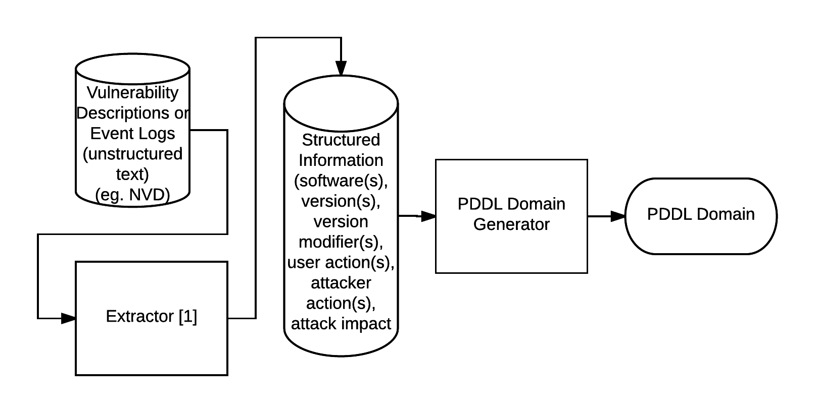
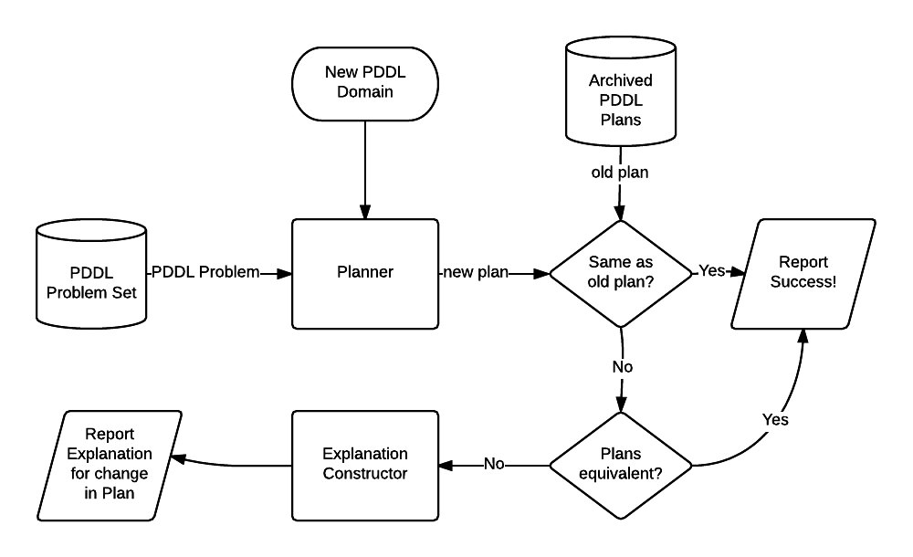
Attack Graph Automation
Generating attack graph automatically
Assisting incremental development of attack graph

Slide 8
PDDL
PDDL: Planning Domain Definition Language [2]
→ Used to represent the “physics” of a domain or the cause-effect relationships in a domain
→ Comprises PDDL domain and PDDL plans
PDDL domain: specifies what actions are possible and what their pre-conditions and effects are
PDDL problem: specifies the initial state and the goal state
PDDL plan: a set of actions from the domain that lead from the initial state to the goal state
An expressive domain-independent language that can be used for modeling attack graphs [3][4][5]

Slide 9
Our Solution : PDDLAssistant
We design and develop a tool PDDLAssistant
Generating attack graphs automatically using text based vulnerability descriptions and/or event logs
Supporting incremental building and/or refinement of the attack graph with feedback
Reason: Event logs or attack descriptions can change, or more attack descriptions may need to be modeled, and therefore, maintaining consistency of the attack graph is challenging
Visualizing attack graphs

Slide 10
Overview of PDDLAssistant
The PDDLAssistant design has the following key steps
Step 1: Information extraction and processing from event/attack logs to generate structured information [1]
Step 2: PDDL domain generation from the structured information → This represents cause-effect relationships
Step 3: We test the PDDL domain using different PDDL problems, which are extracted from the information in event logs
Step 4: We use an AI planner to generate one PDDL plan for each PDDL Problem along with the PDDL Domain → This is the attack graph
Step 5: Feedback/Refinement: When a new PDDL domain is created, PDDLAssistant checks for the consistency of PDDL plans and provides feedback on plans which failed, thus helping the developer maintain the cause-effect relationships

Slide 11
PDDLAssistant
Generating domains automatically using PDDLAssistant:
→ Steps:
Extract meaningful information or structured information from text [1]
Use structured information to generate PDDL domain

Slide 12
PDDLAssistant
Generating domains automatically using PDDLAssistant:
→ Generating PDDL domain:
; CVE-2010-0483: vbscript.dll in VBScript 5.1, 5.6, 5.7, and 5.8 in Microsoft Windows 2000 SP4, XP SP2 and SP3, and Server 2003 SP2, when Internet Explorer is used, allows user-assisted remote attackers to execute arbitrary code by referencing a (1) local pathname, (2) UNC share pathname, or (3) WebDAV server with a crafted .hlp file in the fourth argument (aka helpfile argument) to the MsgBox function, leading to code execution involving winhlp32.exe when the F1 key is pressed, aka "VBScript Help Keypress Vulnerability."
(define (domain attackgraph)
…
(:action user-has-vulnerable-software-CVE-2010-0483
:parameters (?s - software)
:precondition
(and (software ?s) (or (= ?s VBScript) ) (or (= (version ?s) 51) (= (version ?s) 56) (= (version ?s) 57) (= (version ?s) 5.8) (= (version ?s) 2000) (= (version ?s) 2003) (= (version ?s) 2) (= (version ?s) 2) (= (version ?s) 32.0) (= (version ?s) 5.0) ) )
:effect (vulnerable-software ?s))
(:action CVE-2010-0483-user-action-Internet-Explorer-is-used
:parameters (?s - software)
:precondition
(and (software ?s) (vulnerable-software ?s))
:effect (Internet-Explorer-is-used ?s))
… )

Slide 13
PDDLAssistant
PDDL Plan:
0: USER-HAS-VULNERABLE-SOFTWARE-CVE-2010-0483 VBSCRIPT
1: CVE-2010-0483-USER-ACTION-INTERNET-EXPLORER-IS-USED VBSCRIPT
2: CVE-2010-0483-USER-ACTION-THE-F1-KEY-IS-PRESSED VBSCRIPT
3: ATTACKER-ACTION-REFERENCING-A-LRB-1-RRB-LOCAL-PATHNAME-LRB-2-RRB-UNC-SHARE-PATHNAME-OR-LRB-3-RRB-WEBDAV-SERVER-WITH-A-CRAFTED-HLP-FILE-IN-THE-FOURTH-ARGUMENT-LRB-AKA-HELPFILE-ARGUMENT-RRB-TO-THE-MSGBOX-FUNCTION-LEADI-CVE-2010-0483 VBSCRIPT

Slide 14
→ Support for incrementally building plans
PDDLAssistant

Slide 15
PDDLAssistant
→Assumes that there are two versions of the PDDL domain:
(i) last known stable version
(ii) current PDDL domain
→Ensures that the current PDDL domain is consistent with the PDDL problems and plans from the old domain
→Assumes that the PDDL domain, PDDL problem and the plan are syntactically correct
→Reports if one or more PDDL plans failed for the current version (i.e. current version of the domain is not consistent)

Slide 16
PDDLAssistant
Example Output:
$ java -jar PDDLAssistant.jar domains/domainPAG.pddl domains/domainPAGV2.pddl problems/ archivedPlans/
Domains found:
1) domains/domainPAG.pddl: PAG
2) domains/domainPAGV2.pddl: PAG
Problems found:
1) problems/PAG-problem1.pddl: PAG-problem1
Archived plans found:
1) archivedPlans/PAG-problem1.plan
----------------------------------
1) plan: PAG-problem1.pddl
----------------------------------
Creating planning graph for domainPAG.pddl,
PAG-problem1.pddl and PAG-problem1.plan
...done
Creating planning graph for domainPAGV2.pddl,
PAG-problem1.pddl and new plan
...done
plans different? True
...
…
plans different? True
Difference observed:
State Layer 1: same
Action Layer 1: same
State Layer 2: same
Action Layer 2: same
State Layer 3: different!
extra predicates found in action: USER-VISITS-SITE
extra effects:
1) (use-software gmail)
2) (running gmail)
----------------------------------
plans passed: 0
plans failed: 1
----------------------------------

Slide 17
PDDLAssistant: Long Term Goals
→Consolidating attack graphs across all the problem files into a single attack graph
→Formalizing predicates used in the PDDL domain
→Automatically generating predicates using the state of the system to estimate how far/likely an attack is
This would be the first step towards building an intervention system that could suggest an alternative course of action to avoid an attack impact
→Deploying and testing the system on the NIST test bed

Slide 18
PDDLAssistant
Questions?

Slide 19
References
[1] Weerawardhana, Sachini, et al. "Automated Extraction of Vulnerability Information for Home Computer Security." International Symposium on Foundations and Practice of Security. Springer, Cham, 2014.
[2] McDermott, Drew, et al. "PDDL-the planning domain definition language." (1998).
[3] Roberts, Mark, et al. "Personalized vulnerability analysis through automated planning." Working Notes of IJCAI (2011). [4] Boddy, Mark S., et al. "Course of Action Generation for Cyber Security Using Classical Planning." ICAPS. 2005.
[5] Roberts, Mark, et al. "Using planning for a personalized security agent." Workshop on Problem Solving using Classical Planners at 26th AAAI Conf. on Artificial Intelligence. 2012.

