Slide 1
Meltdown
Bruhadeshwar
bru.bezawada@colostate.edu

Slide 2
Motivation
Meltdown is security attack on user data mapped to kernel memory
Meltdown uses out-of-order execution feature of micro-processors to extract kernel data
The attack is independent of OS vulnerabilities
Meltdown is possible through a combination of
Cache side-channel inference
Out-of-order execution
The attack is applicable in almost all processors manufactured after 2010

Slide 3
Background: Instruction Pipelining
Pipelining is an optimization technique to keep the processor busy
Parts of the instruction cycle: Fetch, Decode, Execute Read memory, Write back can be executed independently

Slide 4
Background: Speculative execution
This is the process of executing an instruction in anticipation that it might be used
This provides instruction level parallelism
For instance in a conditional statement, both the instructions in a condition might be executed
Depending on the condition, only one of the execution is retired or committed
The other instruction is flushed from the pipeline
Tomasulo algorithm describes these details

Slide 5
Background: Out-of-order Execution
Multiple instructions executed regardless of the actual program order
lw $3, 100($4) in execution, cache miss
sub $5, $6, $7 can execute during the cache miss
add $2, $3, $4 waits until the miss is satisfied
The instructions are fetched, decoded and prepared for execution and pushed into a reservation station
Those instructions without data dependencies will execute in no specific order
Others will stall until dependency is satisfied (resolving data hazards)

Slide 6
Background: Page Sharing
Sharing of pages across un-trusted processes is common
Computing systems use copy-on-write mechanisms to separate access
More importantly, when shared page is accessed from memory, that page is cached
This allows for side-channel attacks on caches
A spy process can monitor access to a shared page and use timing information as side-channel

Slide 7
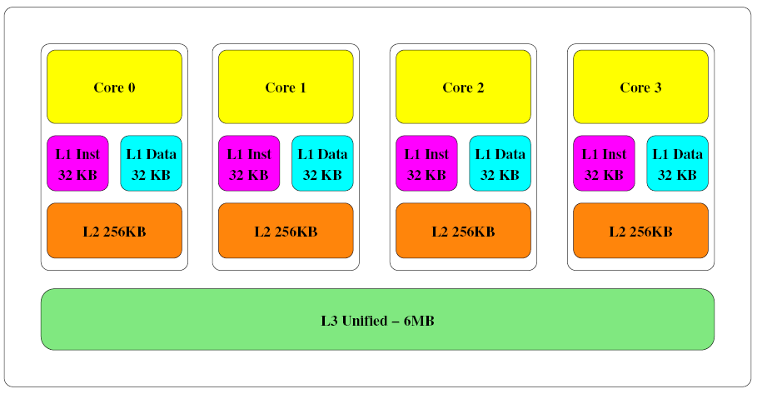
Background: Memory Hierarchy
Intel Core-i5 Memory Architecture

Slide 8
Meltdown Attack
Combination of two steps
Cache side-channel Attack : Flush + Reload
Out-of-order Execution

Slide 9
Cache Side-channel Attack
A spy process evicts the shared page from the cache using clflush instruction
The victim process is allowed to execute some time
The spy process checks if the victim process loaded those pages again
If access to these pages is seen, then the spy makes inferences about the execution sequence
The Flush+Reload is most efficient attack

Slide 10
Flush+Reload
Three steps + a pre-processing mmap step
First: Flush the shared cache line from memory using clflush
Second: Wait for some time
Third: Reload the memory line
If the victim access the memory during waiting period, the page is in cache and will load faster
If not, the loading is done from memory and hence, longer
The timing difference is noted by the spy

Slide 11
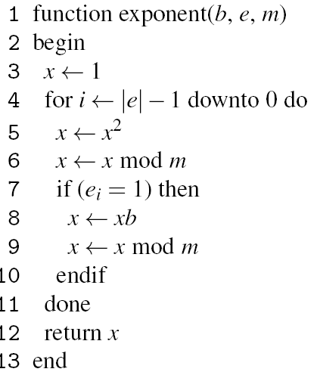
Ex: Extracting RSA Private Keys
Attack Intuition
Exponentiation Algorithm
Exponentiation with square-and-multiply
The message is raised to the power of private key
Depending on bit value the code execution time varies
If key bit is 1 then the if condition is true
Inference: The pages containing square, reduce, multiply, reduce are executed when private key bit is 1

Slide 12
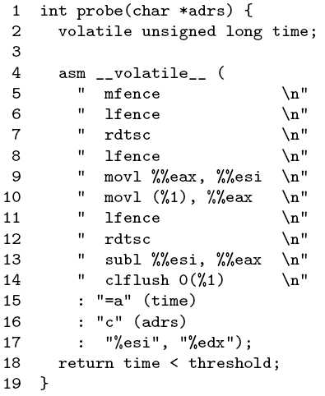
Flush+Reload Attack Code
The code measures the time for loading the page
The clflush keeps removing the monitored pages from memory
The other commands are to ensure that this code executes in-order
The final output is the time taken to load the corresponding page into memory after a waiting period

Slide 13
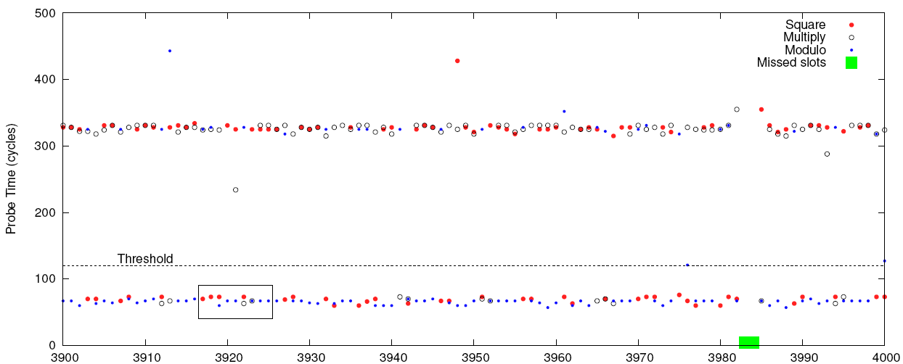
Access Time

Slide 14
Meltdown
User pages are separated using page table addresses in virtual memory
But, entire Physical memory is mapped in the kernel as kernel needs to have access to both kernel pages and user pages
The offsets of kernel code are typically known
ASLR for kernel is KASLR, but not implemented
This is exploited by meltdown
Such instructions are called transient instructions

Slide 15
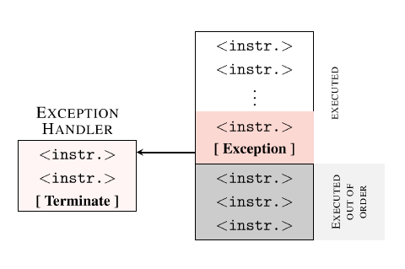
Meltdown
Sample example
Description
Speculative execution executes second line
The array location is accessed and brought into the cache

Slide 16
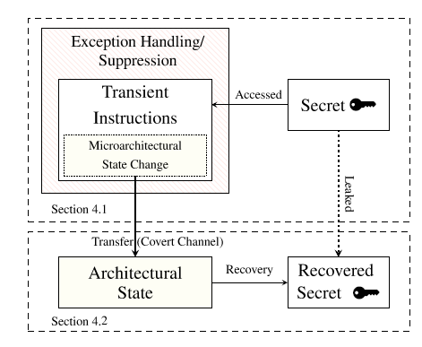
Meltdown : Architecture

Slide 17
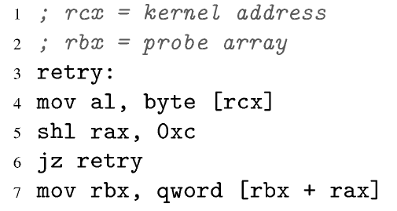
Meltdown : Core Sequence
Line 1 reads an inaccessible address
Should throw an exception but is delayed due to out-of-order execution
Line 4 copies the byte in the kernel address into al
This should not happen but does happen!
The register al is rax
Line 5 multiplies the address with 4096
Line 8 accesses the location pointed by rbx+rax

Slide 18
Meltdown
The location accessed by the code is cached
The attackers uses Flush+Reload to mark the cache access timings
Next, the attacker probes for all the pages in array
Only the cached line will be retrieved faster
The page number of this cache line corresponds to the kernel data
Hence, complete!

Slide 19
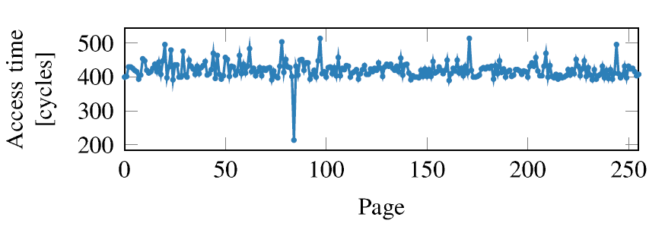
Meltdown : Access Time

Slide 20
Exceptions
What happens to exceptions thrown due to the invalid kernel access?
Can be handled by forking or exception catching

Slide 21
Mitigation
Disable out-of-order execution
Use page access check like AMD
Do not map all user space into kernel
Disable clflush? → other side-channel attacks might be still possible

Slide 22
Summary
Meltdown is a cache side-channel attack affecting nearly every computer
The hardware choices make this attack possible
Open challenges:
How to keep performance high while not allowing such side-channels?
How to discover such side-channels?

