Slide 1
Implementation of Access Control Reference Monitor Security using Moving Target Defense
Athith Amarnath, graduate Student
Database and Security Research Group
Department of Computer Science

Slide 2
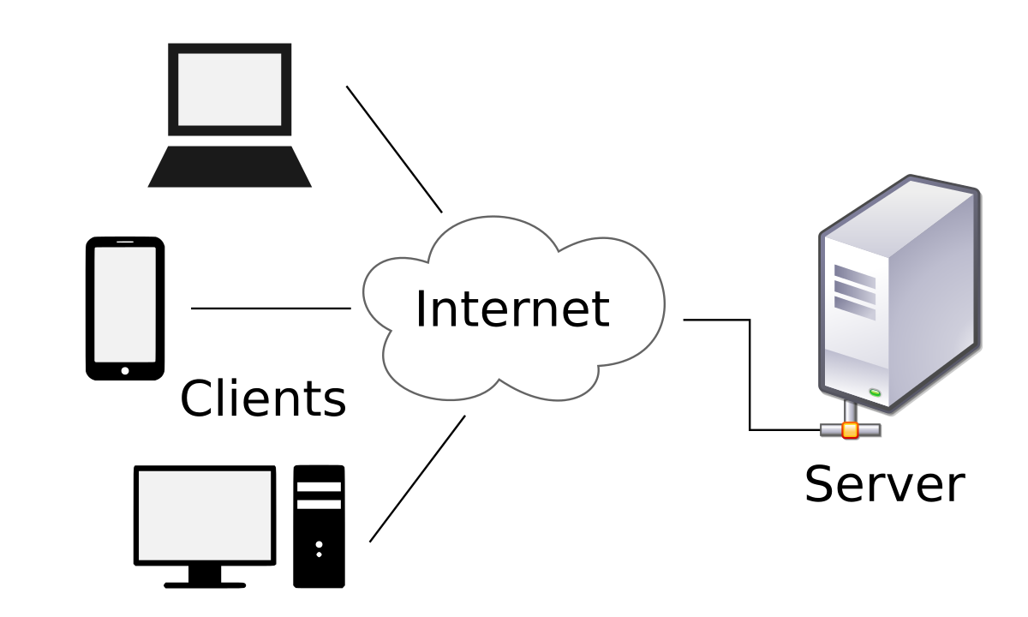
Problem Statement
Security is a very serious concern in this era of digital world
Access Control Enforcement with strong policies that ensures the confidentiality, availability and integrity of data of interest, protecting them is equally important
Access Control Enforcement achieved by trusted computing base assumed to be tamper proof
Difficult to achieve without fully implementing the security kernel in trusted hardware
Single server hosting access control enforcement can be vulnerable
Attacker can eavesdrop, spoof and finally gain access by exploiting vulnerabilities in the system

Slide 3
Proposed Solution – Moving Target Defense
1
2
3
4
Service Location Protocol
L
Implementation of Leader Election Protocol
Extension of Byzantine Fault detection using Consensus Algorithm
Time-Driven and Event- Driven Election strategy
Usage of Selection Location Protocol to locate the leader
Messages signed an verified using Digital Signature Algorithm (DSA)

Slide 4
Moving Target Defense Approach
Group of nodes providing the service instead of a single node
Election Term - a node chosen as a Leader providing Access Control Service for a fixed amount of time
Leader – a node elected using the byzantine consensus algorithm providing service for an election term

Slide 5
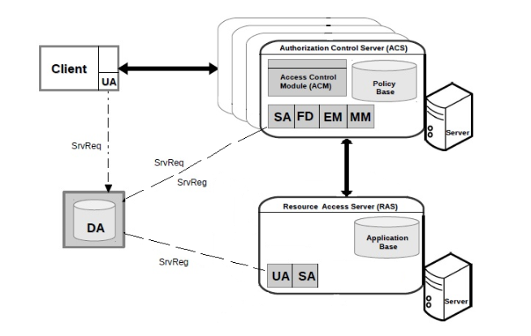
Moving Target Defense Architecture
UA – User Agent
DA – Directory Agent
FD – Fault Detector
EM – Election Module
MM – Migration Module

Slide 6
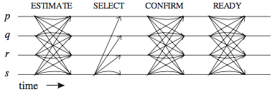
Leader Election Protocol
Coordinator c is given by c = r mod n + 1 where r = number of election term, n = number of nodes
This protocol can work with k byzantine nodes where k = (n – 1) / 3

Slide 7
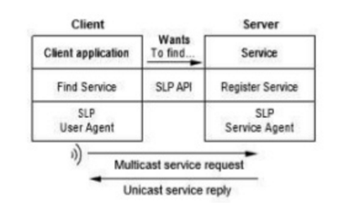
Service Location Protocol

Slide 8
Result
Nodes (n) | No. of Max Faults (k) | No. of LEP messages exchanged | LEP time (s) | Service Registration Time (s) | Access respone time (s) | User Agent Query Time (s)
5 | 1 | 130 | 2.16 | 0.012 | 0.095 | 21.043
8 | 2 | 328 | 3.389 | 0.2 | 0.062 | 24.05
10 | 3 | 510 | 4.261 | 0.034 | 0.074 | 24.054
13 | 4 | 858 | 6.08 | 0.034 | 0.07 | 21.053
15 | 5 | 1140 | 6.473 | 0.056 | 0.057 | 24.055
20 | 6 | 2020 | 8.694 | 0.045 | 0.078 | 24.045
25 | 8 | 3150 | 10.754 | 0.58 | 0.73 | 24.034

Slide 9
Problems with this Approach
Leader Election protocol is Deterministic
Fault Detector detects nodes that deviate from the algorithm or do not follow the message format

