Slide 1
Graph Database to Model Access Control Policies
Rejina Basnet
Dr. Indrakshi Ray

Slide 3
RDBMS: Simple You-tube Model
ChannelId | Channel Name
C1 | Yummy food world
C2 | DIY
C3 | Intro to Programming
C4 | Music
C5 | Vehicle Hacks
C6 | BBC News
C7 | Wildlife
UserId | Channel Id
U1 | C1
U2 | C3
U3 | C7
U1 | C5
ID | User
U1 | John
U2 | Mark
U3 | Rachel
User operates
User
UserId | Channel Id
U1 | C2
U2 | C4
U3 | C4
U3 | C6
Channel
User subscription

Slide 4
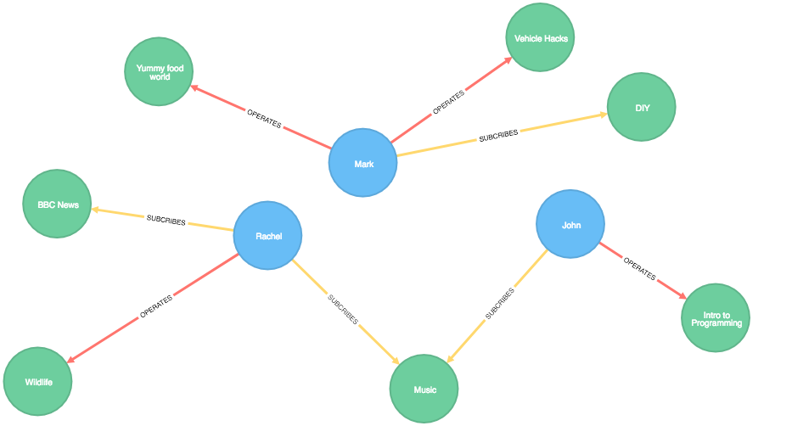
Graph Database: Simple You-tube Model
User
Channel

Slide 5
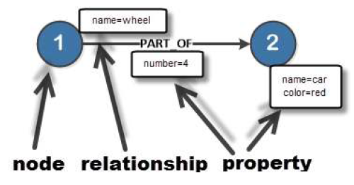
Why Neo4j?
Data model (flexible schema)
ACID properties
Scalability and reliability
Cypher Query Language
Built-in web application
Drivers
Indexing

Slide 6
Performance Evaluation of RDBMS and Graph Database
User: User_id,User_name
Friends: User_id, Friend_id
Fav_movies: User_id, Movie_name
Actors: Movie_name, Actor_name
User
Name
Movie
Name
Fav_movie
Friends
Acted_by
User
Name
Actor
Name

Slide 7
Query Execution Time
S0: Find all friends of Esha
S1:Find favourite movie of Esha
S2: Find the lead actors of Esha’s favourite movie

Slide 8
Performance Evaluation of RDBMS and Graph Database

Slide 9
Is Graph database ready to replace the Relational database??
Requirements of the system should be considered
RDBMS for all other application
Graph Database suitable for dynamic data model, highly connected data
NO
Notes:
Tablular data, constant Schema

Slide 10
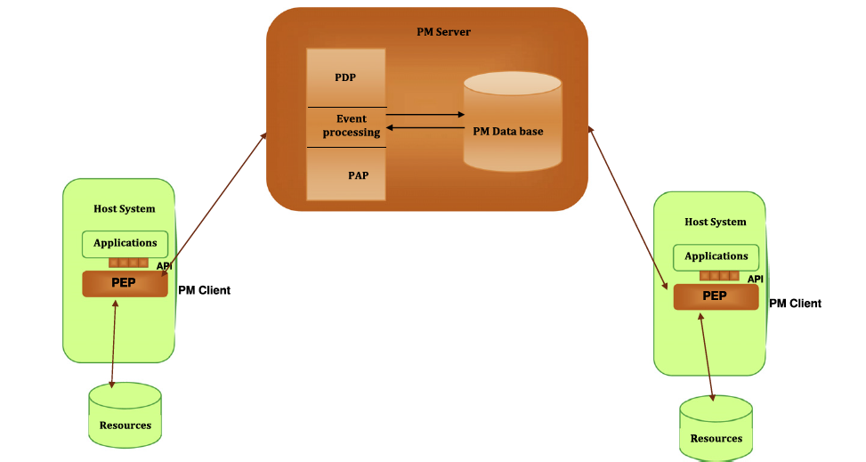
Policy Machine: An access control framework
The System architecture

Slide 11
PM Constructs
PM Basic Elements
PM Relations
User
Processes
Objects
Operations
Access Rights
Policy Classes
User Attribute
Object Attribute
Assignment
Association
Prohibitions
Obligations

Slide 12
Access state is enforced by Reference Mediation
Process Access Request <op,o>_{p}
1
and capability
(op,o)
has not been denied for either u or p.
granted iff
(u, op, o) where u is process_user(p)
2
denies have precedence over privileges
applies an ‘‘and” combination algorithm

Slide 13
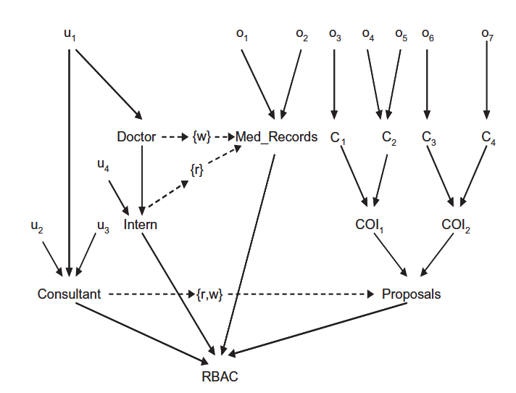
Authorization graph: RBAC specification by PM
Doctor, Intern and consultant are roles
Derived Privileges from the authorization graph
(u1,{r,w},{o1,o2,o3,o4,o5,o6,o7}),
(u2,{r,w},{o3,o4,o5,o6,o7}),
(u3,{r,w},{o3,o4,o5,o6,o7}),
(u4,{r},{o1,o2})

Slide 14
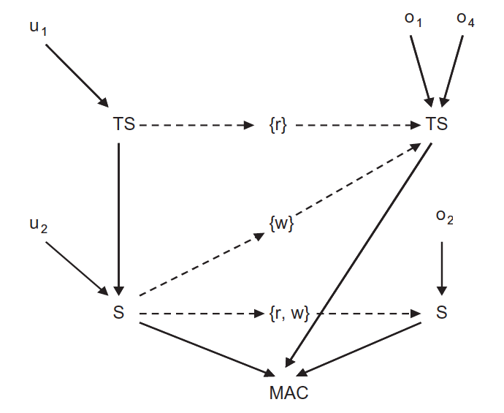
Authorization graph: MAC specification by PM
Derived Privileges from the authorization graph
(u1,{r,w},{o1,o2,o4}),
(u2,{r,w},{o2}),
(u2,{w},{o1}),
(u2,{w},{o4})

Slide 15
(u1,{r,w},{o1,o2,o3,o4,o5,o6,o7})
(u2,{r,w},{o3,o5,o6,o7})
(u2,{w},{o4})
(u3,{r,w},{o3,o5,o6,o7})
(u3,{w},{o4})
Combining Policies RBAC and MAC

Slide 16
Mapping Between Policy Constructs
And
Neo4j
PM Elements | Neo4j Design
User | Node with label User Property exist constraint
User Attributes | Node with label UserAttribute Might or might not have property
Object | Node with label Object Property exist constraint
Object Attributes | Node with label ObjectAttribute Might or might not have property
Policy Class | Node with label Policy Class Might or might not have property
Assignment | Relationship with label Assignment User->UserAttribute, UserAttribute->UserAttribute, Object->ObjectAttribute, ObjectAttribute->ObjectAttribute,UserAttribute->PolicyClass ObjectAttribute->PolicyClass
Association | Relationship with label Association Properties in the form , list of access right with value true
Prohibition | Relationship with label Prohibition Properties in the form , list of access right with value true or false
Obligation | Transaction Event handlers

Slide 17
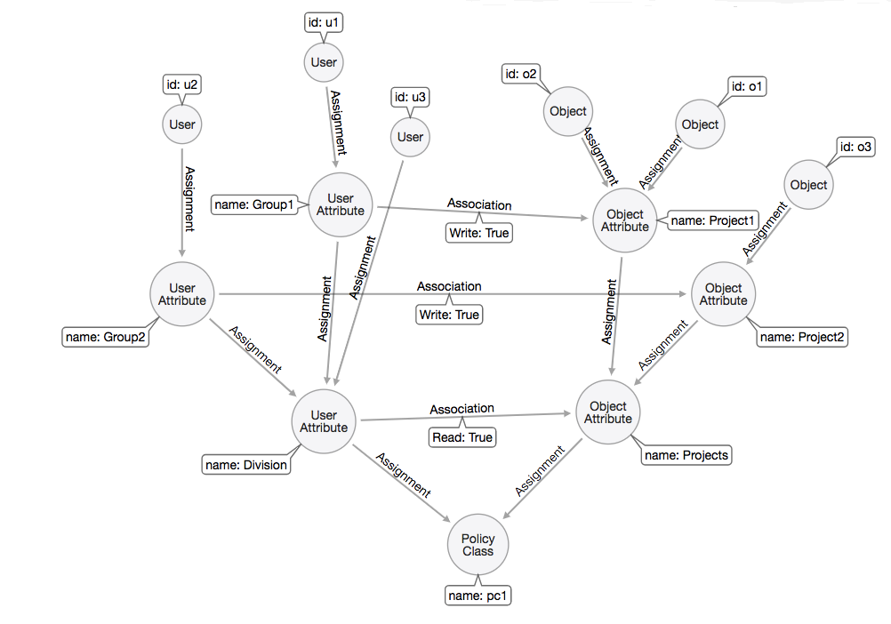
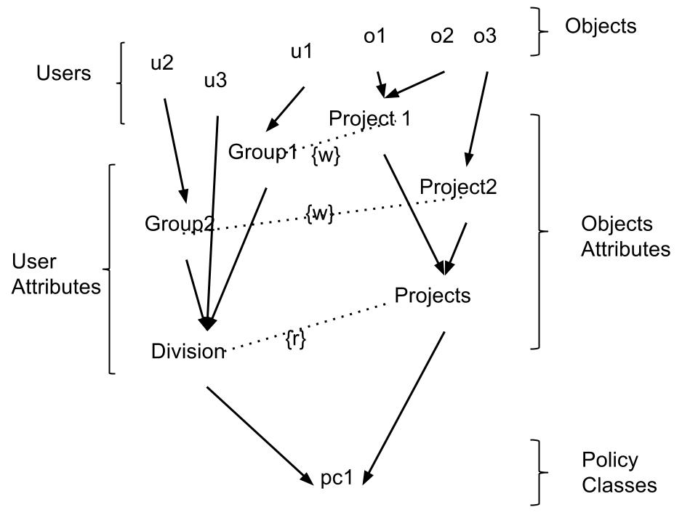
PM policy to Neo4j

Slide 18
Conclusion
Neo4j can effectively represent Polices as specified by policy Machine
1
Can address dynamic changes to policies using transaction event handlers
3
Response time for the access request can be improved
2

Slide 19
Thank you
Any Queries??

