Slide 1
Digital Signatures for DNA
Diptendu Kar, Indrajit Ray
[Computer Science]
In collaboration with: Jenna Gallegos, Jean Peccoud
[Chemical and Biological Engineering]
Colorado State University

Slide 2
The aim of this project is to provide physical significance to digital signatures
But first, a bit of background on biology

Slide 3
Biology 001
Cell: the basic structural, functional, and biological unit of all known living organisms.
Mainly two types
Prokaryotic cells - bacteria, archaea.
No true nucleus.
Eukaryotic cells - plants, animals, fungi, slime moulds, protozoa, and algae.
True nucleus with double membrane
Both type of cell contain DNA.

Slide 4
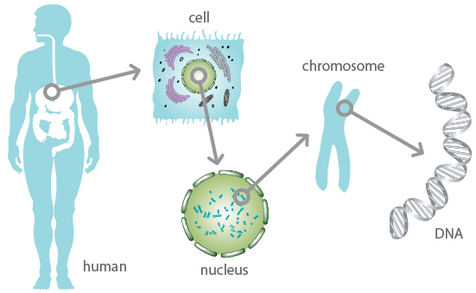
Biology 001
Eukaryotes

Slide 5
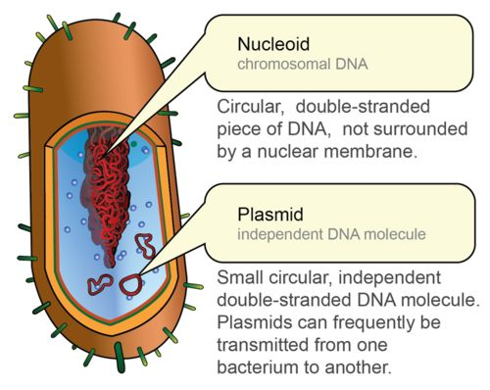
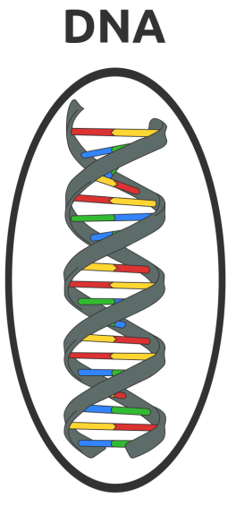
Biology 001
Prokaryotes

Slide 6
Biology 001
DNA, or deoxyribonucleic acid, is the hereditary material in humans and almost all other organisms.
Most DNA is located in the cell nucleus (where it is called nuclear DNA), but a small amount of DNA can also be found in the mitochondria (where it is called mitochondrial DNA).
The information in DNA is stored as a code made up of four chemical bases.
adenine (A), guanine (G), cytosine (C), and thymine (T).
Human DNA consists of about 3 billion bases, and more than 99 percent of those bases are the same in all people.
The order, or sequence, of these bases determines the information available for building and maintaining an organism.

Slide 7
Biology 001
Our project utilizes DNA from plasmids.
Plasmid DNA gives the cell extra characteristics like antibiotic resistance.
Plasmid DNA is interesting :
Can isolate them in large quantities.
Can cut and splice them, adding whatever DNA we choose. (tweak with features)
Can put them back into bacteria, where they'll replicate along with the bacteria's own DNA.
Can isolate them again - getting billions of copies of whatever DNA we inserted into the plasmid!
Plasmid are limited to sizes of 2.5-20 kilo bases (kb), in general.

Slide 8
Done with background !

Slide 9
From physical to digital
DNA is a physical entity. How do we apply digital signatures to a physical entity.
DNA sequences are documented electronically as well.
Also, any digital representation of a DNA can be synthesized into a physical molecule.

Slide 10
From physical to digital

Slide 11
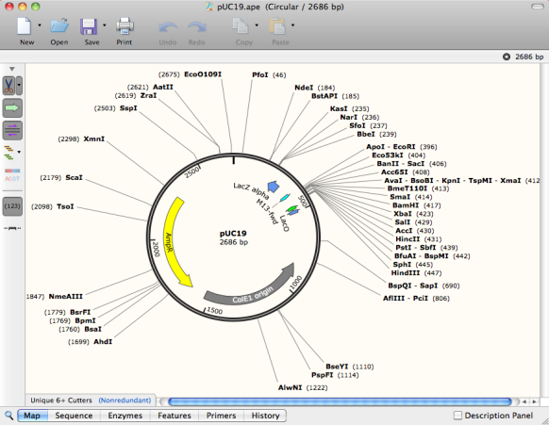
From physical to digital
Digital representation of sequences e.g.
AACATAGGTTAA…..
File formats :
.fasta, .dna, .gb

Slide 12
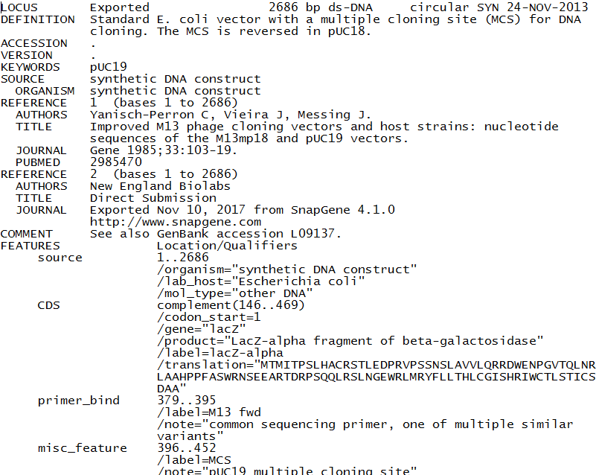
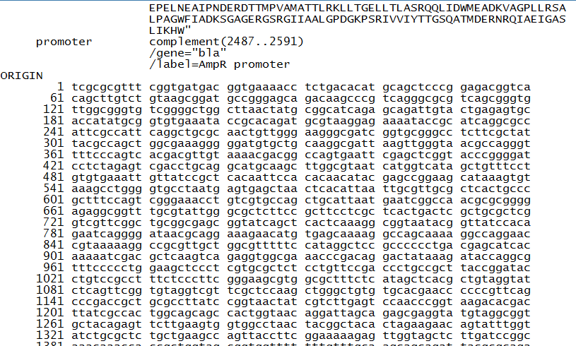
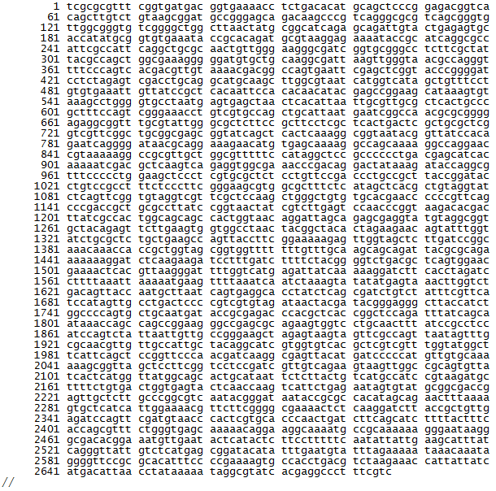
Sample Genbank File

Slide 13
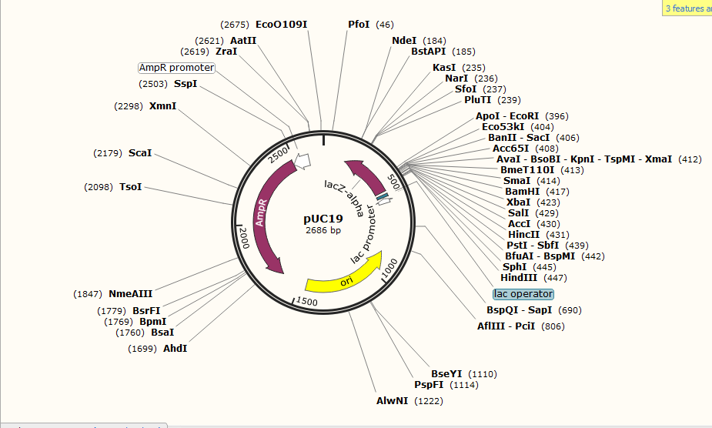
SnapGene View

Slide 14
Time to apply digital signature
Now that we have the digital DNA, we can apply digital signatures.
The message is the sequence – “ACAATGT…..”
We will be using Identity Based Signatures.
Not every lab/person have certificates.
The precise author who worked with the DNA can be determined.
For identity we use ORCID.
Open Researcher and Contributor ID.
16 digit unique identifier – (0123-4454-9876-0143)

Slide 15
Identity Based Signatures
First introduced by Shamir in 1984.
No need to have individual secret keys.
A unique identifier such as email, ORCID etc. acts as a substitute.
A central authority has a public private key pair.
Use the identity to derive a private key.
Sign using derived private key tied to the identity.
Validate using the public key of the central authority.

Slide 16
Identity Based Signatures
Central Authority parameters: <e,d,n>
User submits ID
Gets back - ID^{d} mod n.
Use ID^{d} to sign message.
Use <e,n> to validate.

Slide 17
Simplified Shamir’s Scheme
Shamir’s scheme generates a signature of length 2n for n bit security parameter. (n - 1024, sign - 2048)
We simplified it by removing the random.
Advantage - Signature length = 1024 bits = 512 base pairs. (cannot add large signatures)
Random is not essential in DNA sharing domain.
Same DNA molecule will not be shared twice with someone. (fair assumption)

Slide 18
Simplified Algorithm
User provides ID to central authority.
Gets back ID^{d} mod n.
Signature steps
Hash message (SHA-256)
Sign = (ID^{d}) ^{H(m)} mod n = ID^{d * H(m)} mod n.
Validation Steps
Knows ID and M – Calculate ID^{H(m)} mod n.
(Sign)^{e} mod n = [ID^{d * H(m)}]^{e} mod n = ID^{H(m)} mod n.

Slide 19
Why not Bilinear Pairing?
Hard to implement from scratch.
There exists a library – JPBC (Java Pairing Based Cryptography) from Stanford.
Only one IBS scheme is implemented.
Kenneth G. Paterson and Jacob C. N. Schuldt
Signature Size – 384 bytes = 1536 base pairs (too large)
Issues with molecule stability and functionality.

Slide 20
Signature Generation
User chooses the file to sign, provides ORCID, plasmid ID, start sequence and end sequence.
Convert signature into ACGT sequence.
00 – a, 01 – c, 10 – g, 11-t
Unlike text messages, there is no delimiter to identify which sequence is the signature.
Add two delimiting sequence(start and end).
Chosen by the signer. Universal / rare sequence of 10 bp.
Position of insertion also chosen by signer.
Cannot insert signature at any arbitrary position. There might be features present there.

Slide 21
Embedding signature in DNA
The signers ORCID and plasmid ID is also added with the signature.
Total signature sequence length
10 base pairs for start delimiter.
32 base pairs for 16 digit ORCID.
12 base pairs for 6 digit plasmid ID.
512 base pairs for actual signature.
10 base pairs for end delimiter.
Receiver looks for 556 base pairs within the 2 delimiters during verification.

Slide 22
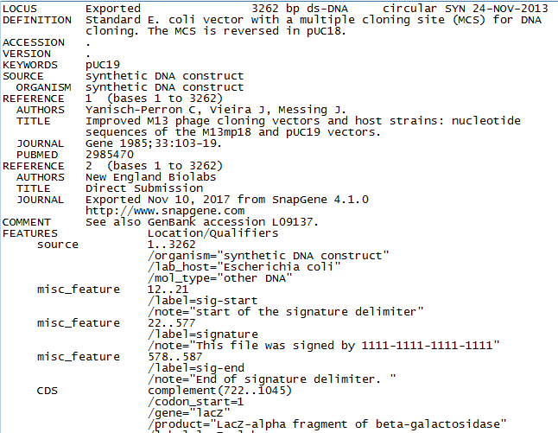
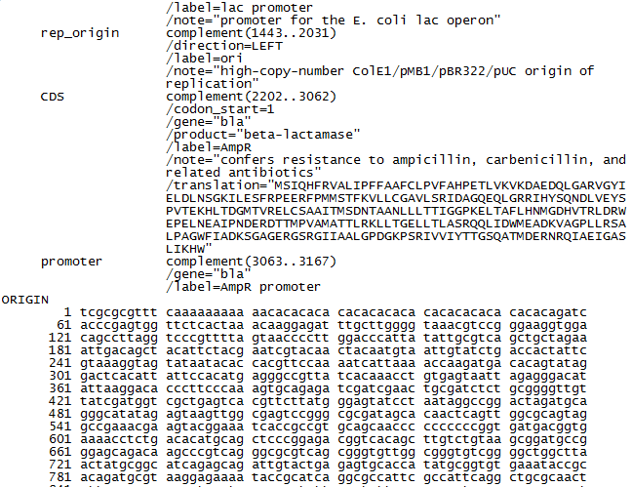
Signed Genbank file

Slide 23
Snapgene: Signed Genbank file

Slide 24
Snapgene: Isolated Signature

Slide 25
From digital to physical
Artificial DNA synthesis companies.
Gene universal – 0.09 /bp
Twist Bioscience – 0.07/bp
Send the entire signed sequence / just signature sequence.
Receive the physical DNA molecule.

Slide 26
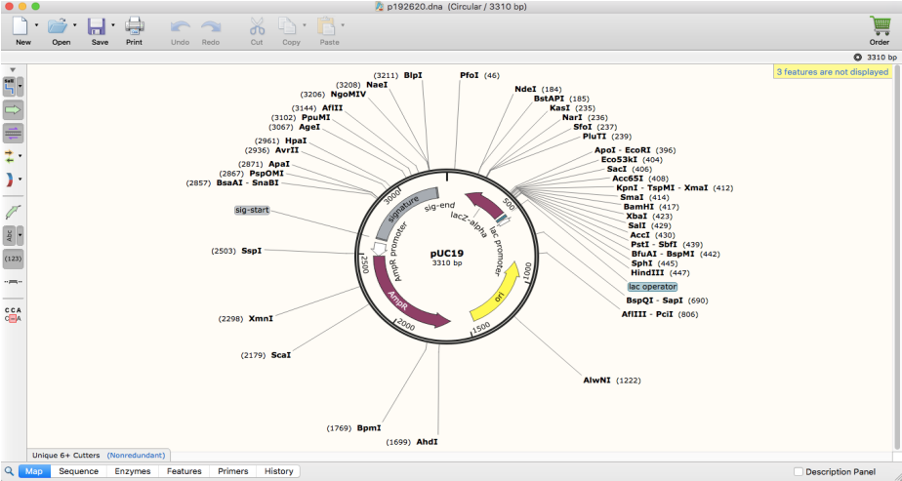
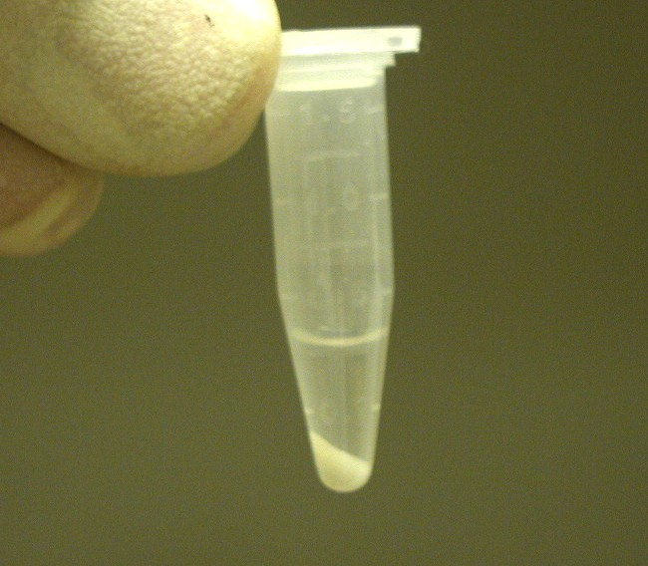
From digital to physical
Entire signed sequence
Ready to share

Slide 27
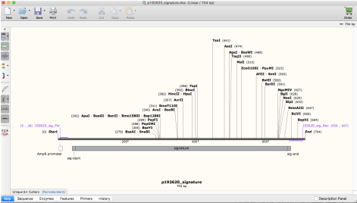
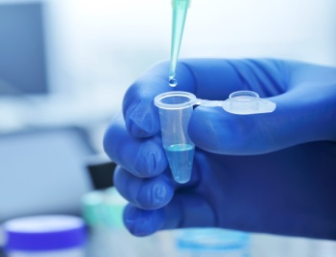
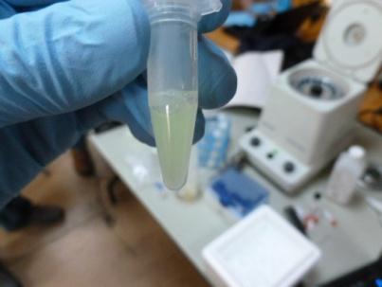
From digital to physical
Only the signature sequence.
Combine with original DNA.
+
=

Slide 28
From digital to physical
There are bacterial enzymes called restriction enzymes, which act like scissors. They recognize short nucleotide sequence and cut at specific points within these sequences.
The staggered cuts yield DNA fragments with single-stranded ends. Those are called "sticky ends", and the plasmid DNA sticks to those sticky ends using DNA Ligase, the "pasting" enzyme.

Slide 29
Signature Verification
Sequence the signed molecule.
Parse the signed genbank file.
Extract the entire sequence.
Use the features to locate the signature sequence.
Lengths of sign, ORCID, plasmid id are already known.
Retrieve original sequence.
Invoke verification algorithm.

Slide 30
That’s it? No. A bit more….

Slide 31
DNA Signature Problem
Digital signature ensures that any change in message or identity or the signature itself will result in failed verification.
Yes, that’s what we want !
But DNA molecules mutate(change) quite often.
Now, the signature cannot be verified.
It’s a natural phenomenon beyond anyone’s control.
Receiver cannot verify, and its not signers fault.

Slide 32
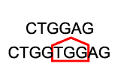
Mutations
Generally 3 types of mutations are possible.
1. Point mutation
2. Insertion
3. Deletion

Slide 33
Error Correction Codes !

Slide 34
Error Correction Codes
Error correction codes (ECC) are widely used in digital storage media like cd/dvd, disks, distributed storage.
We can apply the same techniques here.
We are using Reed Solomon Codes.
Introduced by Irving S. Reed and Gustave Solomon in 1960.
Class of linear block code. Based on Galois Field Arithmetic.
Used in storage devices, Wireless or mobile communications, Satellite communications etc.

Slide 35
Reed Solomon Code
A Reed-Solomon code is specified as RS(n,k,t) with s-bit symbols.
Given a symbol size s, the maximum codeword length (n) for a Reed-Solomon code is n = 2^{s} – 1
the maximum length of a code with 8-bit symbols (s=8) is 255 bytes.
n – block length (max length of code), k – data symbols, t parity symbols.
Can correct up to t/2 symbols.

Slide 36
Reed Solomon Code
Any text is a character array. Each element is a byte.
Lets take 8-bit symbols – bytes.
Block length = 2⁸ – 1 = 255 bytes. (255 bytes at a time).
Example – RS(255,223,32). Uses GF(257)
Data – 223 bytes or chars.
32 bytes or chars parity.
Can correct 16 errors anywhere.
Can be adjusted as RS(255,245,10)
245 data bytes. 10 parity bytes. Can correct 5 errors.

Slide 37
Problem with GF(257)
Lets assume user wants 5 bases to be corrected in the entire sequence.
The entire sequence is more than 255. Lets say it can be covered in 4 blocks.
What is the error tolerance for each block? Definitely not uniform (1.25 per block).
Worst case – 5 per block. Hence total parity bytes = 5*2 *4 = 40. If we could process entire sequence, 5*2 = 10.
Also, a plasmid has generally 2500 to 20,000 bases.
Too many parity bases. Issues with stability.

Slide 38
Extend to GF(65537)
We extended GF(257) to GF(65537).
Now each character is a short (16 bits) instead of byte.
Block length changes to 65537. (can process 65537 shorts at a time) which is sufficient.
Example – RS(65535, 65001, 534)
Advantage
No blocks, no multiple parity blocks.
Can embed this after signature.
Life’s good.

Slide 39
Updated Signature Generation
Users define how many bases to be corrected.
E.g. Correct up to 5 errors, So parity = 10. Each parity is a short not byte.
Create signature as before. Pass <original+sign> to ECC.
Generate 10 parity shorts – 160 bits = 80 base pairs.
Previously,
<start><ORCID + plasmid id + signature><end>
Total – 32 + 12 + 512 = 556 base pairs.
Now,
<start><ORCID + plasmid id + signature + ECC><end>
ECC/8 is the tolerable error.

Slide 40
Updated Validation
If validation succeeds normally, don’t use ECC.
Else create ECC string as <original + data + parity>
Invoke error correction.
If no corrections, alert failed (more error than tolerable)
If corrections are made, invoke verification on corrected sequences.
If passed, show user where and what the error.
Alert user if verification fails after correction as well.

Slide 41
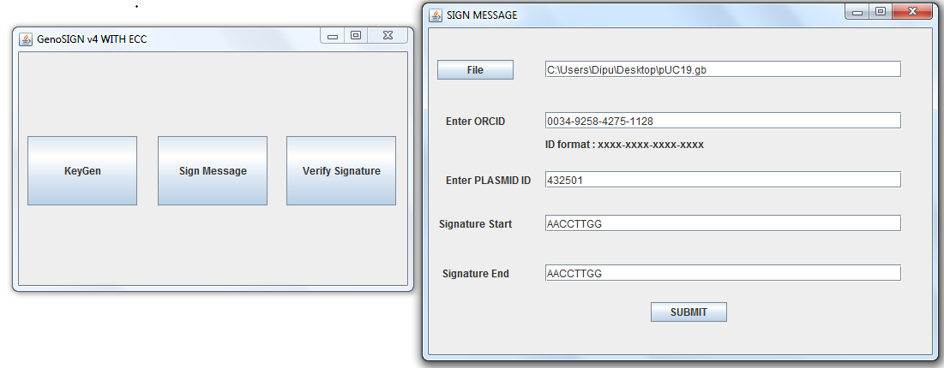
GenoSIGN App

Slide 42
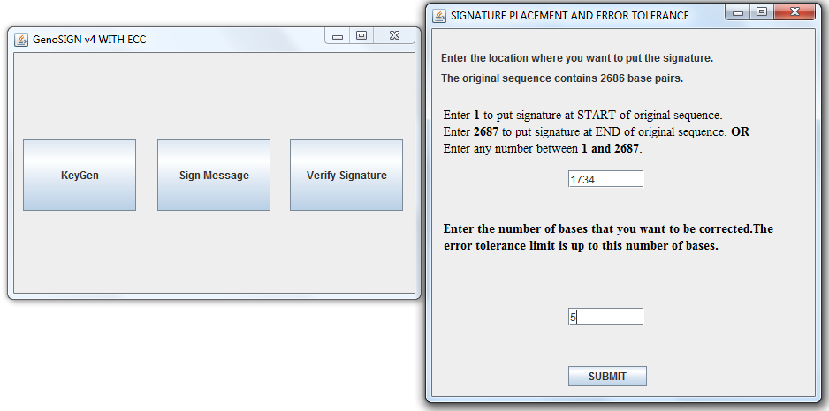
GenoSIGN App

Slide 43
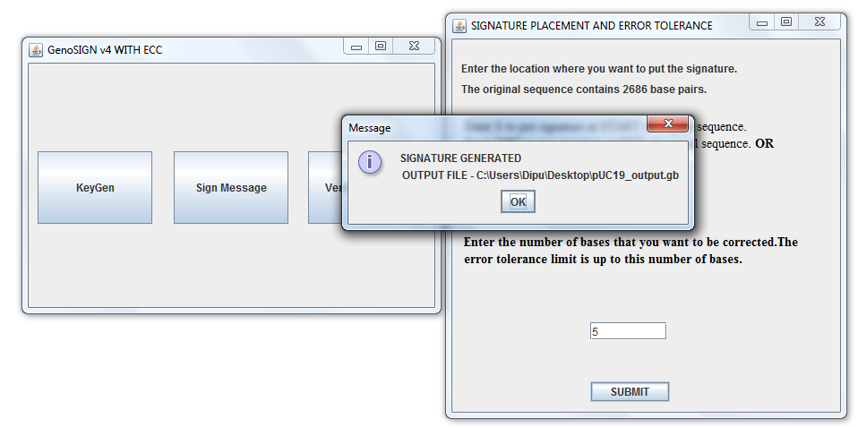
GenoSIGN App

Slide 44
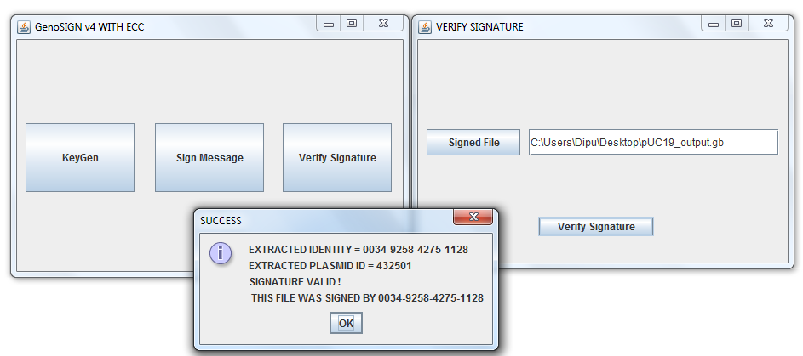
GenoSIGN App

Slide 45
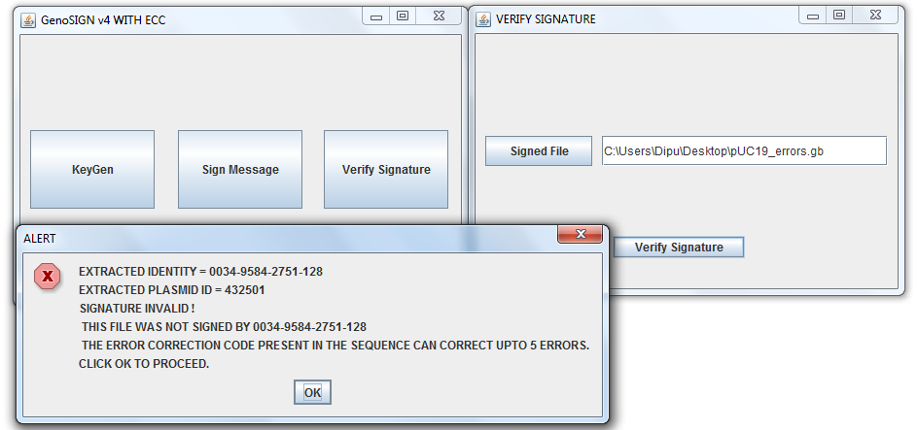
GenoSIGN App

Slide 46
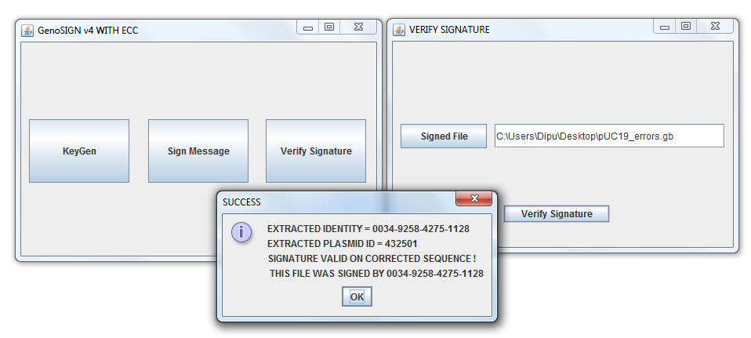
GenoSIGN App

Slide 47
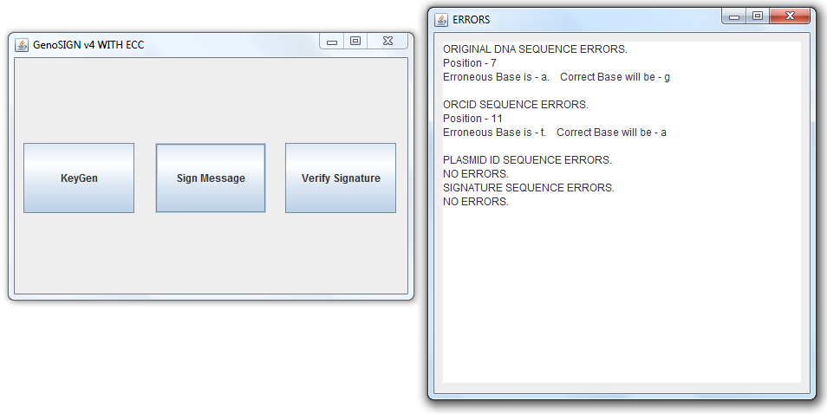
GenoSIGN App

Slide 48
Future Work
Need to address insertion and deletion mutation.
Apply blockchain technology to DNA sharing.
decentralized database of transactions (who shared which DNA and which version) that everyone on the network can see.
Other problems…. (provided by our collaborators)

Slide 49
Thank You ! Thoughts?
“Genetic code is a divine writing.”

