Slide 1
FRESH-PHISH A FRAMEWORK FOR AUTO-DETECTION OF PHISHING WEBSITES
HOSSEIN SHIRAZI, INDRAKSHI RAY
Colorado State University (CSU)

Slide 2
Phishing: Formal definition
"The attempt to obtain sensitive information such as usernames, passwords, and credit card details, often for malicious reasons, by masquerading as a trustworthy entity in an electronic communication" [1]
A problem that is as old as the Internet itself.
Often this type of attack arrives in the form of an email
Image: https://www.businessasap.com
[1] Wikipedia, “Phishing — Wikipedia, the free encyclopedia,” 2016. [Online; accessed 21-October-2016].

Slide 3
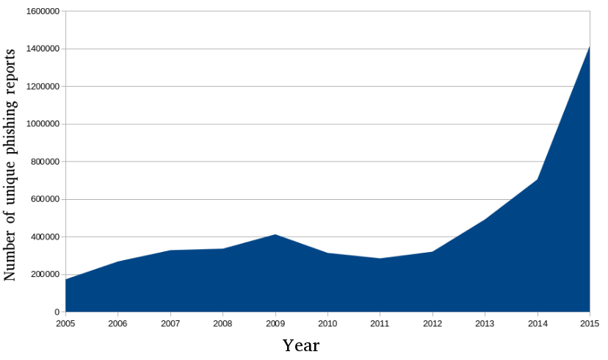
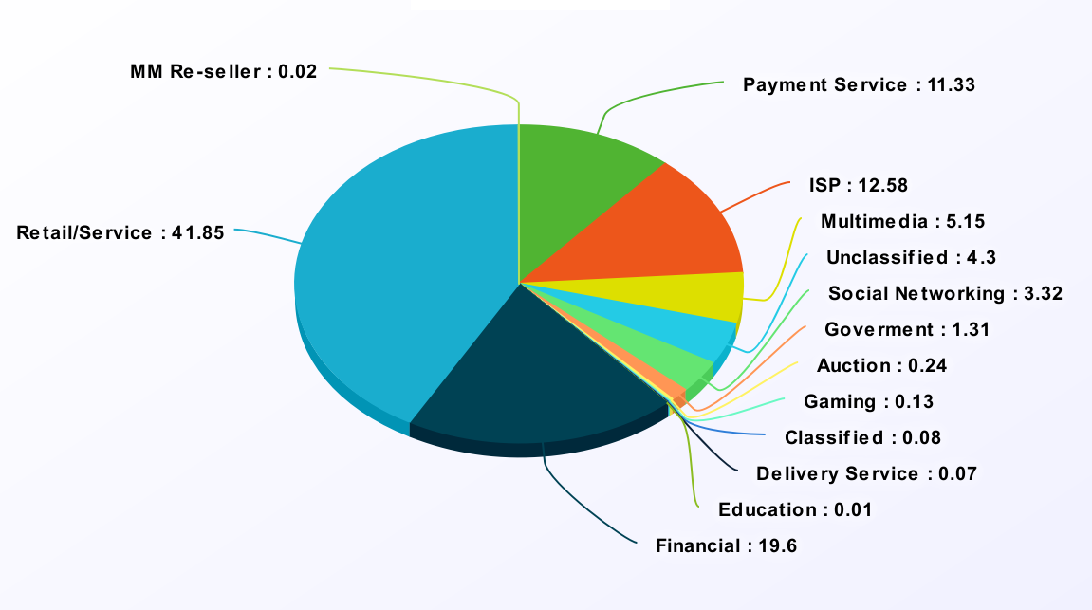
APWG- 4th quarter, 2016
APWG report

Slide 4
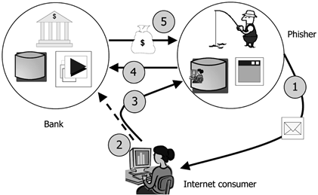
Catch
Hook
Lure
Image: http://resources.infosecinstitute.com

Slide 5
Problem Statement
Input: A web URL suspected to be a phishing website
Output: Yes or No result
Yes means that the URL is a phishing website
No means that it is a legitimate website
Goal : To design an efficient and adaptive phishing detection algorithm that has the ability to adapt to newer data or phishing attack vectors discovered in the wild

Slide 6
Technical Challenges
Rise in smart phone usage has made anti-phishing measures difficult to deploy
Users are worried about performance and usability of mobile phones when deploying such measures
Storing large black-lists is not a practical option for many smart phone users
Rapid rise in phishing websites make black listing impractical
Many black-listed websites are fly-by-night, but still need to be recorded
Phishing websites look like legitimate websites and hence, deeper analysis is required
Public key certificates may not necessarily detect the phishing website
Users usually ignore such warnings and many phishing websites do not use SSL

Slide 7
Desirable properties of solution
Should be communicationally and computationally efficient as the solution might be deployed on any computing platform
Should preserve the privacy of users
For instance, cloud based solutions require the user to reveal each URL visited
Live detection of phishing URLs is a critical requirement due to critical consequences involved
Should be incrementally updatable
Notes:
☺

Slide 8
LIMITATIONS OF STATE-OF-ART Solutions
Protecting from spam email: Still the users gets spam emails,
There are some new approaches (like using social-media) to lure the users, and
We need some approaches to focus on the website itself rather than focusing on the way that a user might get a link
List-Based: The list needs to be updated all the time,
before updating list, the users are at risk and,
How long that list can be?
Human Based: There is no guarantee that the users make a good decision even when they have warned before

Slide 9
Our Approach

Slide 10
Our Approach
Defining Features
Create Dataset
Using ML Classifiers
Measuring Accuracy
Measure Features
Observing websites
Intuition: Phishing websites need to be analyzed in depth based on some measurable features
We use machine learning algorithms because they have been proven to have the ability to discover complex correlation among different data items of similar nature
Our approach consists of two steps: Initial machine learning phase and a dynamic data based model update phase
Notes:
Analyse in depth
Measurable features

Slide 11
Our Approach…
Initial machine learning phase
We have identified features to characterize phishing and legitimate website based on available data
For instance in our initial experience, we used 6000 legitimate websites and 6000 phishing website to train and test our classifier
Dynamic data update: We use newer data instances,
To update our learning model adaptively
To enhance the model by discovering newer features

Slide 12
shortcomings of current Machine learning-based approaches
Solutions are not incrementally updatable
The dataset becomes out-of-dated rapidly and there is no updated dataset of phishing websites
Creating datasets and keeping them updated is a time-consuming process while without it, it is almost impossible to use machine learning algorithms
The feature set is very limited and do not include a wide range of features
Phishing website keep exhibiting newer attack patterns
Rapid advances in machine learning area have not been explored for this problem

Slide 13
Algorithm details
Initial labeled dataset:
Scanned the top 6000 sites in the Alexa database : Assumed as clean
6000 online phishing sites from phishtank.com: Assumed as Phishing
Implemented Features: We have categorized features as follows
URL Based (has at symbol, has double slash, …)
DNS Based (age of domain, …)
External Statistics (Indexed in Google, … )
HTML Based ( rate of external links, …)
Context-Based features: Using TF-IDF to find most important words in the webpage
Social-Networks features (persistence of webpages in the GooglePlus, …)

Slide 14
Classifiers
Implemented Classifiers
TensorFlow using the Tfcontrib Learn library
SVM with Scikit-Learn library
Experiments:
Train and test classifiers against the data collected by the Fresh-Phish framework
Randomly selected 80% of Fresh-Phish dataset for training and reserved 20% for testing.
Ran this experiment 10 times and used average as the final results.

Slide 15
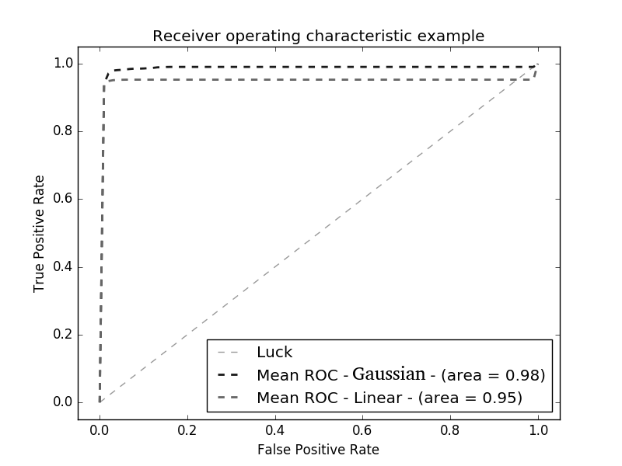
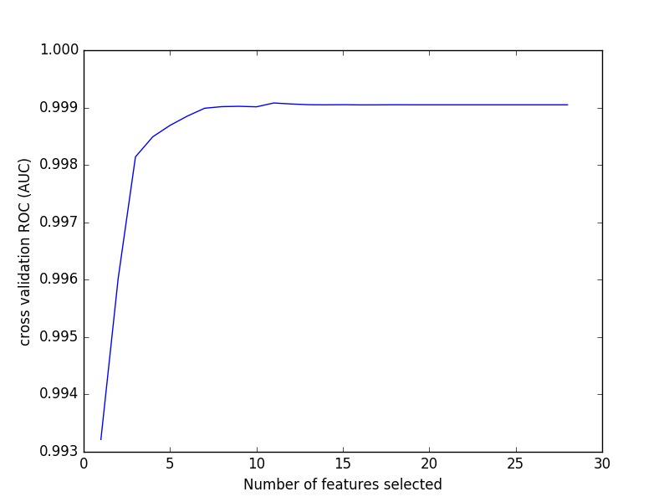
AUC and Selected Features

Slide 16
Future Work

Slide 17
INCREMENTAL UPDATES
The attack surface in the web space is constantly increasing and the proliferation of new social networking sites and e-commerce sites has made it easy for attackers
Effective solutions should be constantly tunable according to such changes in the web space
Challenge: Keeping track of newer attack vectors in such a dynamic and vast area is really challenging
Solution Direction: We are looking at distributed data gathering models as a means to collect and update existing data corpus. One possible implementation is to use crowd-sourcing to gather information on possible phishing websites.

Slide 18
USABLE SOLUTIONS –HCI Friendly Solutions
We are looking at solutions that can be deployed on mobile phones and therefore, usability is a critical aspect
Prepare web-services to generate results for other researchers or users
Challenges: existing techniques were designed for desktop environment and hence, computationally intensive
Possible Solution Approaches
Using newer machine learning models or developing a classifier model suitable for mobile phones. At present we are using machine learning approach. Rapid advances in machine learning are making this a promising area.
A hybrid model where certain parts of computation can be offloaded to cloud. Some components of the solution can be run on the cloud and reduce the computational overhead on the end users.
Notes:
A ) The push to use these techniques on different platforms is likely to result in solutions that can be easily ported to mobile devices without performance tradeoffs.

Slide 19
TRACKING ATTACKER STRATEGIES
Attackers are deploying newer approaches to design phishing websites and newer social networking sites are increasing the targets for the attackers.
The gap between a new technique being employed by the attackers and the time that the defenses are updated is vital and the users are at the high risk within this gap.
With incremental updating of available dataset periodically, we can keep track of changes in the dataset during the time. Comparing different datasets over time helps us to find out how the attackers change their techniques
Challenges: How to quantify an attacker strategy? How we can compare two dataset and determine the patterns in the strategies?
Proposed solution: Using Time-Series analysis coupled with probability density functions of various attack parameters seems a promising approach

Slide 20
DEVELOPING MORE ACCURATE MODELS OF PHISHING WEBSITES
The implemented features are a set of reasonable and basic features for the phishing website
Implementing more sophisticated features will improve the efficacy of the framework.
Challenges: Finding best and most cost effective subset of features
Proposed Solution: Using PCA and feature selection and elimination

Slide 21
Finding Attacked Target
Each phishing website might tries to attack one or more legitimate websites
We plan to add the ability to find attacked targets for each phishing website.
Also, we want to categories the target website like: financial, email and etc.
Challenges: it is difficult to create a labeled dataset with targeted websites because most of phishing repository just report webpages as a phishing and do not add the targeted website

Slide 22
EXPLOITING NEWER MACHING LEARNING ADVANCES
The SVM is one of the best ML classifiers in this field but we can add more classifiers and testify their accuracy and find the best one among different approach.
Adding Online classifiers to update trained classifiers with adding new instances
Challenges: Implementing different algorithms takes time and need being expert in different approaches
Proposed Approach: Retrofitting newer machine learning algorithms into existing feature sets for stronger detection accuracy

Slide 23
Q & A

