Slide 1
An Efficient Implementation of Next Generation Access Control for the Mobile Health Cloud
Rejina Basnet, Subhojeet Mukherjee, Vignesh M. Pagadala, Indrakshi Ray
The Third International Conference on Fog and Mobile Edge Computing

Slide 2
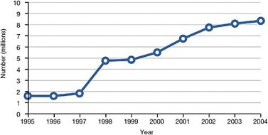
What is mHealth?
mHealth technology has begun to gain traction due to advances in information technology and mobile-computing.
An mHealth system is basically one which involves the use of mobile computing devices in discharging healthcare-related services.

Slide 3
mHealth System Architecture
Physician
- Sensor node
Body-area network
- Mobile node
Insurance company agent
Health Records System
Researcher
Patient

Slide 4
Problem Description
Physician
Access control enforcement point
- Sensor node
Body-area network
- Mobile node
Insurance company agent
Health Records System
Researcher
Patient

Slide 5
mHealth System Requirements
Effective policy representation and enforcement.
Fine-grained data access.
Fast access decisions.

Slide 6
Limitations of the Existing System
RBAC and XACML-based ABAC are used in conventional mHealth systems.
Limitations of RBAC:
A sizeable organization might have many roles, which makes role management difficult.
Is incapable of achieving finer levels of granularity.
Limitations of XACML:
Slow in making access decisions.

Slide 7
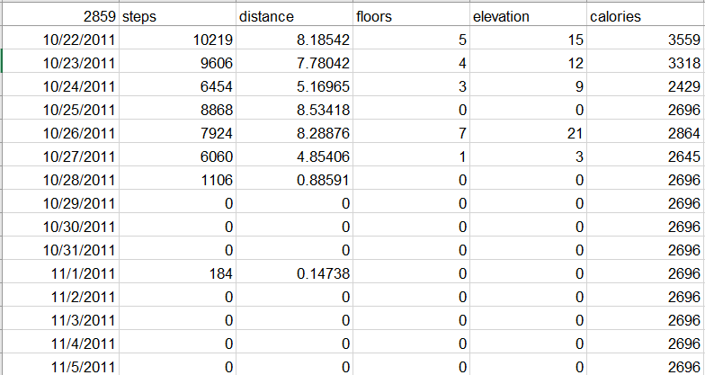
Data Model
We consider our data to consist of 4 features: Patient ID, Date-Time, Calories and Steps Taken, which are taken from a simulated FitBit dataset. [Furberg, R. D. (2015). Self-generated Fitbit dataset 10.22.2011-09.20.2014 [Data set]. Zenodo. http://doi.org/10.5281/zenodo.14996]

Slide 8
Threat Model
Sources of Threats:
Patient (the patient himself or herself)
Internal (someone already with authorized access)
External (someone without authorized access)
Vulnerable Assets:
Mobile Internet Device
Sensor Nodes
Preprocessing Unit
Health Record System
Possible risks
Data quality and integrity
Patient confidentiality
Availability of data

Slide 9
Proposed Approach
Our solution is based upon NIST Policy Machine (PM).
PM can effectively represent mHealth-based policies.
Fine-grained access control can be achieved.
Usage of existing or new graph theoretic approaches can speed up access decisions.
Neo4j graph database is used for implementation.
Persistent storage of data and access control policies, with relevant indexing.
Native storage and processing allows constant time object access.
Can easily integrate with most complex graph search and reachability algorithms.

Slide 10
Solution Architecture
Physician
NIST NGAC enforcement point
- Sensor node
NGAC
Body-area network
- Mobile node
Insurance company agent
Health Records System
Researcher
Patient

Slide 11
Proposed PM Template
Subjects can include, but are not restricted to
Physicians, patient, insurance companies and lawyers.
Subject attributes can include, but are not restricted to
Role: Physicians, patient, insurance companies and lawyers
The objects are individual fields of a patient’s data, as received from the Mobile Node.
Eg. Calorie recordings at a given time instance.
Object attributes can include, but are not restricted to
Owner: Patient ID
Type: Calories, Steps
Time: Time at which the data instance was collected.
The Administrator is responsible assigning actual access rights.

Slide 12
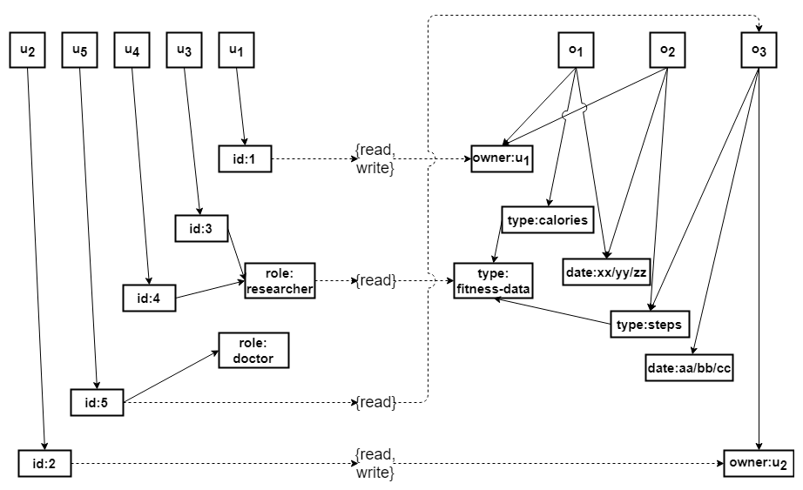
Example Policy
The doctor u5 is allowed read access to patient u2’s ‘steps’ on the date ‘aa/bb/cc’.
The researchers u3 and u4 are allowed read access to all fitness-data features of all patients.

Slide 13
Technical Challenges
Construction of the PM graph:
Adding nodes and edges
Objects and object attributes obtained from incoming traffic.
Users and user attributes are collected from an access portal.
Administrator is responsible for adding associations in the PM graph.
Index construction
User and object nodes are indexed with reachable operation nodes.
Operations nodes are indexed with reachable source nodes.

Slide 14
Technical Challenges
Types of access requests:
Query of type <u, op, o>: Can Dr Jekyll read the patient Mr Hyde’s data?
Query of the type <u, *, *>: What privileges does user u have?

Slide 15
Implementation Architecture
4. User ID
Body-area network
Researcher
3. User ID, Attributes
ownerid, calories = xx, steps = yy
2. Attributes
Registration portal
Policy machine graph database
2. Attributes
Physician
4. User ID
6. Request
(u, op, p)
(u, *, *)
Policies
5. Access Request
7. Requested Data (after policy evaluation)
Access portal
Request
Can I access X’s calorie data?
What access rights do I have?
Data
Administrator

Slide 16
Evaluation of <u1, op2, o1>
Step 1
Get indexes of u1
op1
ua3
oa3
ua1
op2
oa1
u1
ua4
oa4
o1
ua2
op3
oa2
ua5
oa5
op4
In this case, they are {op1, op2, op4}

Slide 17
Evaluation of <u1, op2, o1>
Step 2
Get indexes of o1
op1
ua3
oa3
ua1
op2
oa1
u1
ua4
oa4
o1
ua2
op3
oa2
ua5
oa5
op4
In this case, they are {op2, op3, op4}

Slide 18
Evaluation of <u1, op2, o1>
Step 3
Get intersection of both the indexes.
op1
ua3
oa3
ua1
op2
oa1
u1
ua4
oa4
o1
ua2
op3
oa2
ua5
oa5
op4
Intersection is {op2, op4}. Since op2 belongs to this set, access is granted to u1 to perform operation op2 on object o1.

Slide 19
Evaluation of <u1, *, *>
Step 1
Traverse through all op nodes. {op1, op2, op3, op4}
op1
ua3
oa3
ua1
op2
oa1
u1
ua4
oa4
o1
ua2
op3
oa2
ua5
oa5
op4
For each op node, perform binary search through reachable user nodes. If u1 is found, return the indexed object list. In this case, no object nodes so we return nothing.

Slide 20
Evaluation of <u1, *, *>
Step 2
Traverse through all op nodes. {op1, op2, op3, op4}
op1
ua3
oa3
ua1
op2
oa1
u1
ua4
oa4
o1
ua2
op3
oa2
ua5
oa5
op4
Return {op2, o1}

Slide 21
Evaluation of <u1, *, *>
Step 3
Traverse through all op nodes. {op1, op2, op3, op4}
op1
ua3
oa3
ua1
op2
oa1
u1
ua4
oa4
o1
ua2
op3
oa2
ua5
oa5
op4
Return {}

Slide 22
Evaluation of <u1, *, *>
Step 4
Traverse through all op nodes. {op1, op2, op3, op4}
op1
ua3
oa3
ua1
op2
oa1
u1
ua4
oa4
o1
ua2
op3
oa2
ua5
oa5
op4
Return {op4, o1}

Slide 23
Future Work
Delegate permission assignments to data owners and important stakeholders.
In PHR systems user’s have administrative control over their records.
In EHR systems hospitals/doctors can also have administrative control.
Use O-auth/OpenID Connect based authentication and authorization schemes to confirm initial access requests.
Integrate spatio-temporal access control
Catered to mHeatlh systems.

