Slide 1
Efficient Sybil Classification in Online Social Networks using Structural Features
Dieudo Mulamba
November 2017
Department of Computer Science

Slide 2
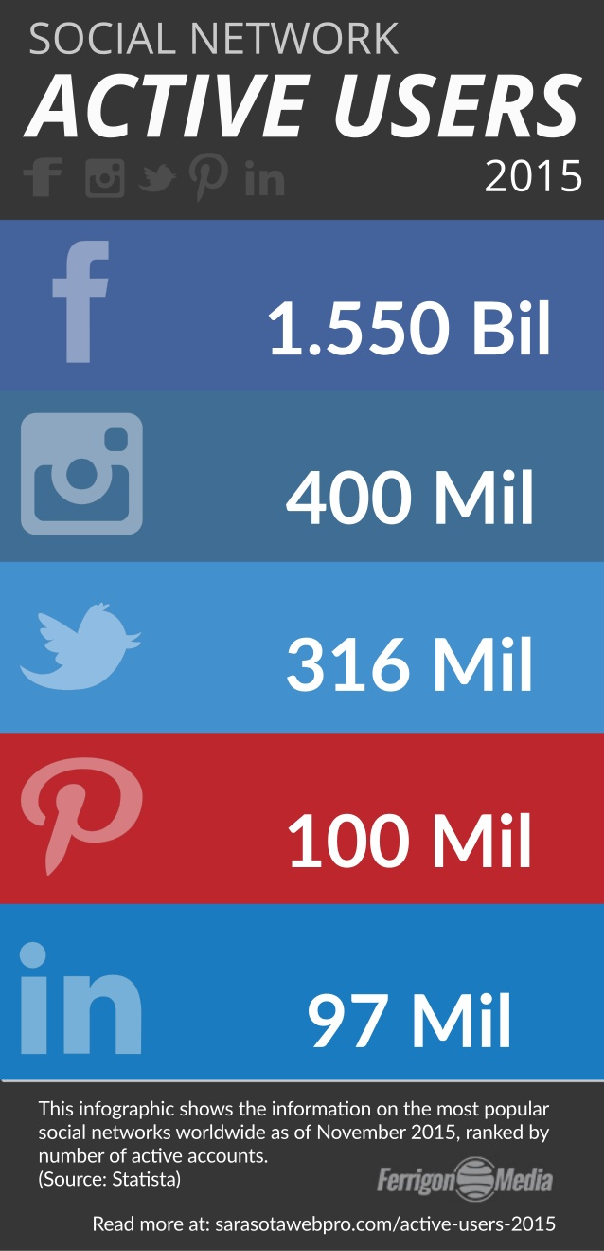
introduction
Online Social Network
Preferred way to connect peoples
Open platform: Anyone can join
Some users can be fake or malicious
- Sybils

Slide 3
introduction
Fake Accounts
Fake accounts are for sale on the underground market

Slide 4
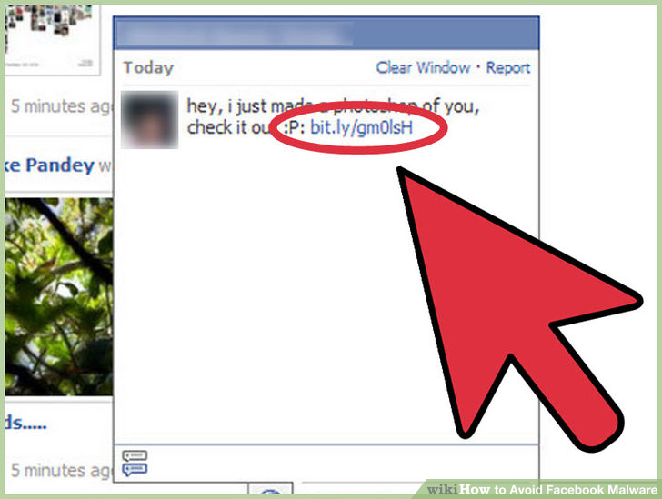
introduction
Fake Accounts
Why are fake accounts harmful ?
Fake accounts can
be used to :
Send spam
Do phishing
Access personal user info
Launch a propaganda campaign.

Slide 5
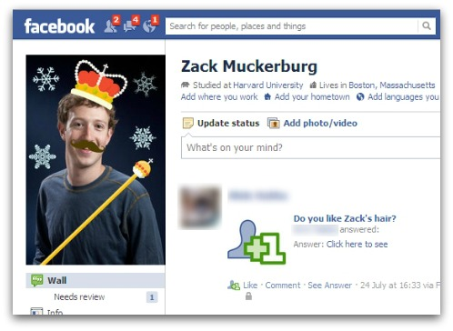
introduction
Detecting Fake Accounts
Detecting fake accounts is difficult:
These accounts may resemble real users
We want to be able to detect
these automatically

Slide 6
introduction
Existing approaches
There are several approaches
to detect sybils:
Origin of data :
User profile
User activities
Social graph structure

Slide 7
introduction
Existing approaches
There are several approaches
to detect sybils:
Content-based approaches
Behavior-based approaches
Graph-Structure based approaches

Slide 8
introduction
Existing approaches
Content-based approaches
Collect node’s attributes (genre, age, mobility,
power, …)
Use machine-learning to classify nodes
Behavior-based approaches
Collect node interaction data (flow, level of activity, …)
Use machine-learning to classify nodes

Slide 9
introduction
Existing approaches
Graph-Structure based approaches
Leverage the relationship between nodes

Slide 10
introduction
Existing approaches
Content-based approaches
Problems :
High false positive and negative rates
Not too difficult to evade (mimicking real nodes, deception)
Most famous: Facebook Immune System (only 20% detection rate) [Boshmaf et al.]

Slide 11
introduction
Existing approaches
Content-based approaches
The fix :
Add interaction data (Behavior-based approaches)
Add social graph data (Graph-Structure based approaches)

Slide 12
introduction
Existing approaches
Problems :
Users do not always provide all the info requested in the profile.
Collecting activities data raises the concern about user privacy)
Goal :
We propose a classification method using only social graph info.

Slide 13
Proposed approach
contributions
First classification method using only info from the structure of the social graph
New set of structural features :
Weighted Degree-core centrality;
Weighted Degree-c lustering centrality;
Degree-intensity centrality;
Degree-coherence centrality;
Core-intensity centrality;
Core-coherence centrality.

Slide 14
Proposed approach
overview
Convert the social network into a graph
Features engineering
Features selection
Build the classification models.
Evaluation

Slide 15
Proposed approach
Attack model
No assumption about attacker capabilities
Attacker can create unlimited number of sybils
Sybils are connected to each other
Attacker can befriend an unlimited number of benign nodes.
Attacker does not have control on the number of friend requests accepted.

Slide 16
Proposed approach
Features engineering
Existing features:
Average nearest neighbor degree.
Average degree.
Core number.
Clustering coefficient.

Slide 17
Proposed approach
Features engineering
Proposed features:
Weighted Degree-degree centrality.
Weighted Degree-Core centrality.
Weighted Degree-clustering centrality.
Weight :

Slide 18
Proposed approach
Features engineering
Proposed features:
A subgraph intensity:
A subgraph coherence:

Slide 19
Proposed approach
Features engineering
Proposed features:
Degree-intensity centrality.
Degree-coherence centrality.
Core-intensity centrality.
Core-coherence centrality.

Slide 20
Proposed approach
Features selection
Our feature selection model is the Recursive Feature Elimination (RFE):
Selected features:
core number,
degree-degree centrality,
core-degree centrality,
degree-coherence centrality,
core-coherence centrality,
average degree

Slide 21
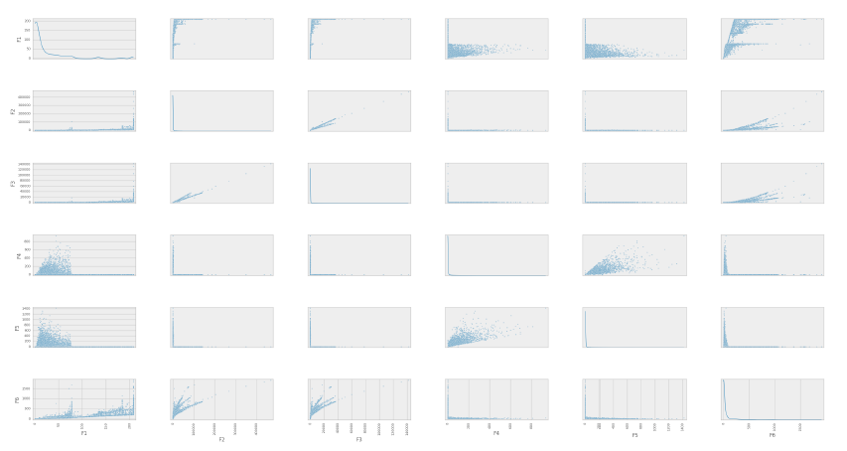
Proposed approach
Features selection
Feature correlation

Slide 22
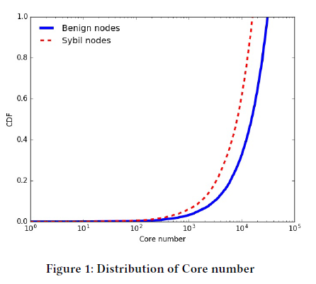
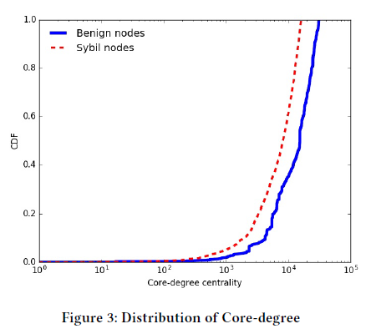
Proposed approach
Features selection
Features distribution

Slide 23
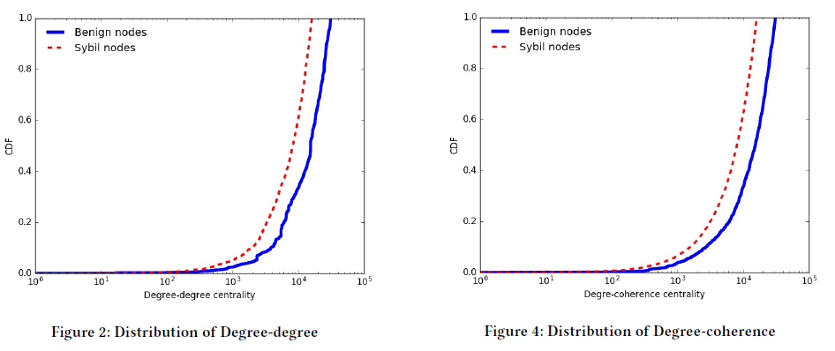
Proposed approach
Features selection
Features distribution

Slide 24
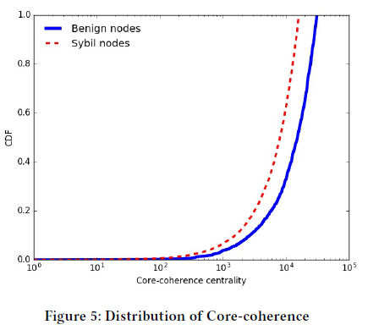
Proposed approach
Features selection
Features distribution

Slide 25
Proposed approach
Experimental results
Synthetic dataset
Honest region has 5,800 nodes and 453,682 edges
Sybil region has 2,200 nodes and 5,000 edges
The graph has 10,000 attack edges.

Slide 26
Proposed approach
Experimental results
Twitter dataset
Graph :
Nodes : 469,504
Edges : 2,153,426
Honest :
Nodes : 372,251
Sybils :
Nodes : 97,253

Slide 27
Proposed approach
Experimental results
Classification methods
SVM,
Random Forest,
and Adaboost.

Slide 28
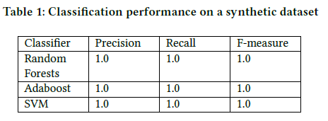
Proposed approach
Experimental results
Classification on synthetic dataset

Slide 29
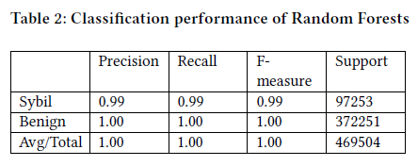
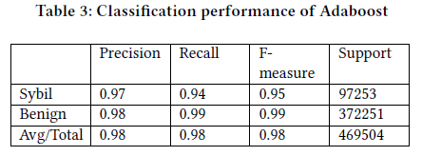
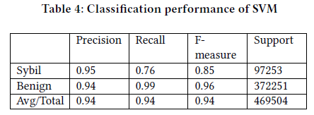
Proposed approach
Experimental results
Classification on Twitter dataset

Slide 30
THANKS

