Slide 1
Digital Signatures to Ensure the Authenticity and Integrity of Synthetic DNA Molecules
Diptendu Mohan Kar, Indrajit Ray, Jenna Gallegos and Jean Peccoud
Colorado State University

Slide 2
Outline
Introduction and motivation.
Existing methods vs. our approach.
Domain constraints.
Challenges and design decisions.
Signature Scheme.
Error tolerance.
Associating a physical DNA with its digital version.
Experiments and future work.

Slide 3
Introduction and motivation

Slide 4
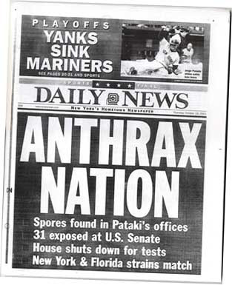
Introduction and motivation
The spore-laden letters killed 5 people, sickened 17 others.
Spawned an expensive, eight-year FBI probe that spanned six continents.
FBI concluded by 2007 that Bruce E. Ivins had created a blend of anthrax spores that was genetically identical to the material used in the 2001 attacks.
DNA Watermarking of Infectious Agents: Progress and Prospects – Jupiter et. al. 2010.

Slide 5
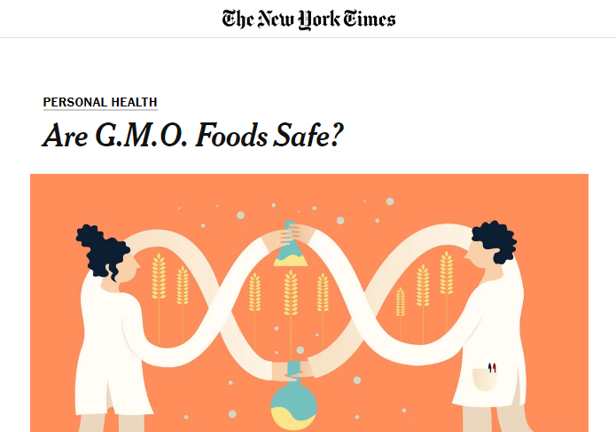
Introduction and motivation
90 percent of scientists believe G.M.O.s are safe.
Monsanto developed Bt corn.
Equipped with a gene from the soil bacteria – Pest Resistant.
Monsanto’s competitor adds some harmful gene to Bt corn.

Slide 6
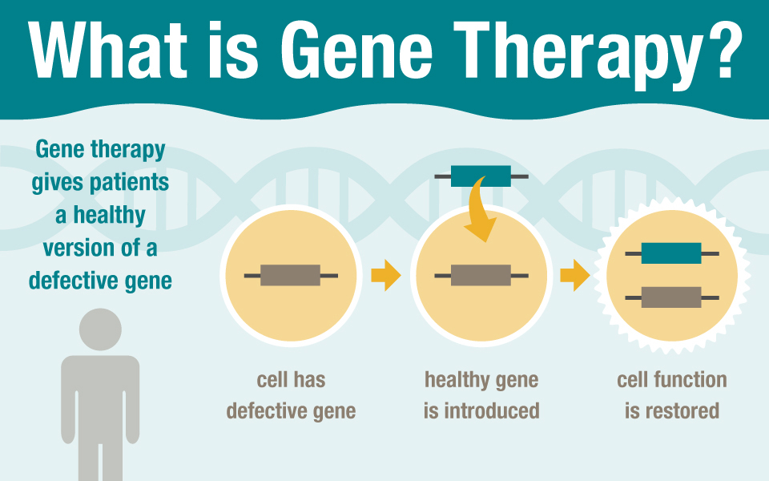
Introduction and motivation
In near future, this might become the state of the art.
“Healthy gene” undergoes a mutation / mixed up with unhealthy gene.
Validating the gene before inserting into human body.

Slide 7
Introduction and motivation
DNA synthesis is common and many synthetic DNA samples are licensed IP.
Molecular biologists study these samples and manipulate them – to observe the new properties added or removed, improvements such as antibiotic resistance.
Samples are shared between many researchers, academic labs or new samples ordered from gene synthesis companies.
Attribution of a physical DNA sample is difficult with the existing technologies.

Slide 8
Introduction and motivation
Sequence in a DNA sample is documented electronically as well.
Include origin information in the digital DNA file.
Problems
Very loose, sample may change hands many times more than the digital file.
Sharing full pathogen sequences is a bio-security risk.
Bio-tech companies don’t disclose some sequence information. Protect IP.
Problem cannot be solved digital DNA file.
Needs to be in the physical DNA sample.

Slide 9
Existing methods vs. Our approach

Slide 10
Existing methods
Present day solutions use watermarks to identify origin.
Jupiter et. al, DNA Watermarking of Infectious Agents.
Liss et.al, Embedding Permanent Watermarks in Synthetic Genes.
Limitations
Independent of the DNA sequence in which the watermark is applied. No integrity to the original DNA. Watermark can remain intact while other parts of the DNA can mutate.
The watermark sequence can be identified and used by an attacker placing it into other harmful virus DNA.

Slide 11
Existing methods
Present day solutions use watermarks to identify origin.
Heider et. al, DNA-based Watermarks using the DNA-Crypt Algorithm.
One of the most cited papers in this domain.
Limitations
The watermark is generated from a binary data e.g. image or name and added to the original sequence.
Compromising the binary data results in generating the same watermark.
Has option for symmetric key encryption of the watermark. But keys need to be exported. Has provision for export.
Has option for asymmetric key encryption. RSA only. But does not talk about the challenges.

Slide 12
Our approach
Digital Signatures instead of watermarks.
Widely used in any digital domain.
Identity based signatures.
Private Key Infrastructure (PKI) is not well known to biologists.
All of them have an unique identification - ORCID.
Open Researcher and Contributor ID – a 16 digit unique identification number.
More suited to our domain.

Slide 13
Domain constraints

Slide 14
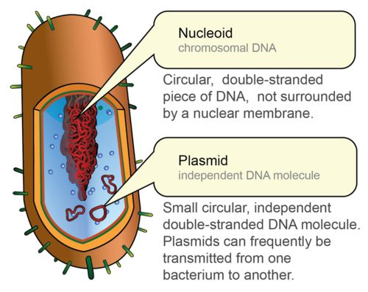
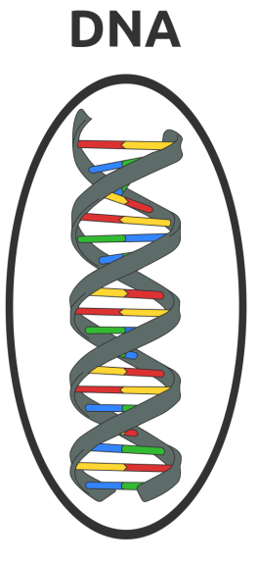
Domain constraints - working with plasmids.

Slide 15
Domain constraints – why plasmids.
Can isolate them in large quantities.
Can cut and splice them, adding whatever DNA we choose. (tweak with features)
Can put them back into bacteria, where they'll replicate along with the bacteria's own DNA.
Can isolate them again - getting billions of copies of whatever DNA we inserted into the plasmid!
Plasmid are limited to sizes of 2.5 - 20 kilo bases (kb), in general.
A base is one of the four building blocks of DNA – A, C, G, T.

Slide 16
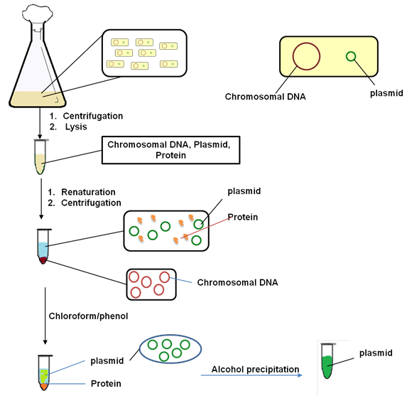
Domain constraints – plasmid extraction.

Slide 17
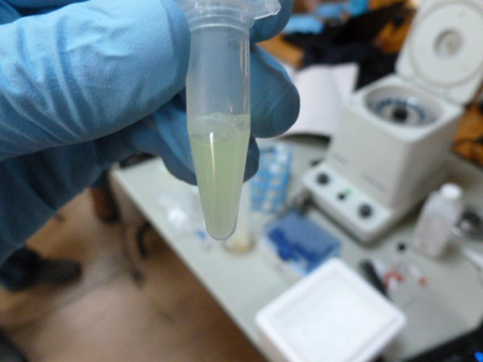
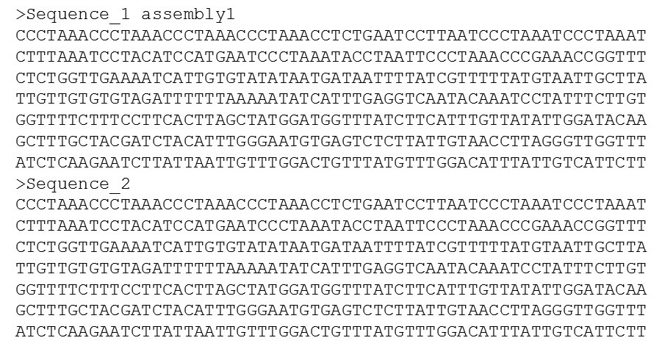
Domain constraints – sequencing a plasmid.
FASTA FILE – extension .fasta / .fa

Slide 18
Domain constraints – digital DNA file formats.
The output of a DNA Sequencer is always a .fasta file.
Contains the raw sequences only. The sequences can be converted to a annotated file called genbank (.gb) file which contains the sequences along with their descriptions.
Sequence manipulation software e.g. Snapgene can be used to do so.
Contains a database of descriptions. Will try to automatically annotate any matching sub-sequence. The user can add, delete or overwrite.
Provides a more visual map than just a sequence of ACGT.

Slide 19
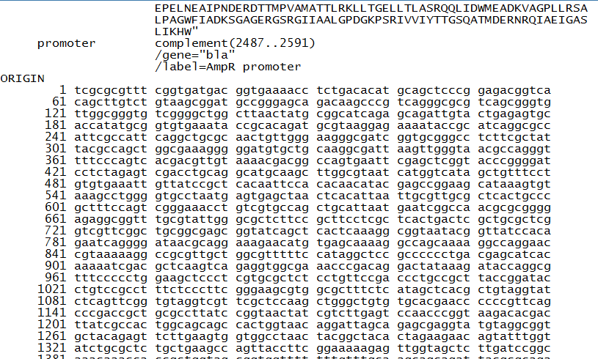
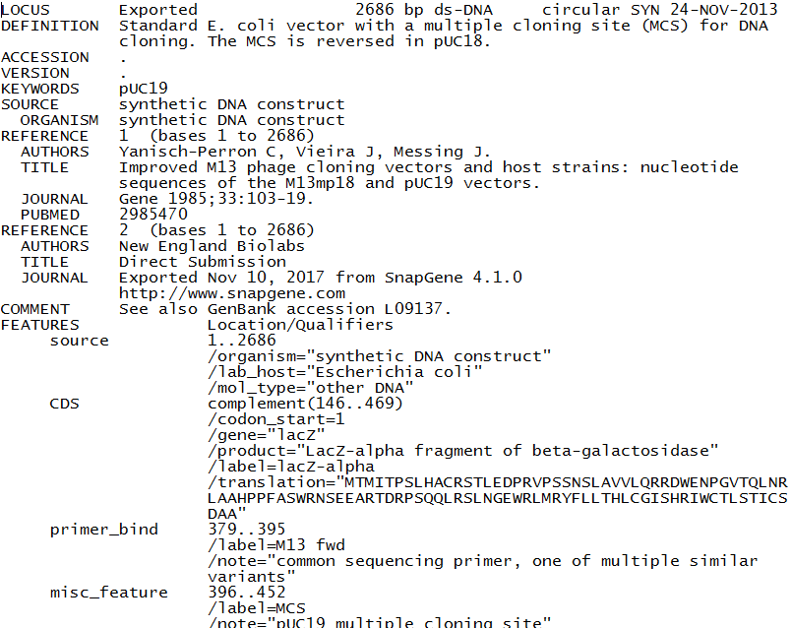
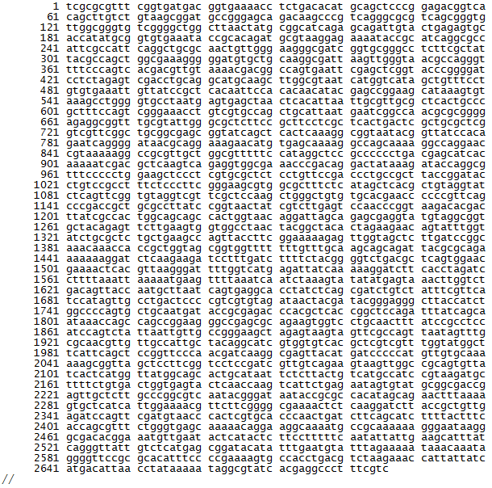
Domain constraints – sample genbank file.

Slide 20
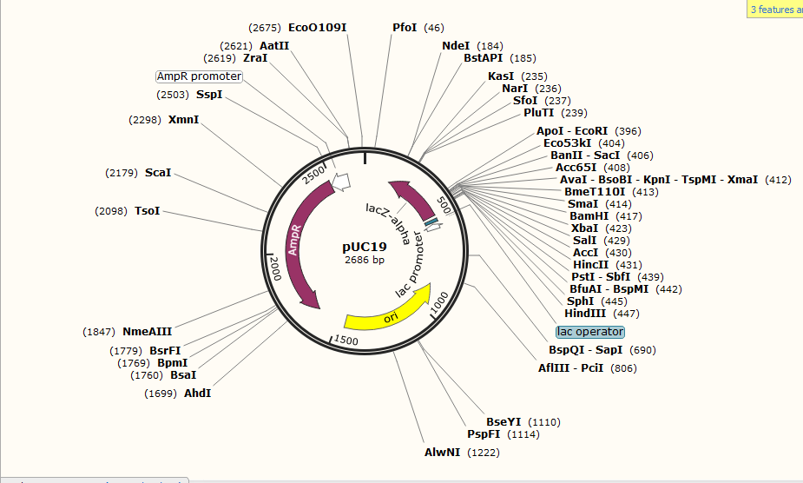
Domain constraints – sample map.

Slide 21
Domain constraints – plasmid DNA properties
A plasmid DNA is double stranded and circular.
Circular properties.
Sequence a sample. Output is ACGGTTCA.
Sequence the sample again. Output is TCAACGGT.
Double stranded properties.
Double helix. Sequencer reads in any one direction.
May read in the other direction next time.
Reverse Complement.
Hence, there can be 2N number of possible correct representation of a plasmid sequence.

Slide 22
Challenges and design decisions

Slide 23
Challenges and design decisions
Signature Identification.
Cannot use delimiters like we use in digital files. (tags, comma, colon etc.)
User can choose their own delimiter of 10 base pairs. Not already present. Specific to their project.
As of now we have chosen ACGCTTCGCA as start and GTATCCTATG as end delimiter.
Can be identified visually and rare to occur in plasmids naturally.
Unlikely to develop secondary structures.
Balanced number of ACGT.

Slide 24
Challenges and design decisions
Signature length.
One byte is 4 base pairs.
A signature of 384 bytes is trivial. But 1536 base pairs is not.
A shorter signature is less likely to introduce a new function or impact stability.
A shorter signature is less likely to mutate and will be cheaper to synthesize.
Signature placement.
Cannot place in any arbitrary location. There might be an existing feature there.
User inputs the location where to place the signature e.g. 104 from the start.
The genbank file already has the list of features that are present in the plasmid. Our tool uses this information to alert user in case of collision.

Slide 25
Challenges and design decisions
Error tolerance.
Signature ensures that change in a single base pair will result in failed verification.
But, DNA are prone to naturally occurring mutations.
Cannot just resend the sample like resending email.
Use error correction code – we used Reed-Solomon code.
The user provides how many error to tolerate. More the error tolerance, more the length of the code.

Slide 26
Signature scheme

Slide 27
Signature scheme - overview
We have used Shamir’s identity based signature scheme with a minor modification. Assume central authority parameters - <e, d, n>.
Our modified scheme
User provides ID to central authority.
Gets back S_{ID} = ID^{d} mod n.
Signature steps
Hash message m (SHA-256). Get H(m).
Sign = (ID^{d}) ^{H(m)} mod n = ID^{d * H(m)} mod n.
Validation Steps
Knows ID and M
Calculate ID^{H(m)} mod n.
(Sign)^{e} mod n = [ID^{d * H(m)}]^{e} mod n
= ID^{H(m)} mod n.
Original Shamir’s scheme
First two steps are same.
Signature steps
Choose random r ∈ Z*n.
Compute R = r^{e} mod n.
Compute c = H(R||m) mod n.
Compute t = (S_{ID} . r^{c}) mod n.
Output signature Sign = (R, t).
Validation Steps
t^{e} = H(ID) . R^{{H(R||m)}} mod n.

Slide 28
Signature scheme – security proof
Shamir’s IBS is secure if no polynomial-time adversary can forge the signature of a given message m.
Shamir’s scheme
Signature steps
Choose random r ∈ Z*_{n}.
Compute R = r^{e} mod n.
Compute c = H(R||m) mod n.
Compute t = (S_{ID} . r^{c}) mod n.
Output signature Sign = (R, t).
Find S_{ID} from the equation t = (S_{ID} . r^{c}) mod n.
Let r^{c} = w. So, S_{ID} = t. w ⁻¹.
In order to find any inverse modulo n, one has to know φ(n). This is equivalent to the RSA problem.
Our modified scheme
Signature steps
Hash message m (SHA-256). Get H(m).
Sign = (S_{ID}) ^{H(m)} mod n = ID^{d * H(m)} mod n.
Find S_{ID} from the equation Sign = (S_{ID}) ^{H(m)} mod n.
Let H(m)⁻¹ = y. So, S_{ID} = (Sign)^{y} mod n.
In order to find any inverse modulo n, one has to know φ(n). This is equivalent to the RSA problem.

Slide 29
Signature scheme – pros and cons
The signature output in Shamir’s IBS is a tuple modulo n . (R, t). Hence if n is chosen as 1024 bits, the signature length is 2048 bits or 1024 base pairs.
The signature output in our scheme is a single value modulo n. Hence if n is 1024 bits, the signature length is 1024 bits or 512 base pairs.
Due to the presence of R, the same message will generate a different signature every time.
In our case, the same message will generate the same signature every time.
The R can be useful to prevent replay of messages.
In our domain, replay of message implies sending the signed DNA sample to the receiver again. This is not same as packet crafting. The attacker has to synthesize the DNA. The receiver gets a duplicate sample.
Practical risk is minimal. Signature length is of more importance.

Slide 30
Error tolerance

Slide 31
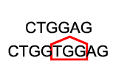
Error tolerance
Digital signature ensures that any change in message or identity or the signature itself will result in failed verification.
But DNA molecules can mutate(change).
Point Mutation Addition Mutation Deletion Mutation
Error correction codes will help the receiver to correct and rectify some errors that occur due to mutation.
As of now, we are concerned with point mutation.

Slide 32
Error tolerance – behaves as error detection
The error correction code present in the physical DNA sample acts more as error detection code.
Sender wanted to send the plasmid with sequence – ACAATGGTCA.
Receiver gets the sample but its mutated. When sequenced, the output is – ACAATGGTCG.
The error correction code will tell the receiver that the last base will be A rather than G.
But the physical sample still contains G in the last place. It is never corrected.
Receiver uses this information to check if the mutation has occurred in any important feature within the plasmid or in a place where it does not impact the functionality.
Based on this, the receiver can choose to re-order the sample hoping the new one will not mutate or proceed with the mutated sample.

Slide 33
Associating the physical DNA with its digital representation

Slide 34
Why association
Sender shares the signed physical DNA sample.
Receiver gets the physical DNA sample, sequences it to obtain a fasta file with the raw sequences.
Can be converted to genbank. But will not get the manually added descriptions.
Receiver needs the genbank file which the sender worked on.
Need to ensure that the genbank file and physical DNA is somehow tied together.

Slide 35
Create association
The genbank file has two parts – annotations and sequence, separated by the keyword ORIGIN.
Let us call the sequence part as M_{seq} and annotations as M_{desc}.
Generate signature from M_{seq} as before. Call this signature sequence as M_{sig}.
Calculate M_{comb} = H(H(M_{sig}) || H(M_{desc})), where || is concatenation.
Generate signature σ as – (S_{ID}) ^ M_{comb} mod n. Put this signature before keyword origin with a tag ASSOC.
Share the file with the recipient.

Slide 36
Verify association
Recipient gets the shared genbank file. Call it F_{gb}.
Recipient also generates a fasta file from the shared DNA sample. Call it F_{fasta}.
Signature validation is invoked on F_{fasta} first.
If signature validation succeeds, then association is checked.
Extract the descriptions from F_{gb}, up to the tag ASSOC. This is M_{desc} . Calculate H(M_{desc}).
The signature sequence M_{sig} is already known from validation step before. Calculate H(M_{sig}) and M_{comb}.
Retrieve σ from ASSOC. Check if σ^{e} = SID ^ (M_{comb}) mod n.

Slide 37
Experiments and future work

Slide 38
Experimental validation
Objective is to demonstrate:
Workflow: design > sign > sequence > verify
signature does not impact plasmid function
ECC functions as expected in vivo
Approach:
Simulate different signature applications
Generate the signed plasmids
Test the function of the plasmids
Sequence the plasmids and validate

Slide 39
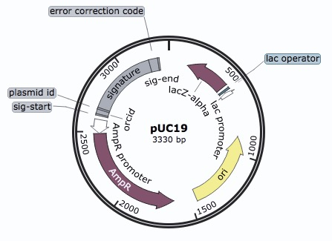
Experimental Validation
Phase I: Add signature to commonly used commercial plasmid pUC19
signature
GOI
Antibiotic resistance gene
Replication Origin
Phase 2: Design and assemble a plasmid for expressing a gene of interest (GOI) and include a signature

Slide 40
Experimental Validation
ECC
SIG
GOI
backbone
Phase III: Order a family of signed plasmids with mutations at different locations

Slide 41
Experimental validation
Workflow progress:
PhaseI: design > order sequences > assemble > check function > sequence > verify
PhaseII: design > order sequences > assemble > check function > sequence > verify
PhaseIII: design > order plasmids > check function > sequence > verify

Slide 42
Future work
Need to generate shorter signatures. This will be both cost effective and will have less impact on the functionality of the plasmid.
We did not address addition and deletion mutation.
We assumed that the start and end tag which contains the signature will not mutate. Otherwise, the signature could not be located.
Association between the digital file and physical sample needs to be more concrete.
Addressing the cyclic permutation and reverse complement such that the receivers fasta file does not have to be aligned with the sender genbank file before validation.

Slide 43
Thank you ! Questions and feedback !

