Slide 1
Attribute Based Encryption
Diptendu Kar
Bruhadeshwar Bezawada
Colorado State University

Slide 2
Background
Elliptic Curve Cryptography

Slide 3
Existing Public Key Systems
RSA is based upon the ‘belief’ that factoring is ‘difficult’.
Other PKS like Diffie-Hellman, El-Gamal relies on Discrete Logarithm Problem (DLP). i.e.
Given: g ∈ ℤ_{p ,} h = gª mod p ; find a.
Sophisticated attacks lowers the computation to find “a”.
Square root method
Baby – Step Giant – Step ^{[1][2][3]}
Pollard’s rho method ^{[4][5]}
Index calculus method ^{[6][7][8]}

Slide 4
Existing Public Key Systems
To counter these attacks –
Make “p” quite large ∼ 2048 – 4096 bit numbers.
Effect – Increased computation time.
Can we find other groups where we can achieve the same security with much less computation time?

Slide 5
Elliptic Curve Cryptosystem
Origin – Diophantine Equations [Diophantus – Alexandria, Egypt around 200 A.D]
Rational points on the curve: y² = x³ - x + 9
Elliptic Curve (EC) systems as applied to cryptography were first proposed in 1985 independently by Neal Koblitz and Victor Miller.
Only Square root method is applicable to these group (Index Calculus method – not yet found to work)

Slide 6
Elliptic Curve Cryptosystem
Applications - Any application where security is needed but lacks the power, storage and computational power that is necessary for our current cryptosystems
Wireless communication devices
Smart cards
Web servers that need to handle many encryption sessions

Slide 7
Elliptic Curve Cryptosystem
An elliptic curve is a plane curve defined by an equation of the form
where a,b ∈ ℤ_{p} , and 4a³ + 27b² ≠ 0 (mod p)
Examples -

Slide 8
EC as cyclic group
ℤ₁₁ = {1,2,3,4,5,6,7,8,9,10}
Generator (g) = 2
Any element in ℤ₁₁ can be represented as
g^{x} mod p
Finding other elements
(g * g) mod 11 = 4
(g * g * g) mod 11 = 8 …
E : y2 = x3 + 2x + 2 mod 17
Generator (P) = (5,1)
Other points on the curve.
How to find other points on the curve?

Slide 9
Group Operations on EC
Main operations - point addition and point multiplication
Adding two points that lie on an Elliptic Curve – results in a third point on the curve
Point multiplication is repeated addition
If P is a known point on the curve (aka Base point/generator) and it is multiplied by a scalar k, Q = k.P is the operation of adding P + P + P + P… +P (k times)
Q is the resulting public key and k is the private key in the public-private key pair

Slide 10
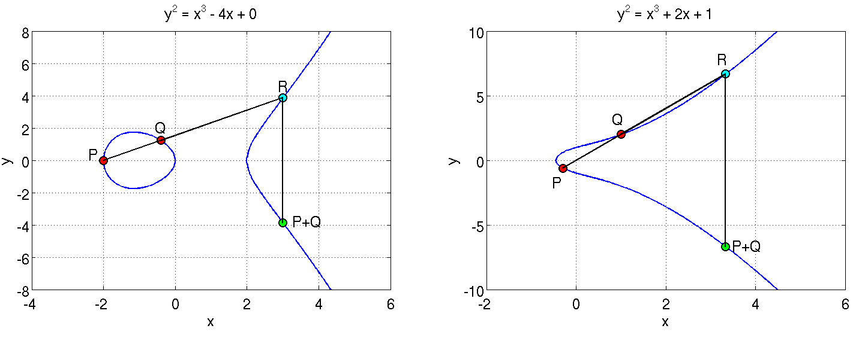
Point addition
Adding two points on the curve
P and Q are added to obtain P+Q which is a reflection of R along the X axis

Slide 11
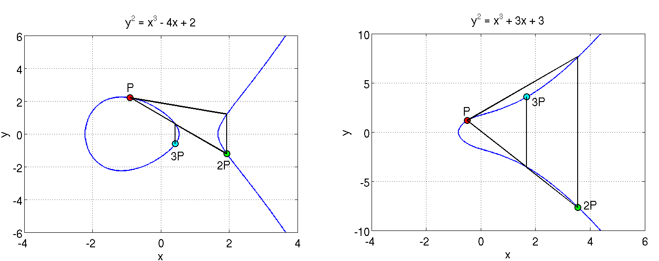
Point doubling
A tangent at P is extended to cut the curve at a point; its reflection is 2P
Adding P and 2P gives 3P
Similarly, such operations can be performed as many times as desired to obtain Q = kP

Slide 12
EC DLP
Discrete Log Problem
The security of ECC is due the intractability or difficulty of solving the inverse operation of finding k given Q and P
This is termed as the discrete log problem
Methods to solve include brute force and Pollard’s Rho attack both of which are computationally expensive or unfeasible for a large p (not as large as in Zp)
The version applicable in ECC is called the Elliptic Curve Discrete Log Problem
Exponential running time

Slide 13
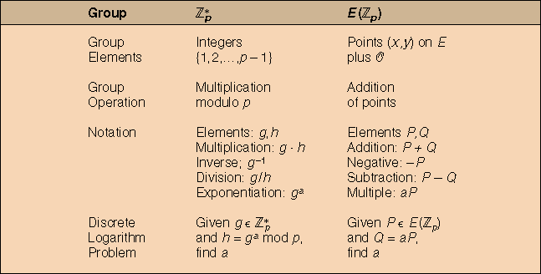
ℤp and E(ℤp)

Slide 14
Bilinear Pairing
Let G1 and G2 be cyclic groups of the same order.
Definition - A bilinear map from G₁ × G₁ to G₂ is a function
e : G1 × G1 → G₂ such that for all u, v ∈ G1 ; a, b ∈ Z,
e(uª, v^{b}) = e(u^{b}, vª) = e(au, bv) = e(u, v)^{ab}
Non – Degenerate
There exist u, v ∈ G1 such that e(u,v) ≠ 1 _{G2}
Computable
Computing e(u,v) for any u, v ∈ G1 is efficient

Slide 15
Bilinear Pairing
We can also use G1 × G2 → G_{t} as a bilinear map.
Let e : G1 × G2 → G_{t} be a bilinear map.
Let g1 and g2 be generators of G1 and G2, respectively.
Definition - The map e is an admissible bilinear map if e(g1, g2) generates G₂ and e is efficiently computable.
Typically G is an elliptic curve (or subgroup thereof)
The elliptic curve defined by y² = x³ + 1 over the finite field Fp (simple example)
G_{t} is normally a finite field

Slide 16
Bilinear Pairing
(Modified) Weil pairing and Tate pairing are more or less only known examples
Very complicated math
No need to understand it to use them
Weil and Tate pairings computed using Miller’s algorithm
Computationally inexpensive
Tate pairing normally somewhat faster than Weil
Making these faster still is current research

Slide 17
Why ABE?

Slide 18
Need for ABE
Problems with PKI
Sender must have recipient’s certificate
Complexity of certificate management and CRLs
Enter Identity-Based Encryption
A public-key encryption system in which an arbitrary string can be used as the public key e.g. Any personal information: e-mail address, postal address, etc.
Sender only needs to know recipient’s identity attribute to send an encrypted message
Proposed by Shamir in 1984. First IDE system discovered in 2001 by Boneh and Franklin, based on Weil pairing.

Slide 19
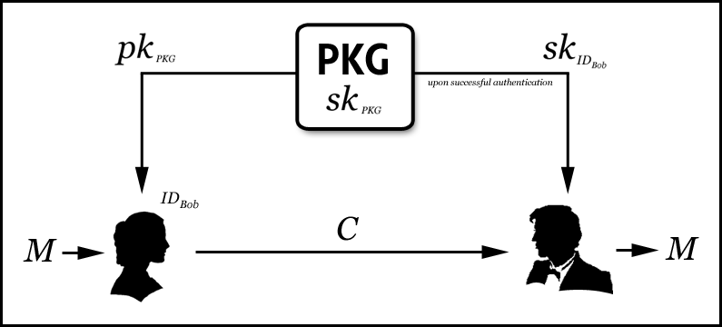
IBE

Slide 20
Attribute Based Encryption
Attribute-based encryption (ABE): New means for encrypted access control.
Ciphertexts not necessarily encrypted to one particular user.
Users’ private keys and ciphertexts associated with a set of attributes or a policy over attributes.
A “match” between user’s private key and the ciphertext, decryption is possible.

Slide 21
Attribute Based Encryption
Type of identity-based encryption
One public key
Master private key used to make more restricted private keys
Two types – KP-ABE and CP-ABE
KP-ABE
Ciphertext is encrypted with attributes. Policies are enclosed in secret keys.
CP-ABE
Ciphertext is encrypted under a policy. Secret keys are tied to attributes.

Slide 22
CP-ABE

Slide 23
Policy Features
Monotone Access Structure
Internal nodes:
AND gates
OR gates
Also k of n threshold gates
OR
2 of 3
AND
IT dept.
OR
sales
manager
exec. level >= 5
marketing
hire date < 2002

Slide 24
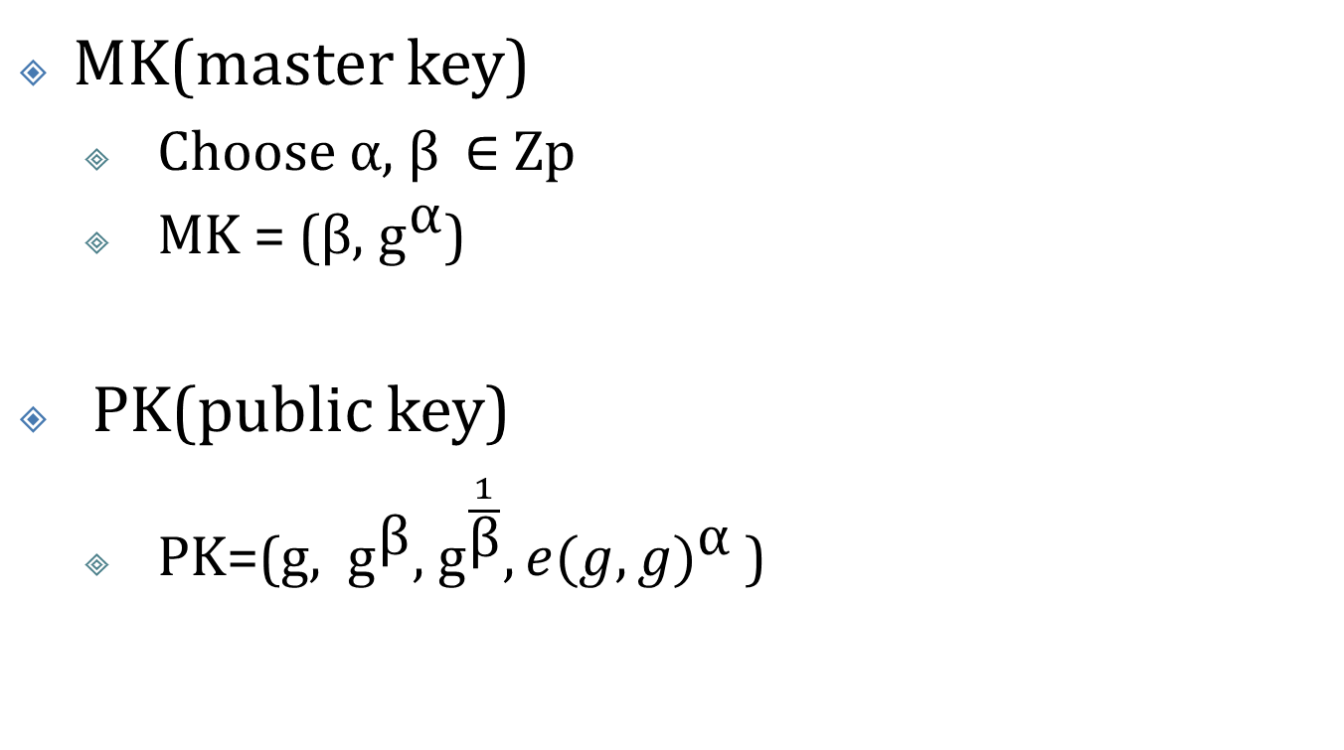
Setup

Slide 25
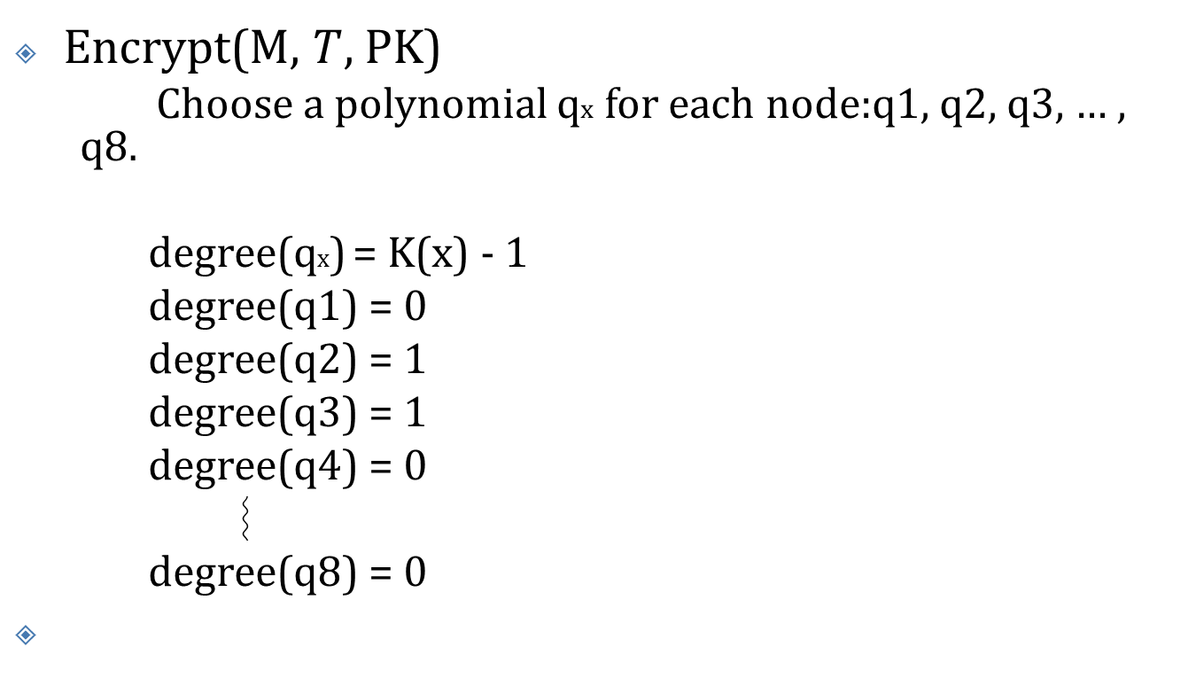
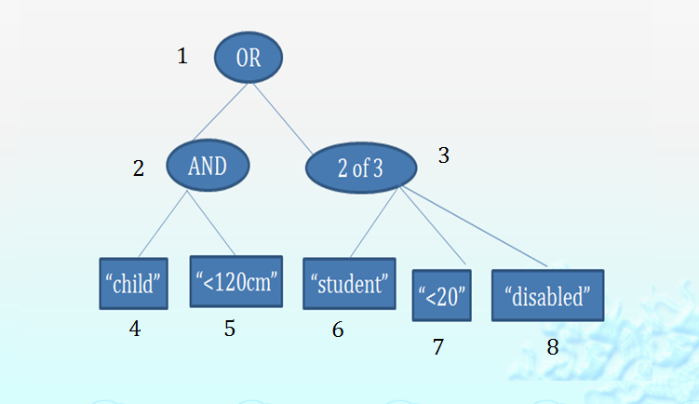
Encryption

Slide 26
Encryption
q1(0)=s
q2(0)=q1(2)
q3(0)=q1(3)
q4(0)=q2(4)
q5(0)=q2(5)
q6(0)=q3(6)
q8(0)=q3(8)
q7(0)=q3(7)

Slide 27
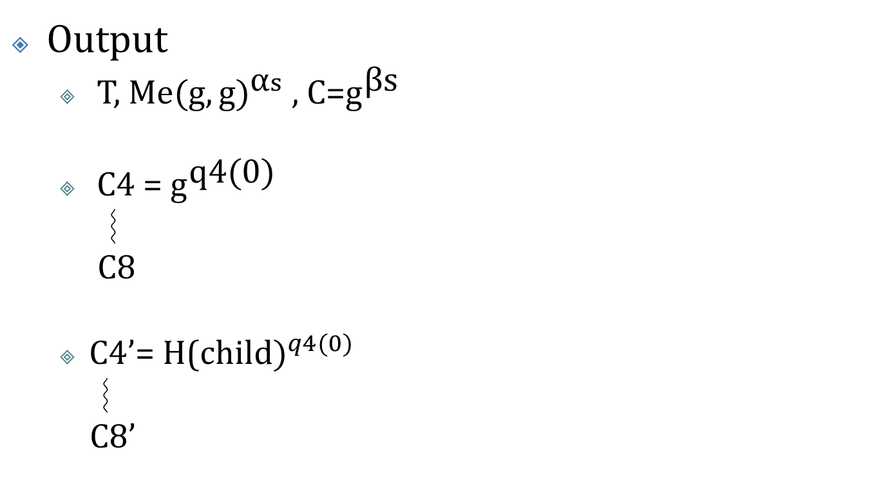
Encryption

Slide 28
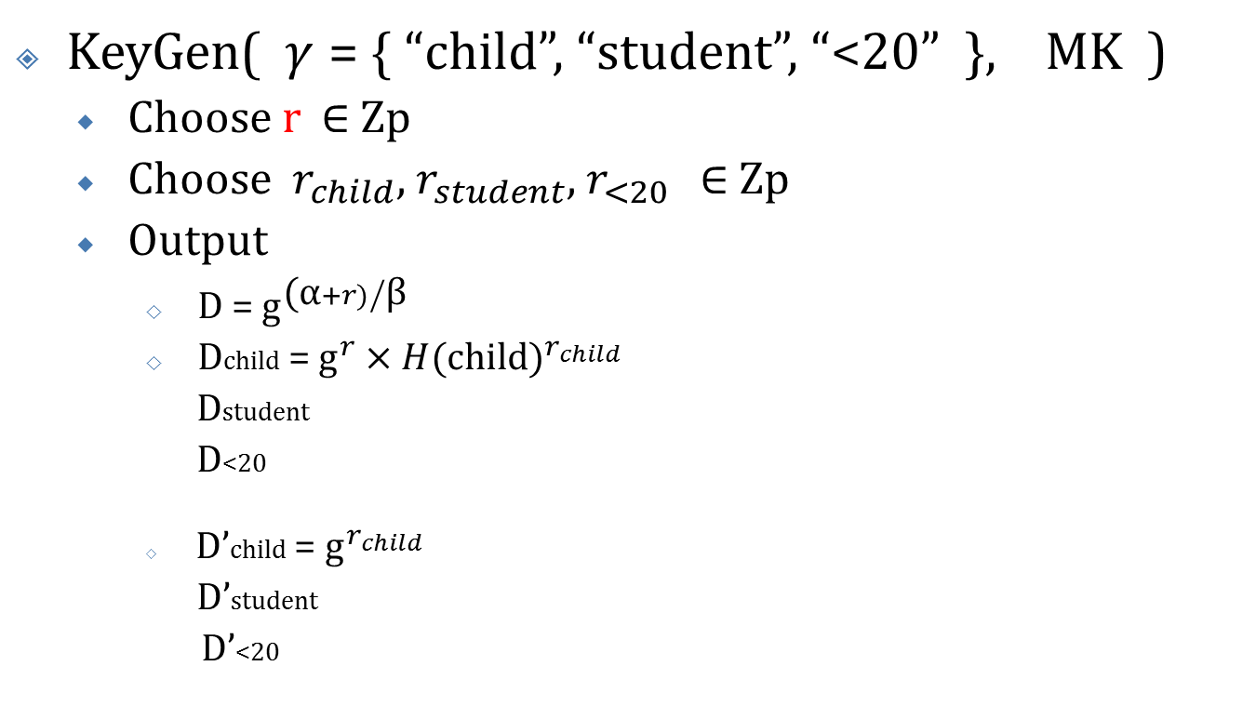
Key Generation

Slide 29
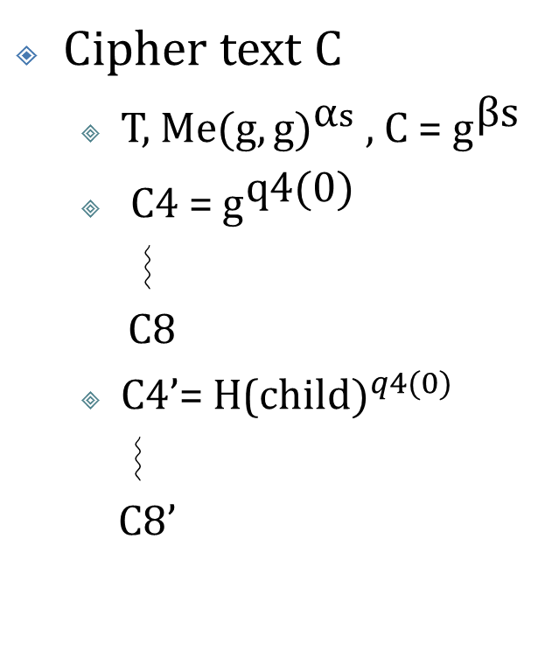
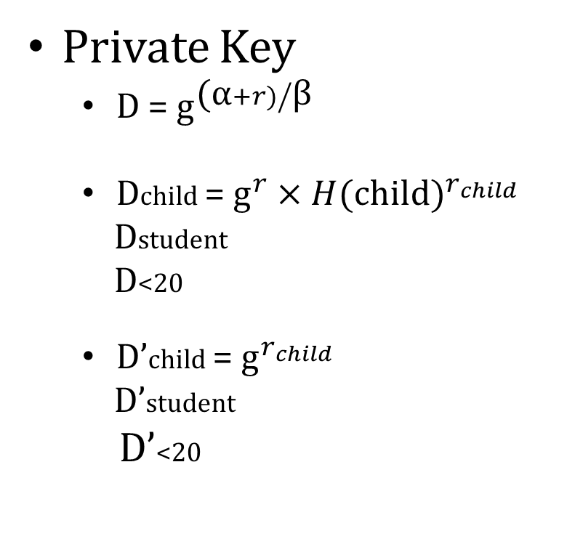
Decryption

Slide 30
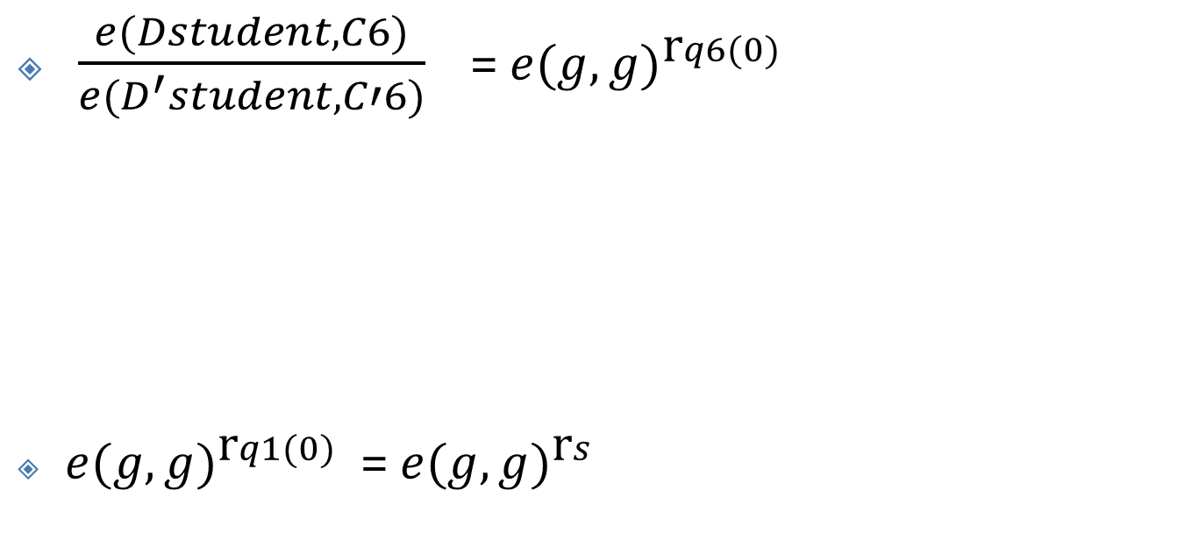
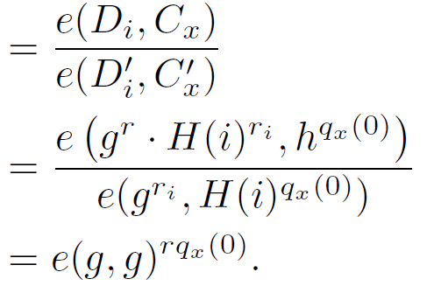
Decryption
30

Slide 31
Reference
[1] D. Shanks. Class number, a theory of factorization and genera. In Proc. Symp. Pure Math. 20, pages 415—440. AMS, Providence, R.I., 1971.
[2] A. Stein and E. Teske, Optimized baby step-giant step methods, Journal of the Ramanujan Mathematical Society 20 (2005), no. 1, 1–32.
[3] D. C. Terr, A modification of Shanks’ baby-step giant-step algorithm, Mathematics of Computation 69 (2000), 767–773.
[4] Pollard, J. M. (1978). "Monte Carlo methods for index computation (mod p)". Mathematics of Computation. 32 (143): 918–924.
[5] Menezes, Alfred J.; van Oorschot, Paul C.; Vanstone, Scott A. (2001). Chapter 3. Handbook of Applied Cryptography.
[6] M.E. Hellman and J.M. Reyneri, Fast computation of discrete logarithms in GF (q),Advances in Cryptology--Proceedings of Crypto, 1983
[7] L. Adleman, A subexponential algorithm for the discrete logarithm problem with applications to cryptography, In 20th Annual Symposium on Foundations of Computer Science, 1979
[8] A. Menezes, P. van Oorschot, S. Vanstone (1997). Handbook of Applied Cryptography. pp. 107–109.

Slide 32
Thank You !
Thoughts ..

