Slide 1
Securing Home IoT Environments with Attribute-Based Access Control
Bruhadeshwar Bezawada Kyle Haefner Indrakshi Ray
3rd ACM Workshop on ABAC (CODASPYW)

Slide 2
Introduction
The home Internet-of-Things ecosystem is growing rapidly
Technology reports estimate about 500 devices per household by 2020
Home IoT environments have three key features
Dynamic: devices added and/or removed over time
Collaborative: devices interact and interfere
Heterogeneous: multiple device-types, protocols and functionality
Security is a critical requirement

Slide 3
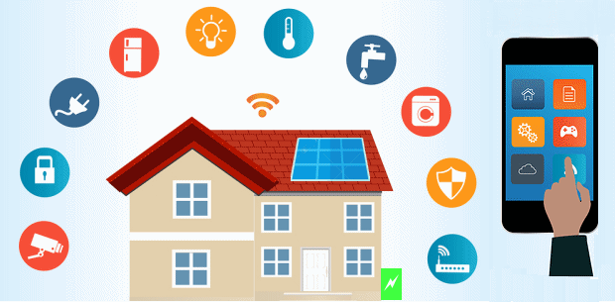
Home IoT Eco-system: Bird’s Eye-view
Smart Bulb
Smart Thermostat
Mobile App Based Control
Smart Lock
SecurityCam
Security Monitoring System
Part of image from: https://www.energymatters.com.au/energy-efficiency/smart-home-automation/

Slide 4
Home IoT Eco-system: Bird’s Eye-view
Security-cam: provides video surveillance and connects to the home owner via Internet/LAN
Smart-lock: provides locking capability and can be turned on/off remotely by home owner
Smart-thermostat: adjusts the temperature setting automatically and can be configured via Internet
Video-bell: provides video of anyone ringing the bell and sends such data to home owner over Internet
Mobile apps: usually pair with devices and control them

Slide 5
Device Interactions
The security monitoring system could query motion sensors/security-cam for status updates
A mobile phone app can turn on Microwave at a predetermined time
The smart fridge can query temperature sensors for adjusting the cooling level
A video-bell provides periodic updates to the home owner

Slide 6
Security Scenarios
Unauthorized external data requests: results in privacy violation of household
Malware: Can be found in untrusted devices leading to data leakage or network disruption
Cross-user interference: trying to control a device at the same time
Misconfigurations: Misconfigured devices causing undesired disruptions
Device additions: Newer devices might affect stability of network operations

Slide 7
Proposed Approach: Attribute-Based Access Control for Home IoT Networks
Attributes associated with entities are used to make policy decisions; changing attributes changes policies
Our Approach: ABAC; most suitable for a diverse and dynamic environment like Home IoT Network
Other models like RBAC, CapBAC, and TBAC have inherent shortcomings
Modeling Home IoT in ABAC is a challenge

Slide 8
Related Work
Role-Based Access Control Models
Inflexible and difficult to adapt to home IoT dynamics
E.g. Parent wanting allow child to access Internet only when parent is at home
Capability-Based Access Control Models
Individual devices are responsible for policy decisions
For home IoT resource constraints make this difficult
Flow-containment Models
Enforcing network level control by observing anomalous flows
Cannot express flows in natural language or be flexible in applying attribute-based flows

Slide 9
ABAC Model: Basics
ABAC Entities
Subject : Entity initiating access request
Object : resource on which the access request is made
Action : The action requested on the resource
Environment : The context of the access request
Policy format:
<Subject (attributes), Object (attributes), Environment(attributes), Action>
NIST NGAC is a reference implementation of ABAC
NGAC treats attributes and entities as containers and defines associations across them

Slide 10
Proposed Approach
We plan to leverage the NIST NGAC model to secure Home IoT environment
NGAC features like containers, inheritance, and obligations are valuable to realize usable security
Our goal is to specify high level user policies and enforce them using network level information
Our approach consists of the following:
Entities and Attributes Description
Home IoT domain pertinent Policy Specification
ABAC-IoT Implementation Architecture

Slide 11
ABAC Model for IoT: Entities and Attributes (sample shown)
Subjects
Human User: <Role, Age, Login name>
Process: <Type of process, Type of initiating device>
Device : <Device identifier, Device priority>
Objects
Device: <Device type, Device Identifier>
Information: <Content-type, Data Size>
Any resource needing protection
Environment
<GPS, Logical-names, Time>
Operations
<send-data, send-control, read-data, read-control>

Slide 12
Home IoT Policy Specification
We specify the policy categories suited for Home IoT characteristics
Dynamic : Device-type Agnostic Policies; to handle addition of new devices
Usability: Quality-of-Experience Policies; to avoid cross-device interference
Network stability: Network Behavior Policies; to ensure network stability
Untrusted devices: Co-located Device Policies; to protect against co-located malicious devices

Slide 13
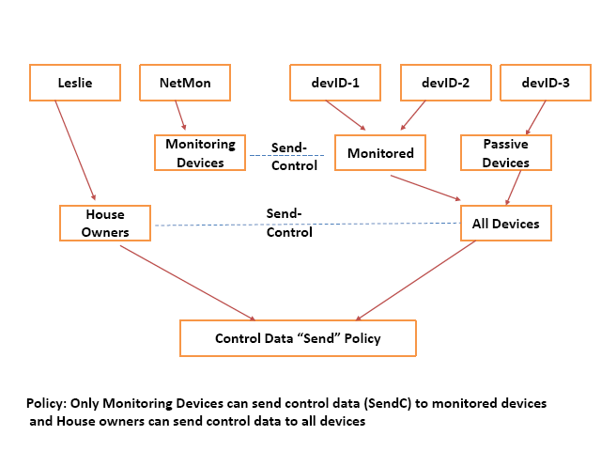
Illustration: Device-Type Agnostic Policy
High-level policy description: “A device cannot send control data to another device unless it is an authorized monitoring device”

Slide 14
Examples of Policies
Quality-of-Experience
“only one app should be connected and in control of one device for the duration of the connection establishment”
Network Behavior
“a non-control device cannot initiate connections to all devices in the network”
Controlling Malicious devices
“non-control device cannot communicate with another device on network”

Slide 15
ABAC-IoT Implementation Architecture
We integrate NIST NGAC with the network switching architecture
Our implementation includes an attribute management module that integrates with the PIP of NIST NGAC
The architecture consists of a fingerprinting module that will extract attributes of unknown devices
Policy enforcement is done at the packet (per packet) or flow level (group of packets)

Slide 16
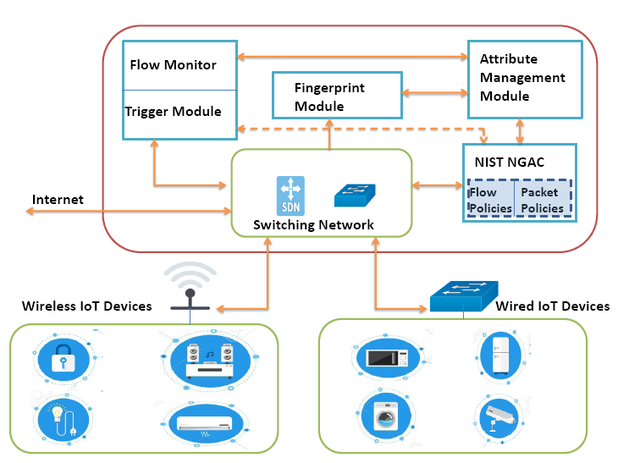
Policy Enforcement Architecture

Slide 17
ABAC-IoT Implementation Architecture
Switching module: Has access to all network traffic from the IoT devices
Fingerprint module: ascertains a device attributes through machine learning algorithms
Flow monitor module: is used to assign attributes to network flows and triggers policies on flows
Attribute management framework: manages attributes of entities and integrates with NIST NGAC to provide up to date attributes

Slide 18
Future Work
Task 1: Generic Policy Specification and Generation
Approach 1: Laboratory experiment
Approach 2: Using CVE database analysis
Task 2 : Attribute Management Framework
User Attributes
Device Attributes
Network Traffic Attributes
Task 3 : Policy Enforcement Architecture
Policy decision point

Slide 19
Summary
We described the first approach for using ABAC in Home IoT environments
We enumerated several possible attributes and identified the different types of policies
We described an enforcement architecture for the ABAC policies
Our future work involves developing the architecture and designing policies

